Slide 1





Стручно-научна конференција ТОПС 2023 Хотел Палисад, Златибор 28.05.2023.
Пословно удружење „Топлане Србије“
Društvo termičara Srbije
Distributed Energy System for JKP Gradska toplana Nis/Trigeneration
Vladislav Pavićević, Miroslav Vujnović, Dragiša Nikolić

Slide 2
Background 1
50% of the final energy consumption in EU is used for the heating of buildings, hot water, and heating in industrial processes. Also, cooling is getting a major factor in energy consumption creating challenges for the electricity grid. The heating and cooling sectors are key to achieving CO2 emission reduction.
Technically there are more efficient ways to generate heat compared with boilers.
Future energy systems will include more interactions among different forms of energy and sectors, and in particular, sectors of heating and cooling and electricity.
Electricity today is increasingly generated from renewable sources. Renewables (RES) for heating and cooling such as solar thermal energy, have largely been out of focus. Basically, there is not yet a comprehensive approach to support RES district heating and cooling.

Slide 3
Background 2
The less is efficient and carbon intensive the power system, there are more opportunities for cogeneration and trigeneration production and there are more opportunities for benefits relative to electric alternatives.
In this article described are configuration, technical and financial performances of the Trigeneration plant (TP) that is proposed by USAID and E3i to be applied in Boiler House Clinic Center (BH CC) and Sport Center Čair. Project is done by SESS doo with DHC of Nis. Trigeneration plant is designed to produce electric energy and heat by a gas engine for generation of power and heat for generation of hot water preparation, and heating and cooling by a vapor compression heat pump (HP) and Absorption Heat Pump (AHP).

Slide 4
Project advantages and limitations
Advantages:
Possibility to produce chieper electric energy
Generate additional revenue
Backup power for UCC and DHC
Reduced polution
Limitations:
Unstable price of natural gas
Limitations from regulation
Lack of expertise in use

Slide 5
Design principles of a trigeneration plant
Developing of the profile of the various heat and cool demands at the appropriate pressures for the applications being studied;
A profile for electricity consumption must be developed in the same way as in the case for heat demand profile. These profiles typically include heat and power demands for “typical” weeks or months for season or month of the year;
Fuel availability and present-day cost as well as projected future costs. The study should also factor process by-product fuels into the development of the energy supply system;
Purchased power availability and its present and expected future cost;
Plant discharge stream data in the same degree of detail as the process heat1 demand data;
Number and rating of major (demand and generation) equipment items. This evaluation usually establishes whether spare capacity and/or supplementary firing should be installed;
Plant, process, and trigeneration system economic lives.

Slide 6
Electric energy consumption
Consumption:
Characteristics:
Pretty large index between maximum and minimum monthly electric energy consumption,
Power that is needed for “covering” electric energy consumption by DHN`s BHKC relatively small.
Izvor: IEA

Slide 7
Heat load (HEH+SHW)
Installed equipment
Heat generation
3.5 MW_{t} boiler that generate HEH and SHW. The boiler operates round the year,
10 MW_{t} boiler for HEH that basically operate only in heating season (October 15 – April 15),
Two steam boilers for production of SS
4. 16 MW_{t} for HEH that is at the moment
conserved and out of use.

Slide 8
Heat load for heating
Estimate of heat energy for heating
Regression equation has form Q = 1,720,076.20 + 3,963.92 * HDD giving estimate of heat energy consumed for HEH.
Coefficient of regression (alternatively coefficient of determination) has high rate of 0.9438, showing strong dependency of heat load (heat consumption) of HDD.
Izvor: IEA

Slide 9
Natural gas consumption
Natural gas consumption
Characteristics:
Diagram shows that consumption of natural gas declines from January 2022 to May 2022
As outside temperature is rising heat load for SHW is going dominant in total heat load of the BHKC. In summer months – basically June, July and August preparation and delivery of SHW and SS are only heat loads of the BHKC.
It is interesting to say that the in BHKC one measurement device measures HEH and SHW consumption/delivery, so in BHKC HEH and SHW are measured as “heating of water”.

Slide 10
Plant layout

Slide 11
Plant layout
RGE performances
HP performances
Item | RGE
Power generation | 1,141 kW
Heat Energy generation | 1,307 kW
Electric efficiency | 0.376
Thermal efficiency | 0.43
Overall efficiency | 0.806
Natural gas consumption | 3,040 kW
RGE losses | 591.5 kW
 | Evaporation Pressure (b) | 5.1
 | Evaporation Temperature (◦C) | 5
 | Condensing Pressure (b) | 37
 | Condensing Temperature (◦C) | 75
 | Heating Capacity (kW) | 1,000
 | Mass Flow (kg/s) | 0.666
 | Evaporation Heat (kW) | 765.9
 | Power Ideal (kW) | 233.1
 | COP Ideal (/) | 4,285
 | Power Real (kW) | 274.23
 | COP Real (/) | 3,643
^{[1]}

Slide 12
HP increase of condensation temperature
Condensation temperatures of 75 and 85 °C
Result
Increasing condensation temperature from 75 to 85°C doesnt increases use of HP, but results with decreasing of COP from 3.643 to 3.264

Slide 13
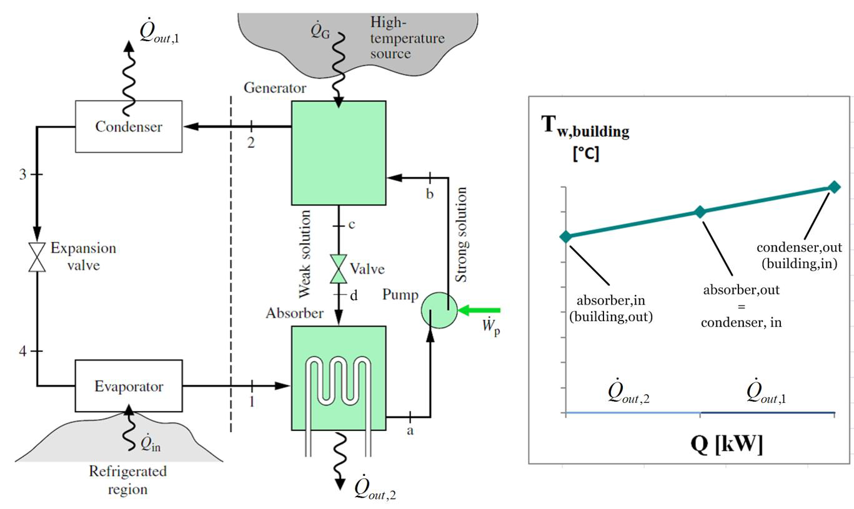
Absorption Heat Pump
Principal layout

Slide 14
Conclusion
Technical Aspects
Both options of trigeneration plant – with vapor compression and absorption HP are technically feasible.
Use of vapor compression HP is proposed because of simplicity, easier maintenance and higher COP.
Use of absorption HP requires a heat supply with temperature > 100 °C (the best low-pressure steam), or heat source with relatively high temperature, or both.
Today it is not easy task to develop infeasible and financially unviable project that is combines CHP and HP.

Slide 15
Cost-benefit analysis: Compression v. Absorption heat pump
Through economic analysis, we will present economic profitability by defining :
Net Present Value (NPV),
Internal Rate of Return (IRR),
Simple Pay-back Period,
Benefit-cost ratio, and
Sensitivity analysis.
The starting point is the determination of the basic measures we will use to define benefits and costs: prices of included energy, exchange rates, and CO2 emission coefficients.

Slide 16
Prices
Exchange rate, April 18th, 2023
 |  |  | 1 EUR = | RSD | 117.2783
 |  |  | 1 USD = | EUR | 0.9145
Energy and COշ prices
 | Gas |  |  | €/1000m³ | 431.45
 | Gas |  |  | €/kWhg | 0.0397
 | Electricity |  |  | €/kWhe | 0.103
 | Heat, DH selling price |  |  | €/kWht | 0.062
 | Heat, DH purchasing price |  |  | €/kWht | 0.059
 | Heat, purchase from 3G system |  |  | €/kWht | 0.020
 | EU ETS COշ |  |  | €/kg | 0.09304
COշ emission coefficients
 | Gas |  |  | kg/1000m³ | 1,995.0
 | Gas |  |  | kg/kWhg | 0.2314
 | Heat |  |  | kg/kWht | 0.2314
 | Electricity |  |  | kg/kWhe | 0.8
Notes:
Considering the importance of heat and the quite different performances when it comes to heat consumption and production, especially with the absorption pump, we had to divide the gas price into three parts. These are the sales and purchase prices of DH Niš gas, according to the latest available balances (the year 2021). The third value for gas refers to the waste heat that can be obtained from the existing boiler in the Niš Clinical Center. Bearing in mind the recent changes in the measurement of gas consumption, we have shown prices per 1000m³ and per kWh, as well as CO2 emissions.

Slide 17
Base data
 |  |  |  | h | 4,000 | 6,000 | 8,600
Gas engine (GE)
 | Annual heat production |  |  | kWht | 5,228,000 | 7,842,000 | 11,240,200
 | Annual electric production |  |  | kWhe | 4,564,000 | 6,846,000 | 9,812,600
 | Annual energy consumption
 |  | Gas |  | 1000m³ | 1,313.17 | 1,969.76 | 2,823.33
 |  | Electricity |  | kWhe
 | Total value of energy consumption |  |  | € | 549,653 | 824,479 | 1,181,753
 | Value of energy costs |  |  | €/kWht&e | 0.0561 | 0.0561 | 0.0561
Compression heat pump
 | Annual heat production |  |  | kWht | 4,000,000 | 6,000,000 | 8,600,000
 | Annual energy consumption
 |  | Heat
 |  | Electricity |  | kWhe | 1,096,920 | 1,645,380 | 2,358,378
 | Total value of energy consumption
 |  | With GE |  | € | 61,573 | 92,360 | 132,382
 |  | Without GE |  | € | 112,983 | 169,474 | 242,913
 | Value of energy costs
 |  | With GE |  | €/kWht | 0.0154 | 0.0154 | 0.0154
 |  | Without GE |  | €/kWht | 0.0282 | 0.0282 | 0.0282
Absorption heat pump
 | Annual heat production |  |  | kWht | 4,182,400 | 6,273,600 | 8,992,160
 | Annual energy consumption
 |  | Heat |  | kWht | 5,228,000 | 7,842,000 | 11,240,200
 |  | Electricity |  | kWhe | 40,000 | 60,000 | 86,000
 | Total value of energy consumption
 |  | With 3G |  | € | 106,805 | 160,208 | 229,631
 |  | Without 3G |  | € | 312,572 | 468,858 | 672,030
 | Value of energy costs
 |  | With 3G |  | €/kWht | 0.0255 | 0.0255 | 0.0255
 |  | Without 3G |  | €/kWht | 0.0747 | 0.0747 | 0.0747
 |  |  |  | h | 4,000 | 6,000 | 8,600
CO2 footprint
 | Compression heat pump
 |  | Heat consumption emission |  | kg
 |  | Electricity consumption emission |  | kg | 877,536 | 1,316,304 | 1,886,702
 |  | Total CO2 emission |  | kg | 877,536 | 1,316,304 | 1,886,702
 |  | Value of CO2 emission |  | € | 81,646 | 122,469 | 175,539
 | Absorption heat pump
 |  | Heat consumption emission |  | kg | 1,209,746 | 1,814,618 | 2,600,953
 |  | Electricity consumption emission |  | kg | 32,000 | 48,000 | 68,800
 |  | Total CO2 emission |  | kg | 1,241,746 | 1,862,618 | 2,669,753
 |  | Value of CO2 emission |  | € | 115,532 | 173,298 | 248,394

Slide 18
Resulting financial values of energy
 |  |  |  | h | 4,000 | 6,000 | 8,600
Energy Values
 | Compression heat pump
 |  | With GE
 |  |  | Output | € | 247,205 | 370,807 | 531,490
 |  |  | Input | € | 61,573 | 92,360 | 132,382
 |  |  | Input with CO2 | € | 143,219 | 214,829 | 307,921
 |  | Without GE
 |  |  | Output | € | 247,205 | 370,807 | 531,490
 |  |  | Input | € | 112,983 | 169,474 | 242,913
 |  |  | Input with CO2 | € | 194,629 | 291,943 | 418,452
 | Absorption heat pump
 |  | With 3G
 |  |  | Output | € | 258,477 | 387,716 | 555,726
 |  |  | Input | € | 106,805 | 160,208 | 229,631
 |  |  | Input with CO2 | € | 222,337 | 333,506 | 478,025
 |  | Without 3G
 |  |  | Output | € | 258,477 | 387,716 | 555,726
 |  |  | Input | € | 312,572 | 468,858 | 672,030
 |  |  | Input with CO2 | € | 428,104 | 642,156 | 920,424

Slide 19
Sensitivity analysis Compression pump
Notes:
It is obvious that the compression pump has outstanding results when working in conjunction with GE. The NPV is large and positive, the internal rate is huge, and the payback period is under 4 years. If it works without GE, the results are more modest, but still very good. The situation changes significantly when CO2 is introduced into the picture. The case with GE is still good, although twice as bad as without CO2, but when we remove GE from the picture, the NPV is negative, the IRR is below the discount rate, and the payback period exceeds 10 years.

Slide 20
Sensitivity analysis Compression pump
Notes:
Compression pumps have the greatest sensitivity to the price of electricity and the price of CO2, and less to the size of investment costs. The price of electricity that leads to the profitability limit (NPV=0) is 0.1751 €/kWh, which is 70% more than the price of that energy source. The prices based on which we did the calculation are defined at the beginning of this paragraph, so - it is the price before this price increase from May 1. It should be noted that the price of electricity in the first case, with connection to GE, is lower and amounts to (see Figure 1) 0.0561 €/kWh, thus 54.5% less than the current market price.
In short, a compression pump that works coupled with GE suffers all possible changes, and without GE it becomes very sensitive to changes, and with CO2 it is in losses.

Slide 21
Sensitivity analysis Absorption pump
Notes:
In a situation where the absorption pump receives heat, practically waste heat, from the boiler of the Niš Clinical Center, the results are excellent: the NPV is positive and large, the same IRR and the payback period is less than 3.5 years. However, when we remove waste heat from the story and add CO2, the results are negative in all cases and the use of an absorption pump in those conditions is not recommended and is unprofitable.

Slide 22
Sensitivity analysis Absorption pump
Notes:
The absorption pump is primarily sensitive to the cost of input heat, CO2, and investments. First, it should be noted that in case there is no available cheap heat, waste heat, absorption puma does not make economic sense, so we will not even explain the sensitivity in that case (shown in Figure 7). It is essential to note that the price of heat above which the operation of the absorption pump does not make sense is 0.0387 €/kWh, of course without calculating CO2. It is necessary to remind (Figure 1) that the cost price of the produced heat in DH Niš is €0.059/kWh. The absorption puma could withstand the current price of CO2 if the heat input price were lower than €0.017/kWh, i.e., 28% of the heat production price of DH Niš.

Slide 23
Conclusions
Similarities:
Both types of heat pumps can be used for both heating and cooling.
Both work by transferring heat from one location to another.
Differences:
Method of heat transfer: Compression heat pumps use refrigerants and compressors to transfer heat, while absorption heat pumps use a combination of a refrigerant and an absorbent solution (usually water and lithium bromide) to transfer heat.
Energy source: Compression heat pumps typically use electricity as their energy source, while absorption heat pumps can use a variety of energy sources, including electricity, gas, and hot water.
Efficiency: Compression heat pumps are generally more efficient than absorption heat pumps, but the efficiency of an absorption heat pump can be improved by using waste heat as the energy source.
Cost: Absorption heat pumps tend to be more expensive to purchase and maintain than compression heat pumps but can be more cost-effective over the long term if waste heat is used as an energy source.
All of this is confirmed by the concrete cases we considered: compression and absorption pumps of the same capacity, with and without inclusion in the appropriate system (compression with a gas engine and absorption with a boiler), and with and without the inclusion of the EU ETS price for CO2. The analysis showed that the compression pump, with a gas engine, has excellent results, much weaker without a gas engine, but still acceptable. An absorption pump can give economically satisfactory results only if it is connected to a cheap heat source and in all other cases it does not give economically acceptable results.

