Slide 1

Wilo pumpe i pumpni sistemi
U sistemima daljinskog grejanja

Slide 2

Istorijat i razvoj
kompanije.
WILO SE Dortmund sа trаdiciјоm dugоm 150 gоdinа, јеdаn је оd nајvеćih prоizvоđаčа pumpi zа grејаnjе, hlаđеnjе, klimаtizаciјu, vоdоsnabdevanje i transport otpadne vode, i sinоnim je nеmаčke trаdiciјe kvаlitеtа i pоuzdаnоsti. Obzirоm nа ovakvo iskustvо, sticanо tоkоm gоdinа pоstојаnjа, WILO је јеdаn оd lidеrа i diktira trendove razvoja pumpi i pumpne tеhnike u svetu.

Slide 3
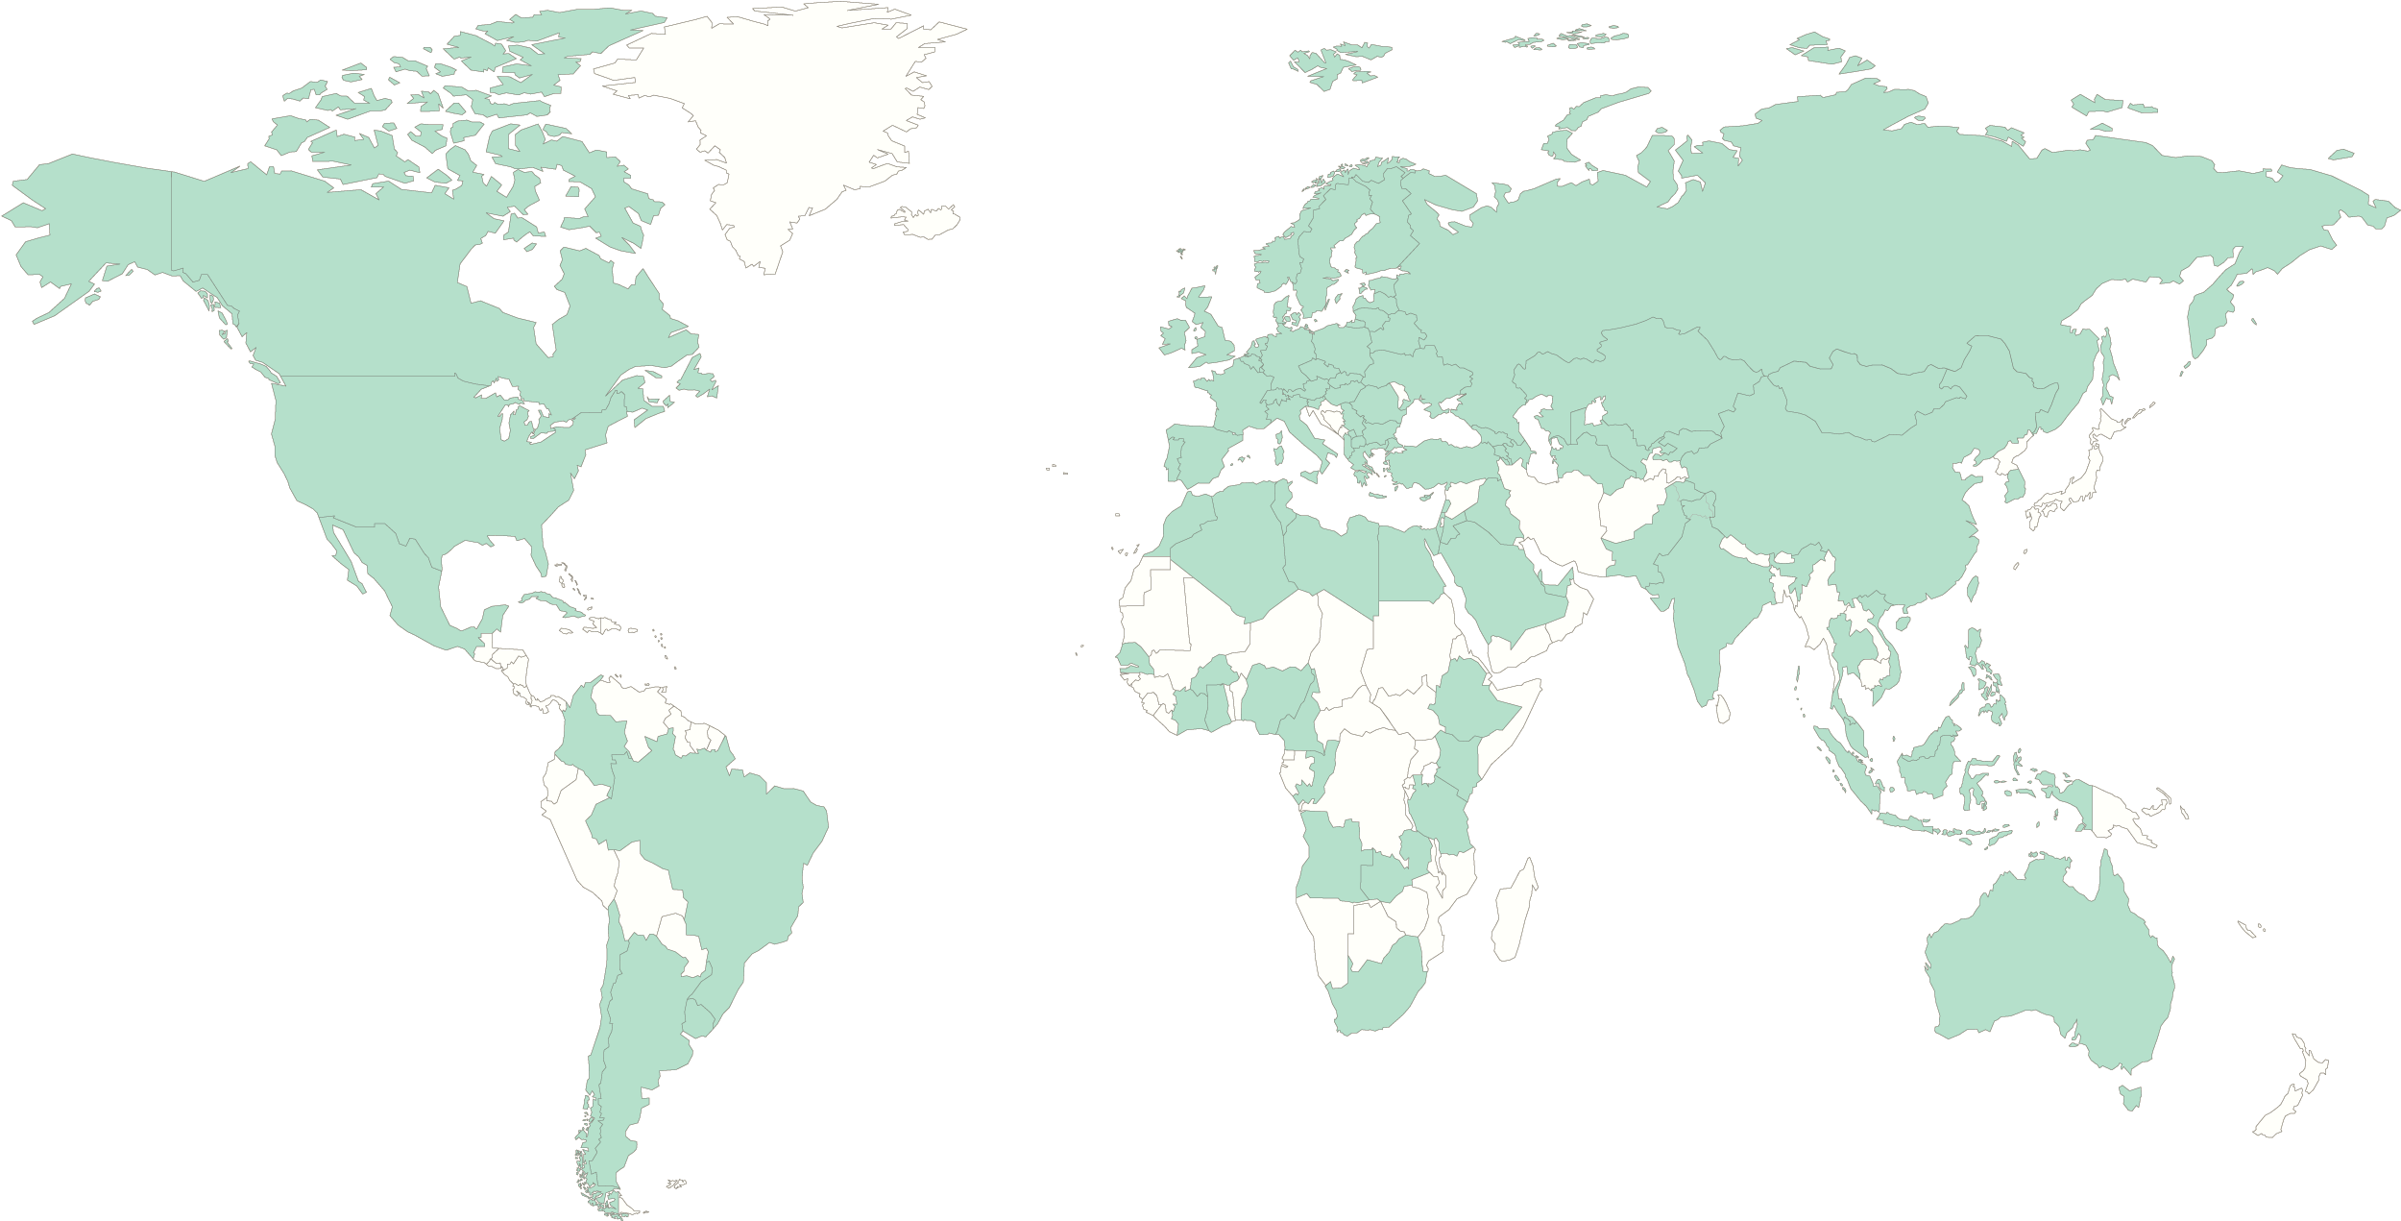
Wilo u svetu.
Germany
Dortmund, Hof
China
Beijing,
Qinhuangdao
Russia
Noginsk
(Moscow region)
USA
Cedarburg, Collierville
France
Laval, Aubigny
Italy
Bari
Korea
Busan
Türkiye
Istanbul
Wilo ima 15 glavnih proizvodnih pogona i prisutan je u više od 80 zemalja širom sveta.
UAE
Dubai
India
Pune,
Kolhapur
Zemlje u kojima je Wilo prisutan
Glavni proizvodni pogoni
Notes:
As an international premium manufacturer of pumps and a world-leading driver of innovation, close proximity to our customers and partners is a necessary target. With our wide-ranging and efficient network of production and sales companies close to our customers, Wilo also has a contact point for your questions and requirements close to you.
Thanks to our "region-for-region" approach, we are ideally positioned and can satisfy regional or local customer needs very efficiently with our regionally or locally manufactured products.

Slide 4
Finansijski podaci za 2022.
Dostignut je novi rekord u prodaji sa porastom od 14,2%.
Promet
1,885.7
m. EUR
EBITDA
196.7
m. EUR
Konsolidovani neto prihod
61.1
m. EUR
Investicije
155.3
m. EUR
Troškovi razvoja
70.6
m. EUR
Broj zaposlenih
8,457
Notes:
The Wilo Group continued on its profitable growth path with strong net sales growth of 14.2 percent. Net sales increased to EUR 1,885.7 million. Organic net sales growth, i.e. after adjustment for exchange rate and acquisition effects, amounted to 12.8 percent.
Consolidated net income also saw strong growth to EUR 61.1 million.
Despite the challenging environment, Wilo also recorded a year-on-year increase in EBITDA to EUR 196.7 million.
Research and development costs amounted to EUR 70.6 million in 2022, corresponding to 3.7 percent of net sales.
Wilo continues to invest heavily in the future. Among other things, EUR 155.3 million was invested in the construction and expansion of new and existing sales and production locations, the modernisation and capacity expansion of production machinery and company acquisitions.
Wilo employed an average of 8,457 people over the year worldwide.

Slide 5





Naši segmenti tržišta.
Vodeći dobavljač pumpi i pumpnih sistema.
Building Services
OEM
Industry
Building Services Residential
Building Services Commercial
Water
Management
Naša inovativna rešenja, pametni proizvodi i individualne usluge pokreću vodu na inteligentan, efikasan i klimatski prihvatljiv način.
Notes:
The Wilo Group is one of the world’s leading premium providers of pumps and pump systems for the building services, water management and industrial sectors. In the past decade, we have developed from a hidden champion into a visible and connected champion. Today, Wilo has 8,457 employees worldwide.
Our innovative solutions, smart products and individual services move water in an intelligent, efficient and climate-friendly manner. We are also making an important contribution to climate protection with our sustainability strategy and in conjunction with our partners. We are systematically pressing ahead with the digital transformation of the Group. We are already the digital pioneer in the industry with our products and solutions, processes and business models.

Slide 6
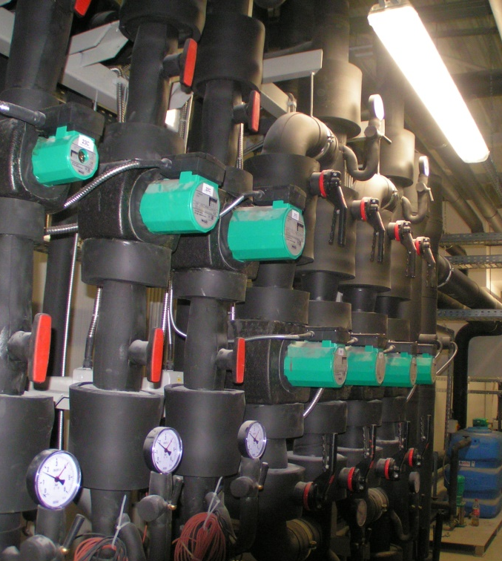
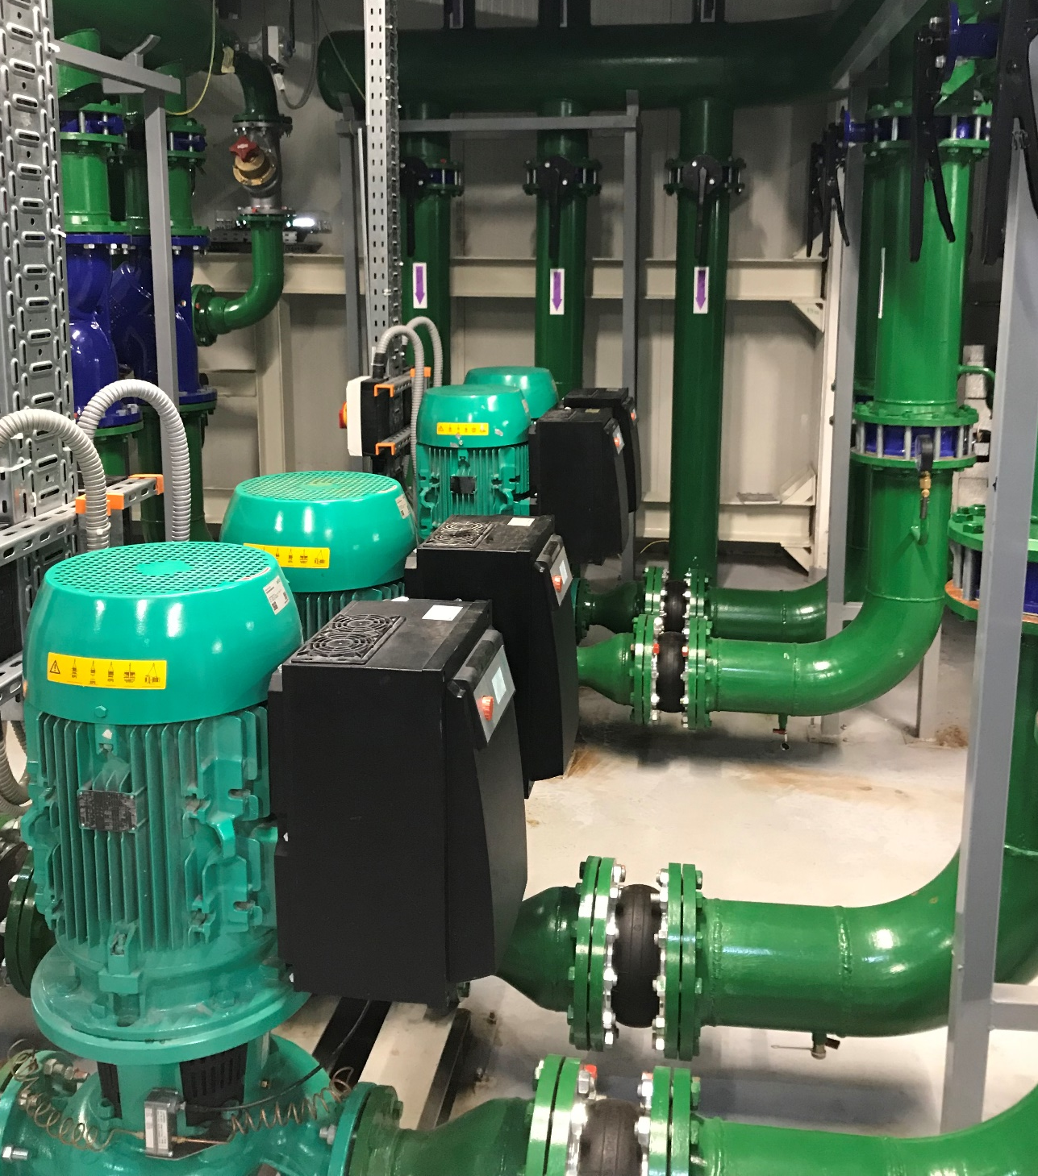
Pumpe manjeg kapaciteta

Slide 7
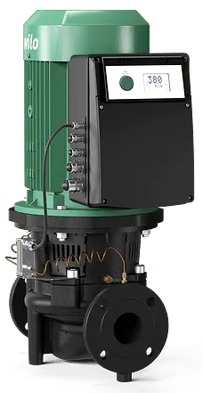
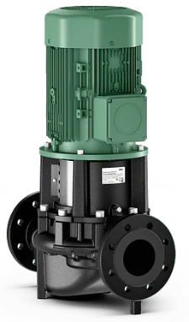
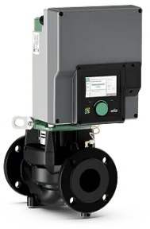
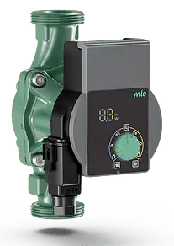
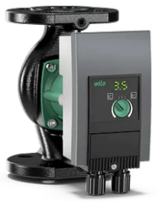
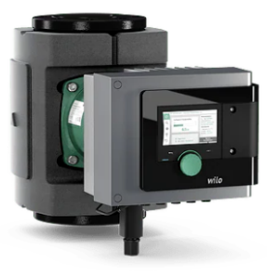
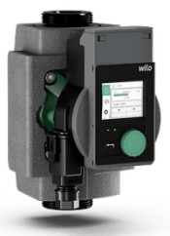
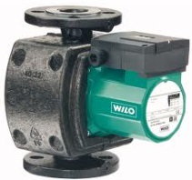
Wilo rešenja u HVAC sistemima
 | Stratos PICO | Yonos PICO1.0 | TOP S | Yonos MAXO | Stratos MAXO | Atmos GIGA-I IPL | IL-E IP-E | Stratos GIGA2.0
Q_{max.} m³/h | 4,5 | 4,8 | 80 | 60 | 73 | 900 | 630 | 220
H_{max.} m | 7,9 | 7,5 | 20 | 16 | 16 | 110 | 65 | 42

Slide 8
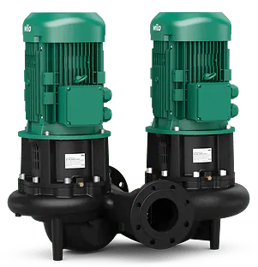
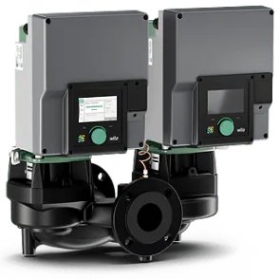
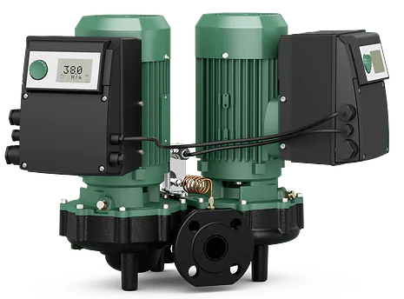
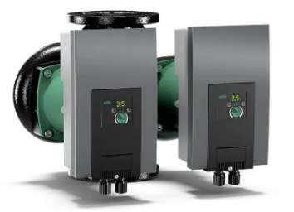
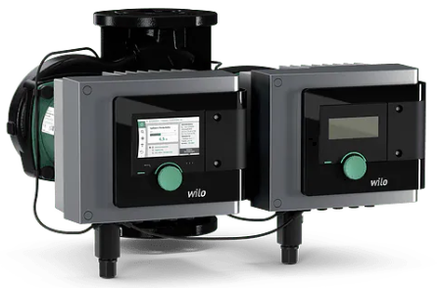
Wilo duplex pumpe u HVAC sistemima
 | Yonos MAXO D | Stratos MAXO D | DPL, DL | DP-E DL-E | Stratos GIGA2.0-D
Q_{max.} m³/h | 52 | 55 | 540 | 450 | 300
H_{max.} m | 16 | 16 | 45 | 23 | 44

Slide 9
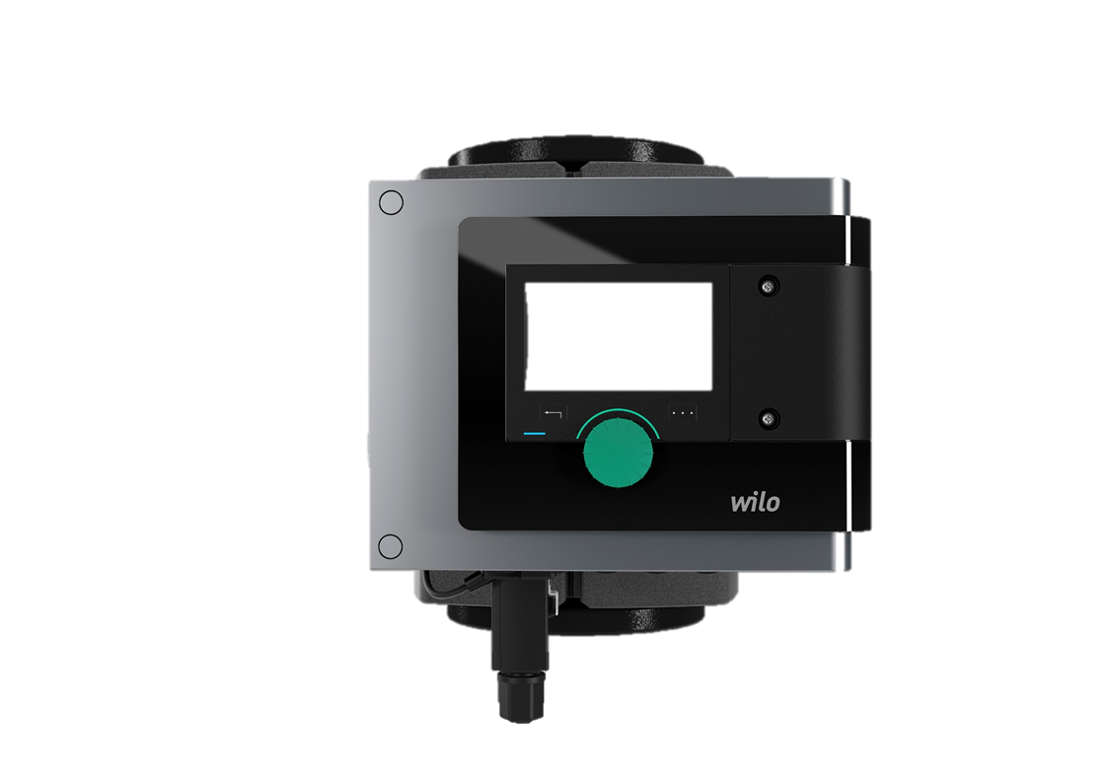
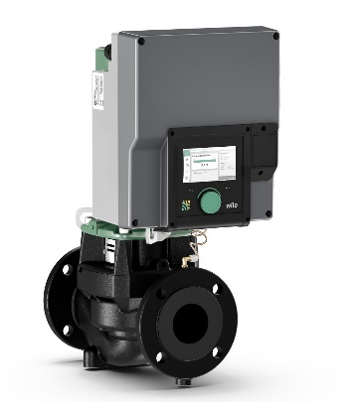
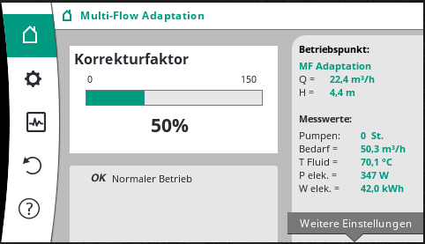
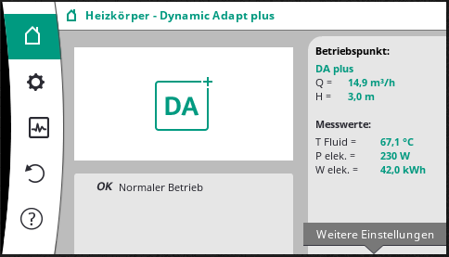
Način upravljanja
Multi-Flow Adaptation
Napojna pumpa-primarna strana
Sekundarna strana
Suma svih protoka na sekundarnoj strani
Ušteda
Električna energija pumpe
+
Ušteda
Energetski zahtev objekta
=
Velika efikasnost sistema
Notes:
Multi-Flow Adaptation
The Multi-Flow Adaptation control mode is applicable for a Stratos GIGA2.0 feeder pump in the primary circuit that, for example, supplies an open distributor, a hydraulic shunt or a heat exchanger. The feeder pump is connected to the Stratos GIGA2.0 and Stratos MAXO pumps in the secondary circuits via a data cable. The feeder pump continuously receives the respective required volume flow from each individual secondary pump at short intervals. The sum of the required volume flows from all secondary pumps is set by the feeder pump as the setpoint volume flow. On commissioning, all associated secondary pumps must be connected to the primary pump so that it can take their volume flows into consideration. A fixed volume flow value can be entered for non-communication-capable secondary pumps.
Control properties:
The feeder pump provides exactly as much volume flow as is required by the secondary pumps. It therefore saves electrical pumping energy in comparison to Δp control. The heat generator’s degree of utilisation is optimised by a lower return temperature. This leads to fuel savings. For local and district heating transfer stations, the lower return temperature leads to higher operational reliability, as it avoids activating the return temperature limiter as well as overflows.
Field of application e.g.:
Pumps in district heating transfer stations without controllers that supply distributors with secondary pumps
Feeder pumps that supply open distributors or heat exchangers with secondary pumps with no speed control through the heat generator

Slide 10
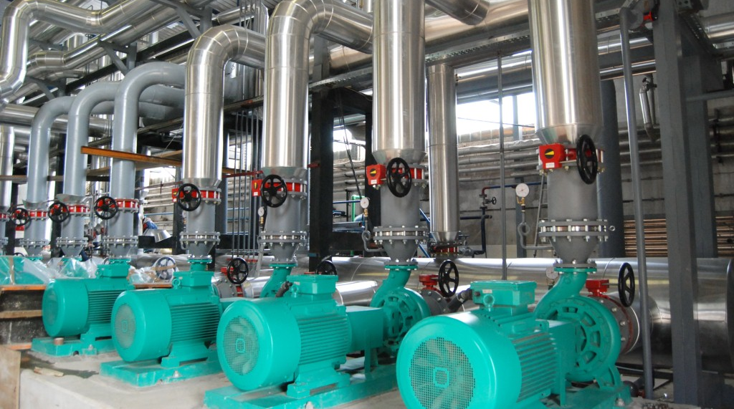
Pumpe većeg kapaciteta

Slide 11
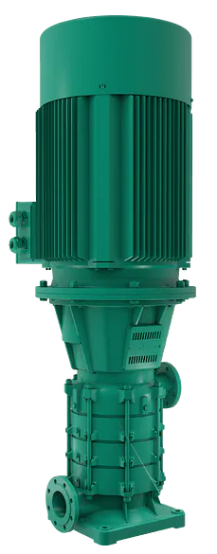
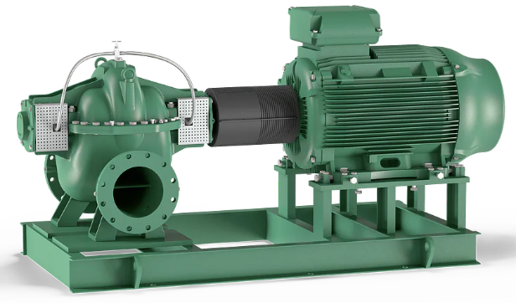
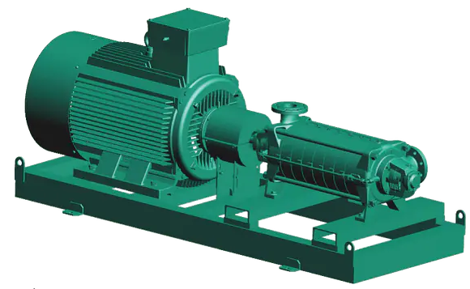
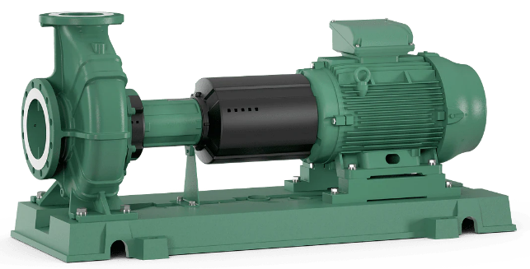
Wilo norm pumpe, pumpe sa aksijalno razdeljenim kućištem i višestepene pumpe
 | Norm pumpe | Pumpe sa aksijalno podeljenim kućištem | Višestepene, segmentne, livene pumpe – H/V ugradnja
Q_{max.} m³/h | 2,600 | 3,400 | 320
H_{max.} m | 150 | 245 | 500

Slide 12
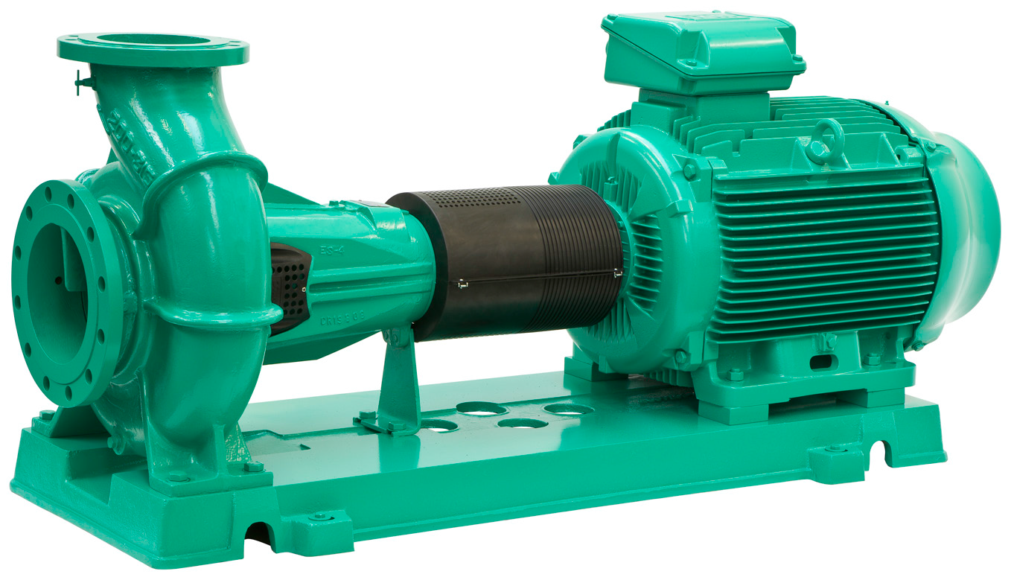
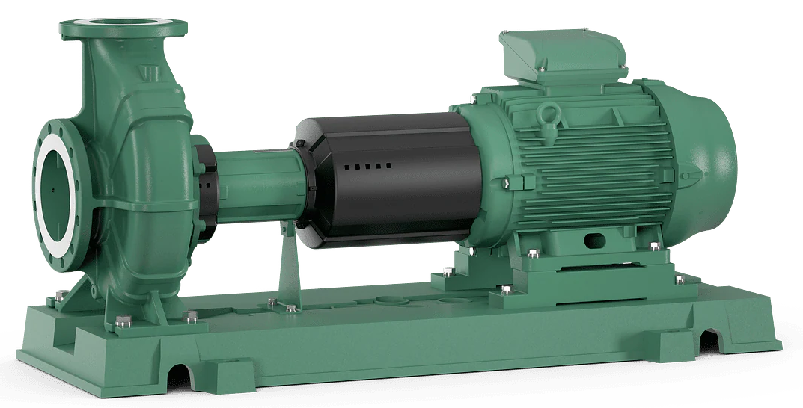
Wilo Atmos GIGA-N / NLG
Jednostepena centrifugalna pumpa
Atmos GIGA-N
Q_{max.} m³/h 1000
H_{max.} m 150
NLG
Q_{max.} m³/h 2500
H_{max.} m 110

Slide 13
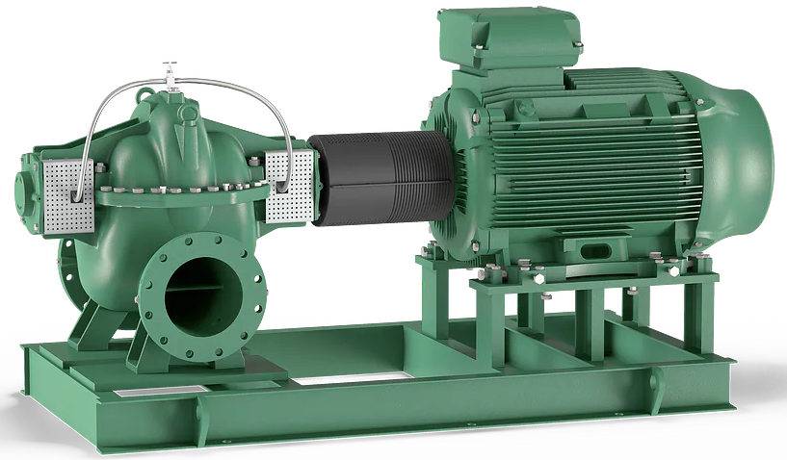
Wilo Atmos Tera SCH / SCP
Pumpa sa aksijalno razdeljenim kućištem pumpe
SCH / SCP
Q_{max.} m³/h 3400
H_{max.} m 190

Slide 14
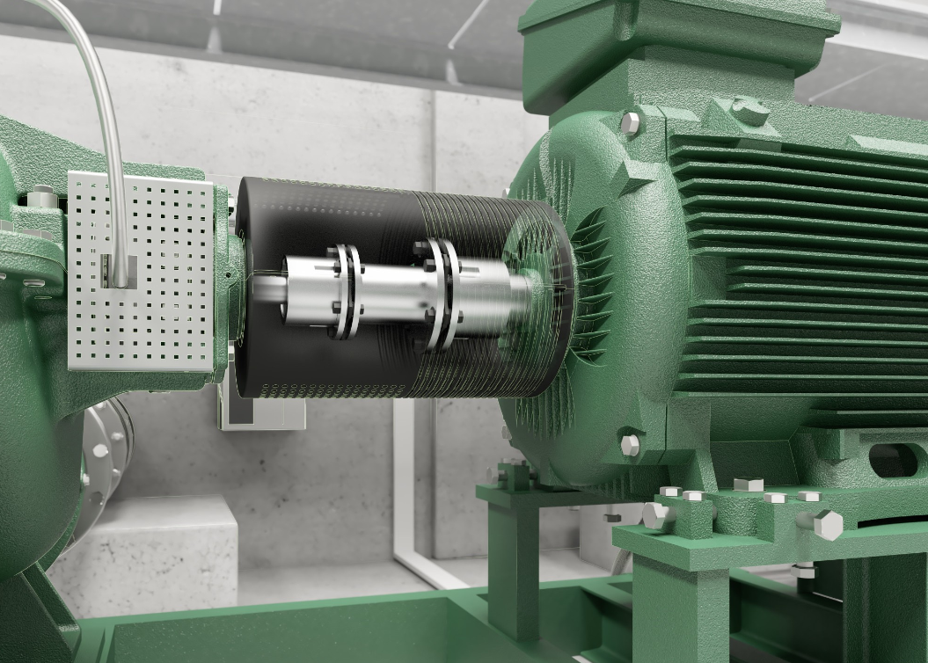
Wilo Atmos Tera SCH / SCP
Lako podešavanje saosnosti između hidraulike i motora

Slide 15
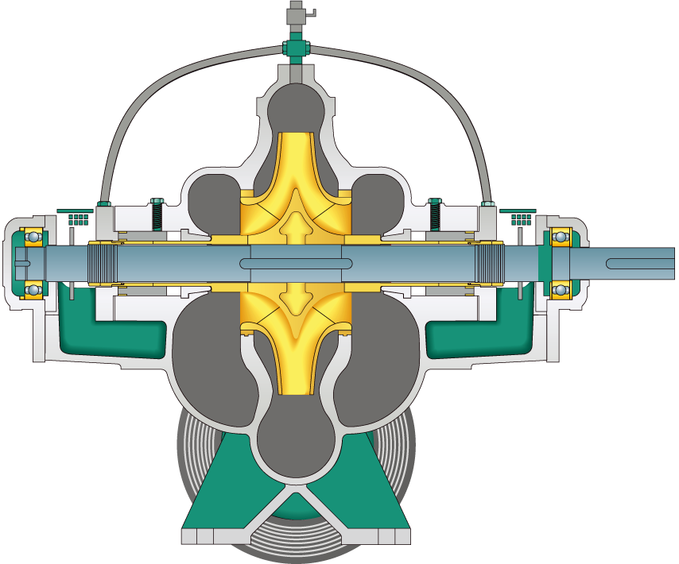
Wilo Atmos Tera SCH / SCP
1
Povratna cev meh. zapt.
7
Radno kolo
2
Mehanički zaptivač Burgman
3
Ležajevi
6
Čaura vratila
4
Vodeća čaura
5
Donji deo kućišta

Slide 16
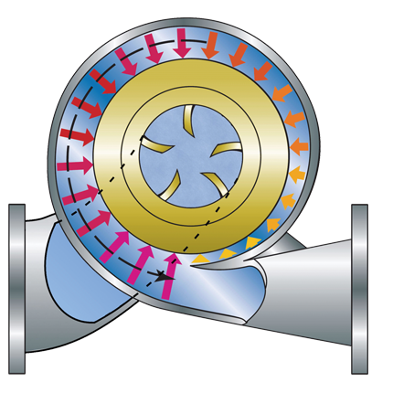
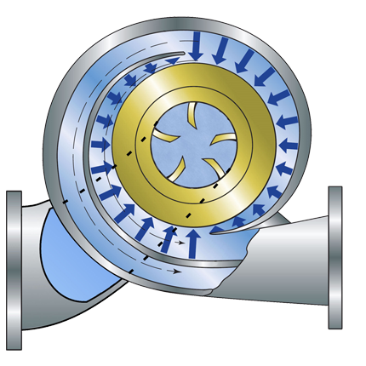
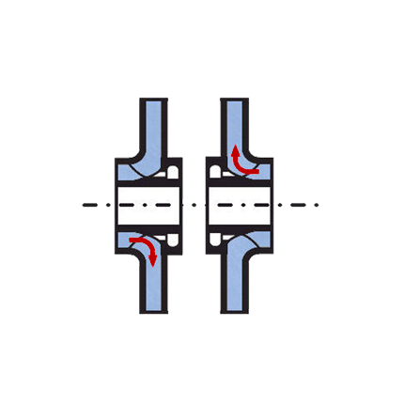
Wilo Atmos Tera SCH / SCP
Moguća hidraulična rešenja:
Dvostrujno radno kolo kao standardno rešenje (HA)
Dva jednostrujna radna kola za velike napore (DS)
Dvospiralno kućište za veće pumpe (DV)

Slide 17

Wilo-ZEOX First H/V
Normalno usisna, visoko efikasna centrifugalna višestepena pumpa visokog pritiska
Horizontala ili vertikalna ugradnja
Zeox FIRST
Q_{max.} m³/h 320
H_{max.} m 500

Slide 18
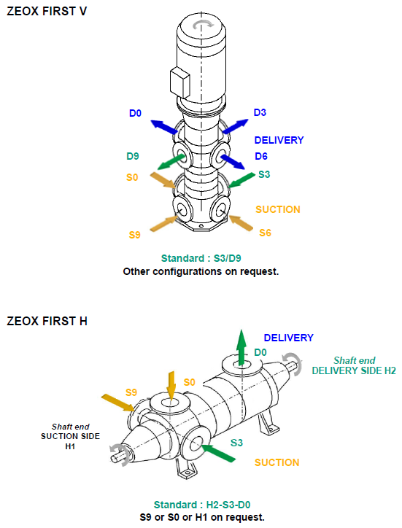
Wilo-ZEOX First H/V
Horizontala ili vertikalna ugradnja

Slide 19
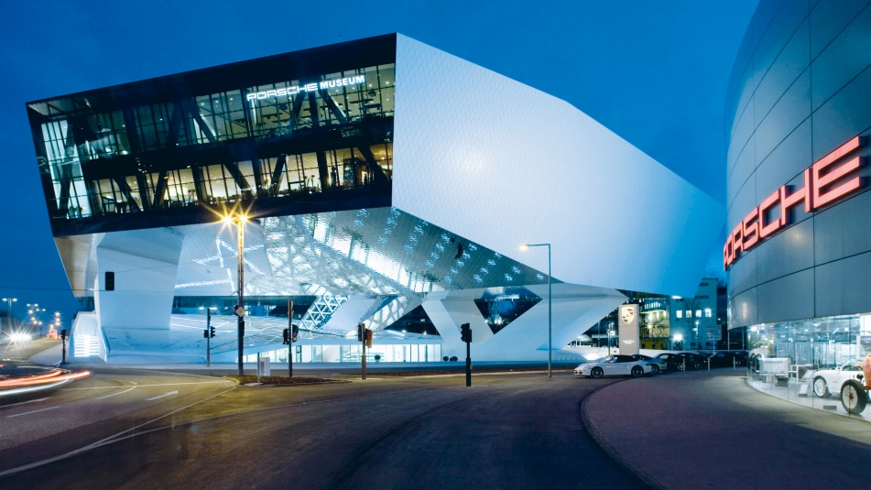
Wilo Beograd – isporuka pumpi velikog kapaciteta

Slide 20
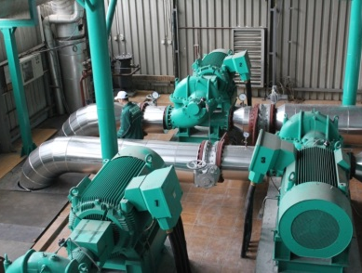
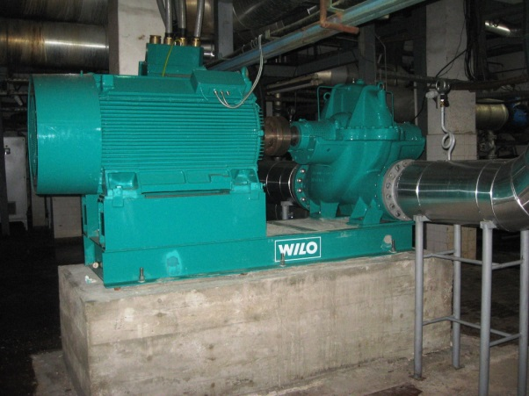
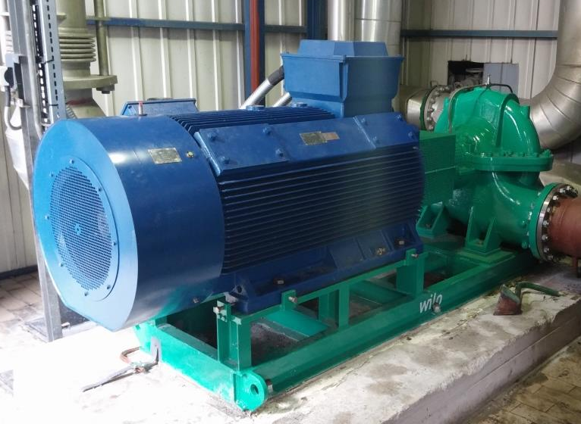
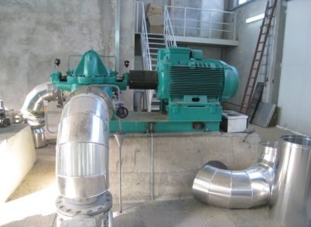

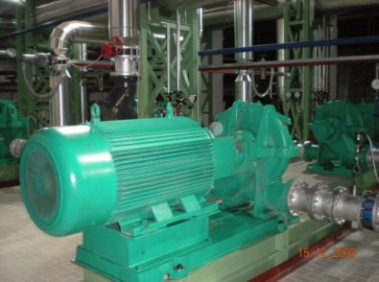
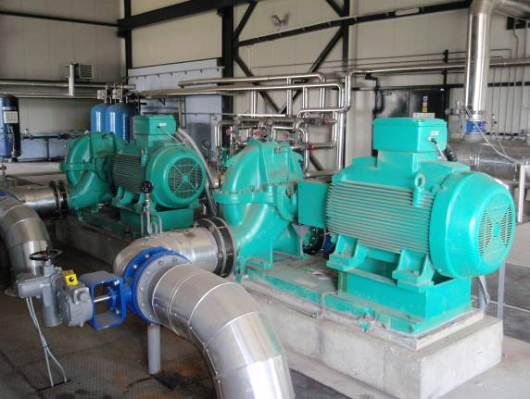
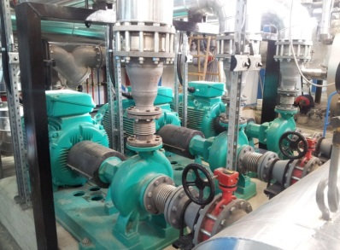
Wilo Beograd – saradnja sa toplanama – isporuka pumpi velikog kapaciteta
• JKP Gradska Toplana Niš, kotlarnica Krivi Vir • JKP Gradska Toplana Niš, kotlarnica Jug • JKP Beogradske Elektrane, Toplana Mirijevo • JKP Gradska Toplana Zrenjanjin • JKP Grejanje Pančevo, Toplana Kotež • JKP Subotička Toplana
• JKP Toplana Valjevo • JKP Toplana Loznica

Slide 21

Hvala na pažnji
Miloš Pandurov, Inženjer prodaje, Wilo Beograd doo
milos.pandurov@wilo.com

