Slide 1

Oilon ChillHeat heat pumps
District heating and Cooling solutions
Jussi Alpua - Oilon / Žiga Debevec – Valmor

Slide 2










Oilon in brief
Founded in 1961
Family-owned company
Strong R&D focus
Burners
Turnover:
EUR 85 million (2022)
Heat pumps
Over 400 employees
One degree better

Slide 3

Oilon dealers in over 60 countries
Oilon
Oilon dealer
One degree better

Slide 4
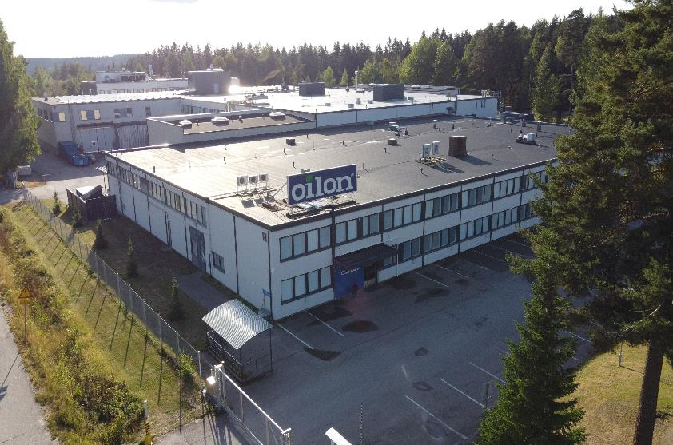
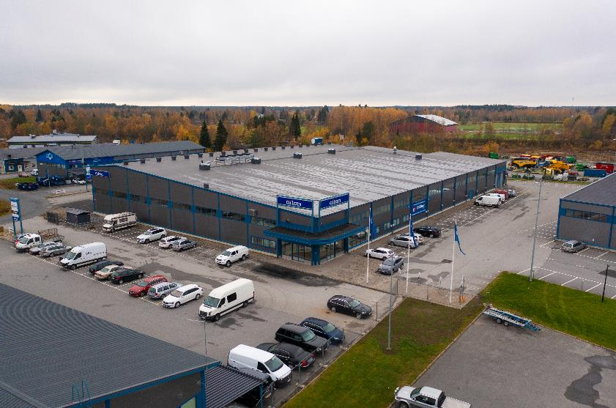
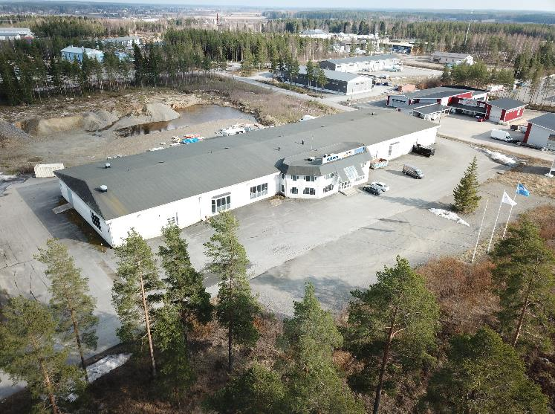
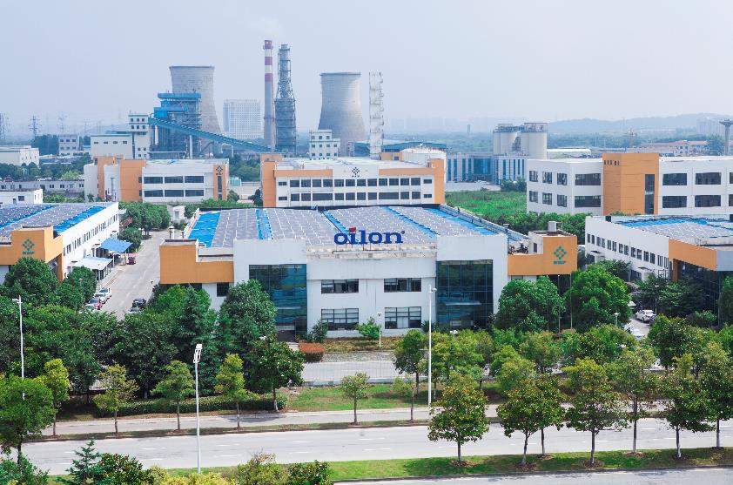
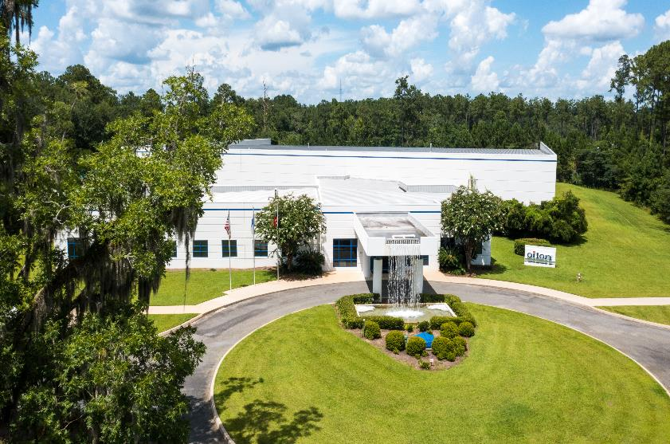
Lahti, Finland
Kokkola, Finland
Lapua, Finland
Wuxi, China
Thomasville, USA
One degree better
One degree better

Slide 5








A 2022: Over 10MW of completed projects with HP
Solution partner for large Heat Pumps implementation
Founded in 2002
Oilon Partner for SEE Region (SI / CRO / SRB / BIH / MKD) since 2022
Heat pumps and chillers
Main applications: high-temp. water production, process cooling and heating
Install base ~200 MW
10 employees
Over 300 large-scale projects

Slide 6

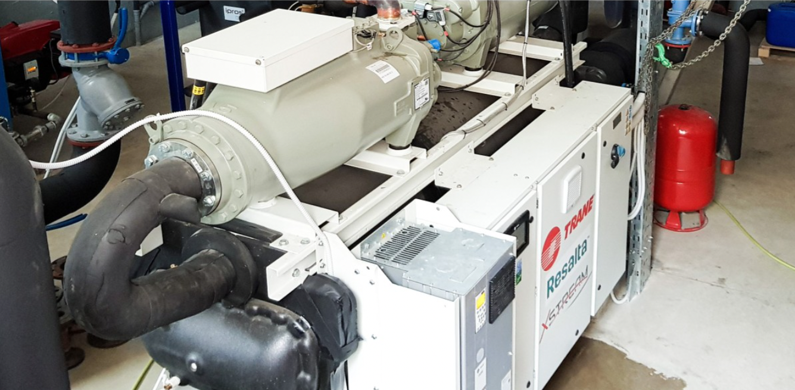
Heating of the thermal park with a water-to-water heat pump: reduction of gas consumption for 95%
The waste thermal water used as a heat source for a 600 kW water-to-water heat pump for producing hot water at a temperature of 65°C
Trane RTWF 320 HSE, equipped with two screw compressors and a frequency inverter, enables high efficiency at partial loads (up to 10%)
Environmentally friendly refrigerant R1234ze
15y maintenance contract for Valmor

Slide 7
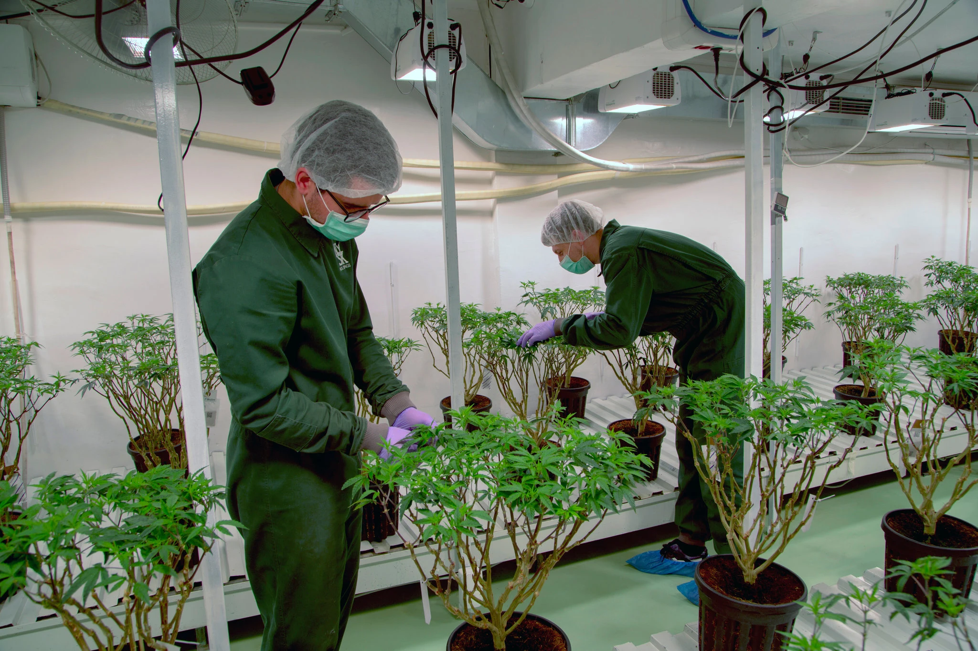
Process Heating & Cooling: The production of cannabis for THC cultivation in North Macedonia
Total cooling capacity of 5.3MW & heating capacity of 3.4MW.
2x water-cooled chillers, each with a capacity of 1.1MW, for the production of chilled water at 5/10°C
The condenser water at 25/30°C serves as a heat source for two water-to-water heat pumps, each with a heating capacity of 1.68MW, for producing heat at temperature levels of 70/60°C
https://www.nytimes.com/2020/03/25/business/north-macedonia-marijuana.html

Slide 8

Oilon Chillheat applications in district heating and cooling solutions
Combined heating and cooling (CHC)
CHC + Network booster
CHC + Network booster + Two-way district heating
Air to water heat pump
Hybrid solution for large real estates
Network booster
Heat recovery from wastewater
4th generation district heating
5th generation district heating
Geotherm – semi depth wells
Notes:
Bullet 3 – not yet implemented; last bullet -> drilling has failed (up to 2km); hybrid solutions -> two way DH; wastewater -> municipal

Slide 9
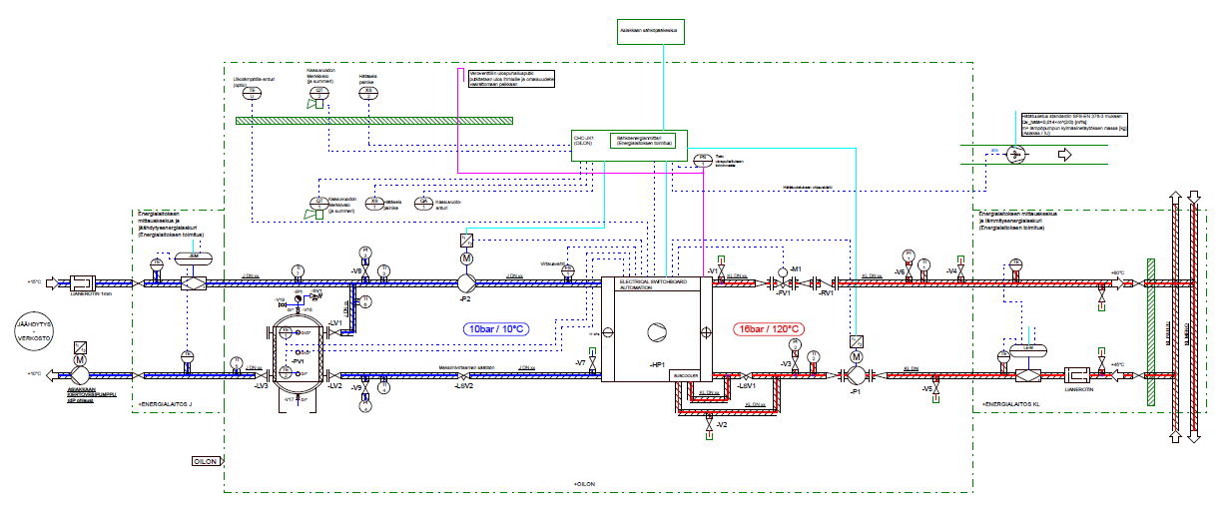
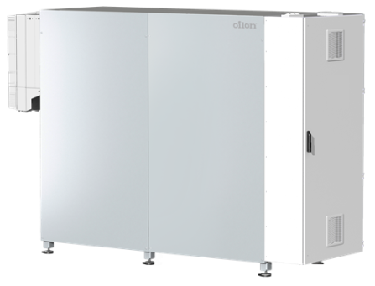
Combined heating and cooling (CHC)
More than 50 installations in Finland
5 on going installations
Recover cooling network waste heat
→-> less carbon footprint
Distribute the heat according to the demand
→ -> benefit of district heating network
Individually set cooling temperature
→ -> independent of district cooling network
Wide capacity adjustment range
Compact size
Low GWP refrigerants
Notes:
58 projects, installed projects; 5 projects at the implementation stage; new business: sell cooling to the customers, collect energy to the DH network; buffer tank is the border; HP is getting the startup signal from the Tank temp. Measurement (bottom), HP is controling the water pump, after the tank is energy meter; after that is the customer’s pump. HP not connected to the BMS of the building; no connection of the third party system.
DH side: 40/50 deg (energy from subcooling) -> puting in supply line 70/95 deg; when temp. Level are below of 120 °C deg the capex in reasanobale. If over 120 the investment costs are unresanoble. Two-way valve for the minimum loads and to get enoguh pressure head from return to supply line; we monitor outlet temp. Level of HP and with this info we control pump + two-way valve.

Slide 10
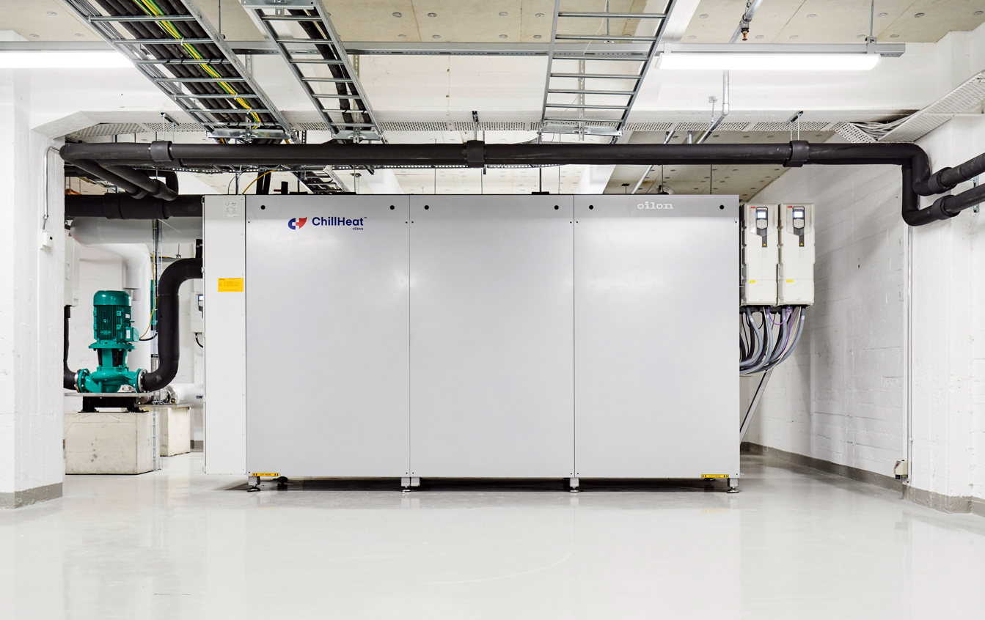
Combined heating and cooling (CHC) – Helen Oy
Heat source: Building cooling 15/10 ºC
Heat sink: District heating network 40/80 ºC
Cooling: 1900 kW
Heating capacity: 2850 kW
COPtot: 5,0
5 pcs Oilon ChillHeat heat pumps
Notes:
System COP around 5; 2 pcs 450 + VFDs on 4 compressors

Slide 11

Combined heating and cooling (CHC) – Valtatie 30
Heat source: Data Center 23/15 ºC
Heat sink: District heating network 50/95 ºC
Cooling: 2724 kW
Heating capacity: 4266 kW
COPtot: 4,42
6 pcs Oilon ChillHeat heat pumps

Slide 12
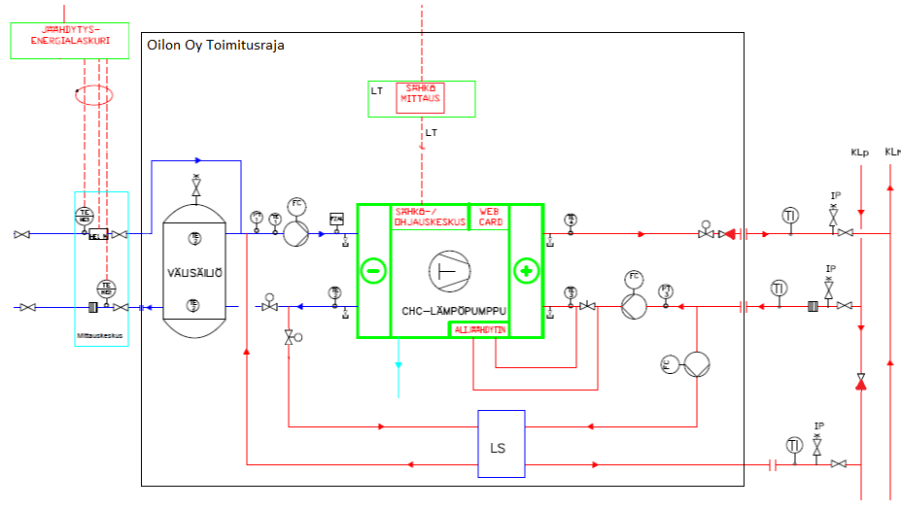
CHC + Network booster
Cooling only in summer time, in winter time the HP would be shut-off
Additional PHE: cooling down the return line of DH
Heating up supply line -> producing the heat in DH with electricity
External machine room automation needed, - controls of HP are not self-sufficient for this solution
Notes:
Cooling only in the summer time, rest of the time the HP would be shut off; LS -> PHE; if there is enough volume take out of the volume; take out temp. Of the return line (good for the powerplant); producing DH with the electricity; YOU NEED EXTERNAL MACHINE ROOM AUTOMATION

Slide 13


CHC + Network booster – Lempäälän Lämpö Oy
Heat source:
  Building cooling (summer)
  Return flow of district heating (winter)
Cooling/heat recovery power: 600/986 kW
Heating capacity (summer/winter): 925/1390 kW
Heat sink: District heating network
Temperatures
  Heat source: 9 ºC / 30 ºC
  District heating: variable (max. 80 ºC)
2 pcs Oilon ChillHeat heat pumps

Slide 14
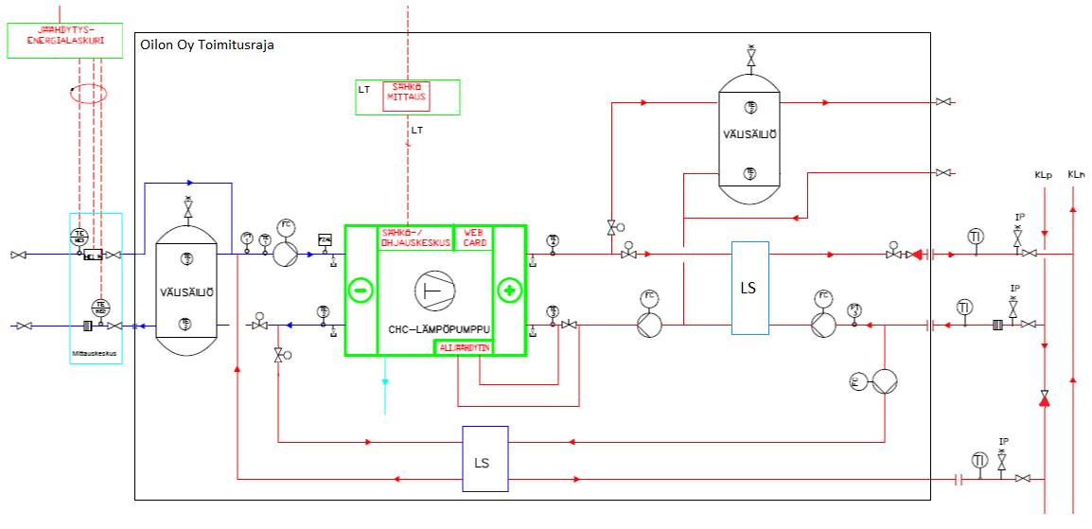
CHC + Network booster + Two-way district heating
Heat is first used in the building, in case of left-over it can be run into district heating
Design idea, not yet installed
Notes:
Not yet supplied; Heat is used first in the building, if there is left, we can run it to the district heating

Slide 15
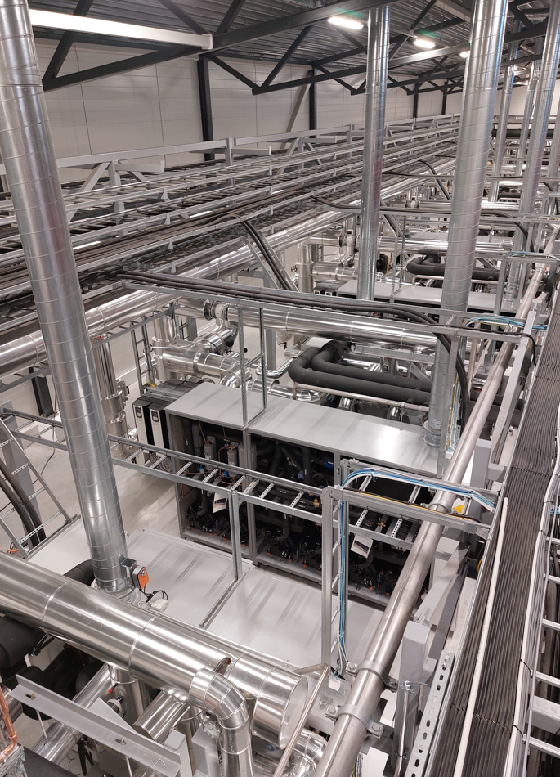
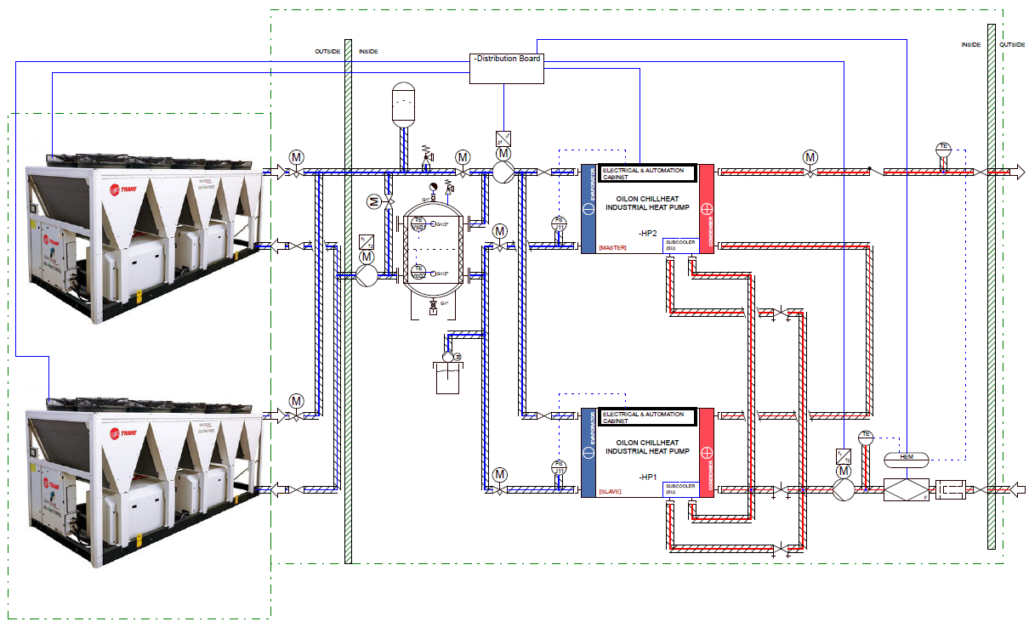
AWHP for high temperatures

Slide 16
AWHP for high temperatures
Fortum Power and Heat Vermo II, Espoo Finland
Heat source:
  Air, min -15 C (1. stage AWHP, not in Oilon’s scope)
  Cooling network 14/6 C
Heat sink: District heating 77-98 ºC
Heating capacity: 9 100-10 320 kW
12 pcs Oilon ChillHeat heat pumps in 2. stage

Slide 17

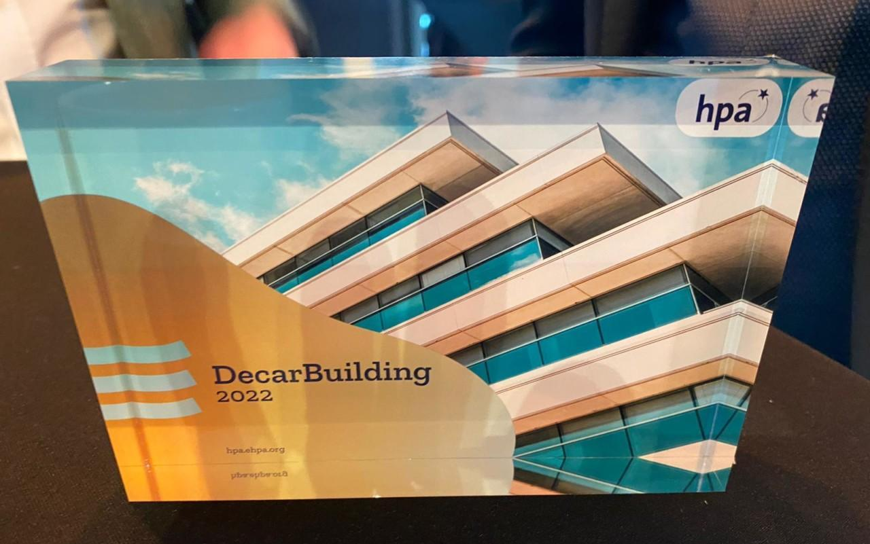
Hybrid solution for large real estate – Helen Oy
Heat source: Geotherm, Condensate from retail refrigeration, Wastewater, Cooling
Heat sink: Building heating, Domestic hot water, District heating
Cooling: 100 kW
Heating capacity: 115 kW
COP:
  Geotherm to building heating 2,94
  Cooling and district heating network 4,67
1 pcs Oilon ChillHeat heat pump
Finner of EHPA DecarBuilding series
Notes:
300m underground boreholes

Slide 18
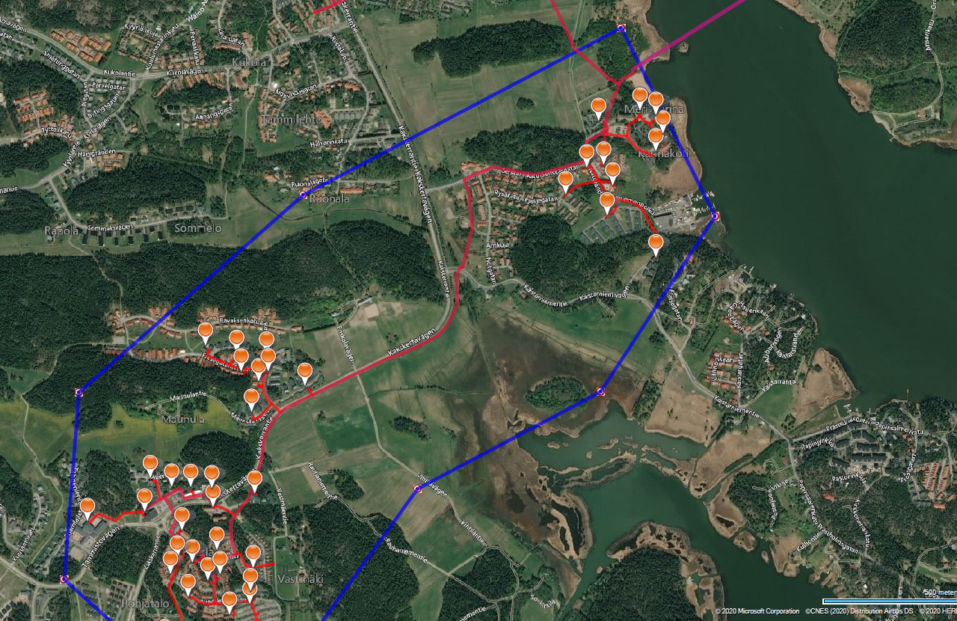

Network booster – Turku Energia Oy
Heat source: Return flow of district heating network 40 ºC
Heat sink: Supply flow of district heating network 70 ºC
Cooling: 160 kW
Heating capacity: 200kW
COPh: 4,70
1 pcs Oilon ChillHeat heat pump
Notes:
Container solutions – not instaleld inside the facilities; advantage no need to run the powerplant to that high temperatures in spring, summer and autumn

Slide 19
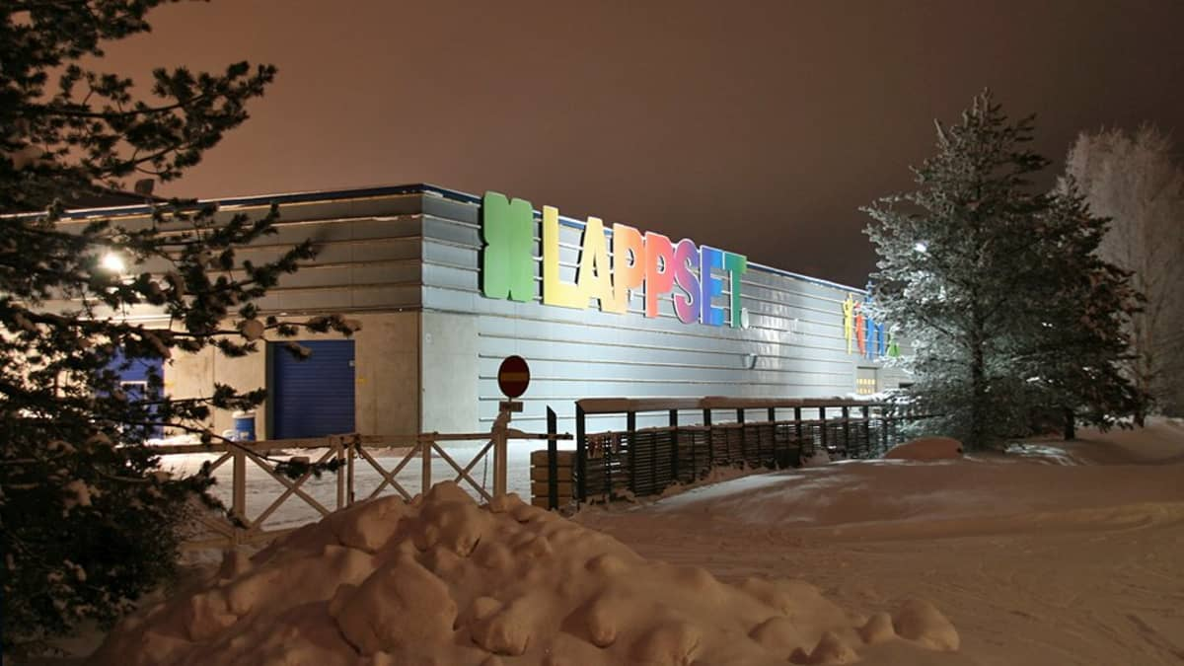

Heat booster – Napapiirin Energia ja Vesi Oy
Heat source: Return flow of district heating network 48-37 ºC
Heat sink: Supply flow of district heating network 70-85 ºC
Cooling: 170 kW
Heating capacity: 240kW
COPh: 3,44
1 pcs Oilon ChillHeat heat pump
Notes:
Energy company can run the network lower (decreased the temp. level) – otherwise they would need to run the whole DH netowork higher just for one client

Slide 20
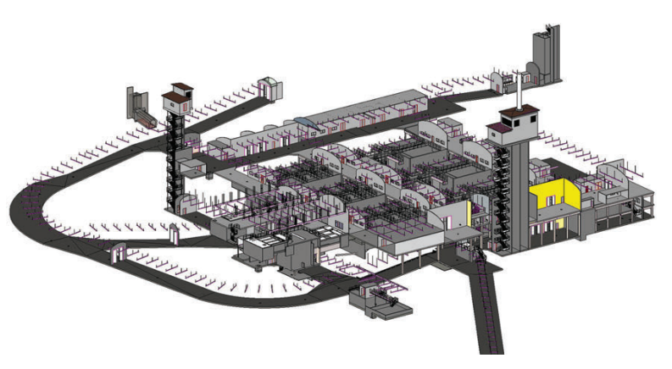

Heat recovery wastewater – Etelä-Savon Energia Oy
Heat Source: Wastewater 9,5/4 ºC
Heat Sink: Local heating network 40/70 ºC
Cooling Capacity: 880 kW
Heating Capacity: 1300 kW
COPtot: 3,04
2 pcs Oilon ChillHeat heat pumps

Slide 21
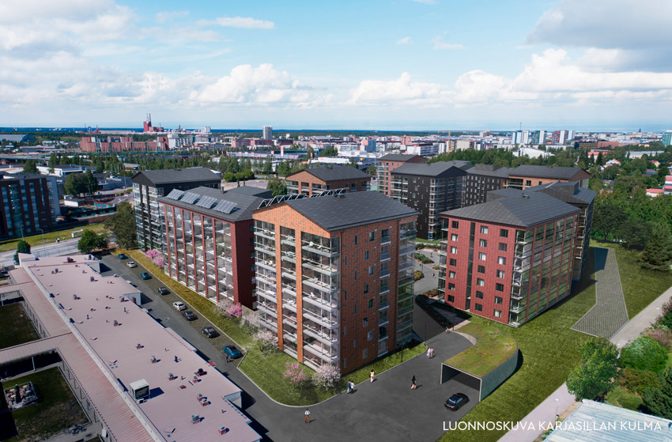
4th generation district heating – Oulun Energia Oy
Heat source:
  Cooling network (summer) 14/7 ºC
  Return flow of district heating network (winter) 38/20 ºC
Heat sink:
  Local heating network and district heating network (Summer) 57/77 ºC
  Local heating network (Winter) 30/72 ºC
Cooling: 255 kW (Summer)
Heating capacity: 870 kW (Winter)
COP:
  Summer (tot) 3,84
  Winter: 3,93
1 pcs Oilon ChillHeat heat pump
Readiness for expansion (1 heat pump)
Notes:
Old network + new network and between the HP; the old network as a heat source; the temp. Level is lower than in the old fashioned DH

Slide 22



5th generation district heating
Heat source: Low temperature network (30-40 ºC)
Heating capacity: 80 - 130 kW
Heat sink: Buildings
Temperatures
  Heating: 55 ºC
  Cooling and heating: 8 ºC / 55 ºC
4 pcs Oilon ChillHeat heat pumps
Notes:
HP installed inside the buildings, utilizing low temp network as a heat source; if the building needs cooling, otherwise the condense is putting back in the main creed, e-on ecto creed

Slide 23
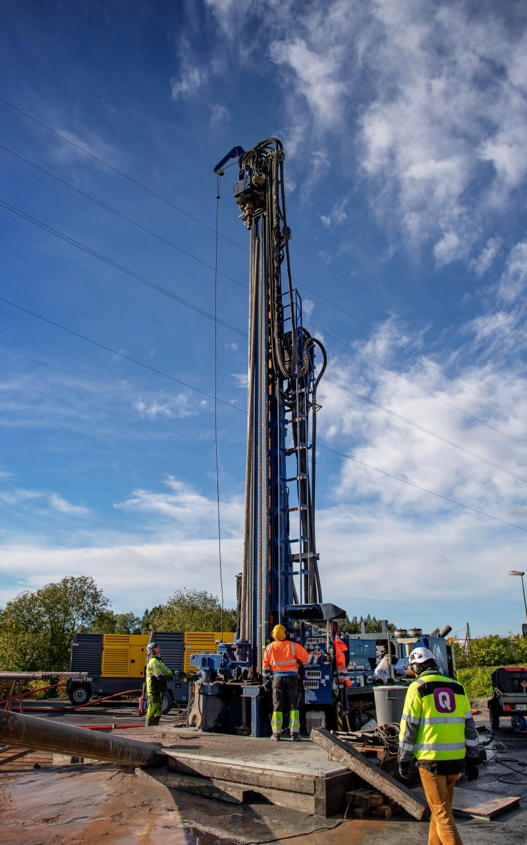
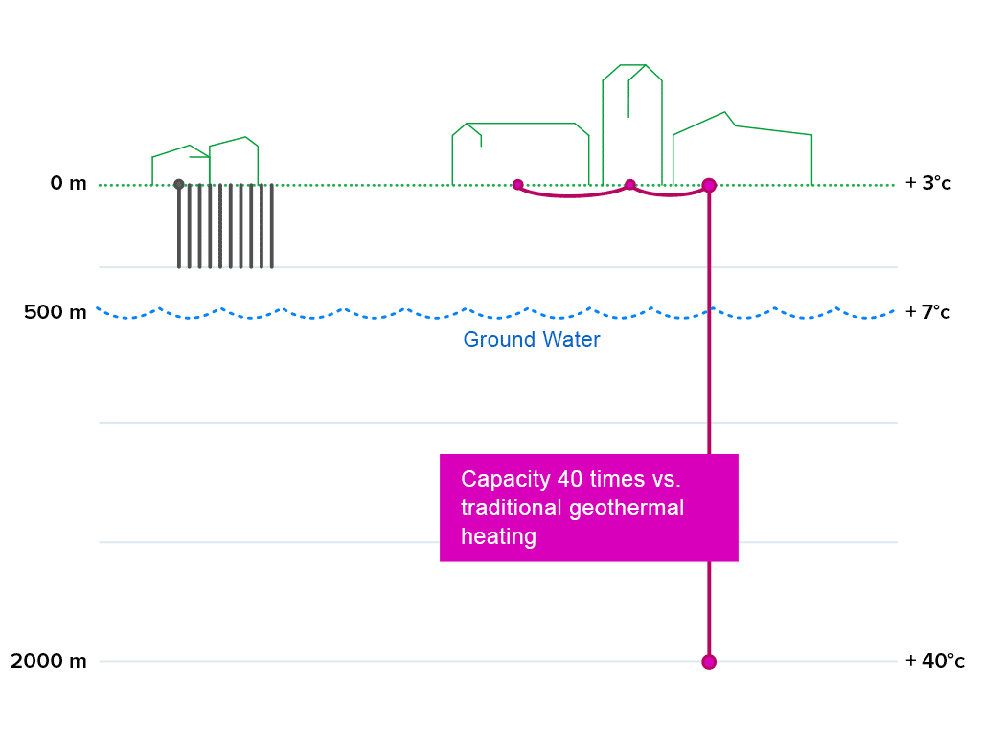
Geotherm – Semi depth wells
Notes:
Waiting for the first project to complete the installation -> the drilling is the problem

Slide 24
Thank you!
www.oilon.com
www.valmor.si
ziga.debevec@valmor.si / jussi.aplua@oilon.com

