Slide 1


HydronicS Machine
System innovations and solutions making DH systems efficient
with low-cost investment and maintenance
Amer Karabegović, Danfoss
amer.kaabegovic@danfoss.com

Slide 2


We Build Green Cities
We believe in the power of water to capture, transfer and store energy – and that the green homes, buildings and cities will be based on the hydronic machines
Notes:
Verujemo u moć vode za hvatanje, prenos i skladištenje energije – i da će zeleni domovi, zgrade i gradovi biti zasnovani na hidrotehničkim mašinama.
Vjerujemo u moć vode da hvata, prenosi i pohranjuje energiju – i da će se zelene kuće, zgrade i gradovi temeljiti na hidroničkim strojevima
2

Slide 3
Welcome to
HydronicS
ystems
olutions
mart Components
oftware
Machine

Slide 4





HydronicS Machine
The HydronicS Machine is Danfoss term for integrating our broad portfolio of increasingly digital components, sub-systems, and digital services, so they work better together.
This will make it easier for our customers to make their hydronic systems more energy efficient and lower the cost of design and commissioning.
What is HydronicS Machine
The objective of the HydronicS Machine department is to speed up system innovation and improve our ability together with RD&E in HydronicS and Climate Solutions departments such as Application Systems and Technologies and digital Services to innovate and develop faster proof of concepts of such HydronicS Machine solutions.
The goal is to provide SCALE, SPEED AND SOLUTIONS in the DEN and to focus on transition with our customers.

Slide 5

Why digital?
“Customer expectations in terms of delivery time and quality of service are constantly growing, while the highly competitive environment pushes DEN companies to lower their prices.
The only way to survive in this environment is to enhance operations and lower internal costs. In order to make this possible, companies must transform and currently, digital transformation promises the best results.”

Slide 6
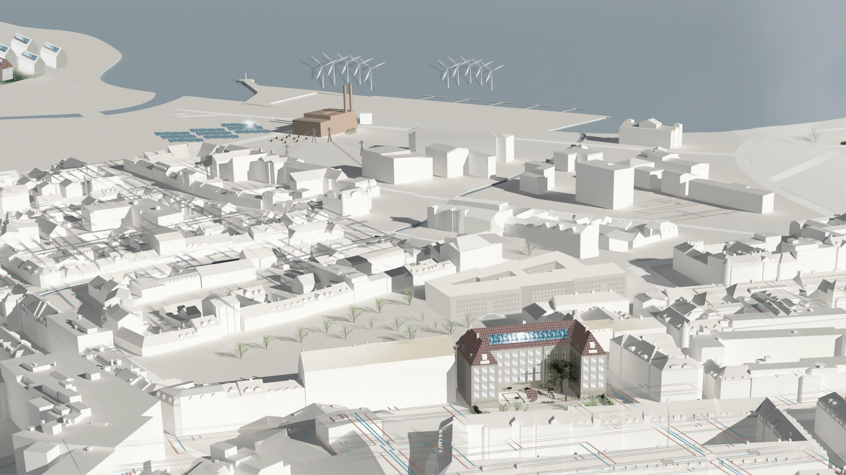
Why digital transformation?
Intelligent management of energy sources
Optimization of production sources and supply temperatures, ensuring the most cost-effective operation
Switching between energy sources, management of renewable and waste heat sources
Shift power production to periods with highest electricity prices to increase sales margin on electricity sale
Optimal use of energy storage
Calculation of best economical energy production mix
Optimal heat distribution
Improved control of temperatures, pressures and flows - in real time and remotely
Knowledge of transport times, heat loss, etc.
Optimization of energy distribution with auto-commissioning and continuous optimization of heating substations
Optimal network design, simulation
Predictive maintenance; reducing operating and maintenance costs and extending the life of valuable assets.
An algorithm based on artificial intelligence predicts the failure of essential components, for example, the heat exchanger, and ensures the correctness of the station.
Smart and efficient buildings
Collecting data from energy sensors and meters for demand forecasting (load forecasting)
Collecting indoor climate data and using building thermal capacity for demand response and peak load savings
Virtual Heat Storage

Slide 7
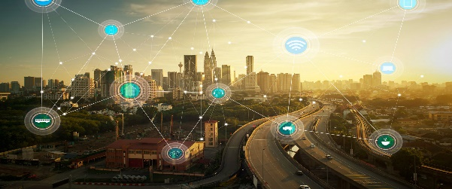
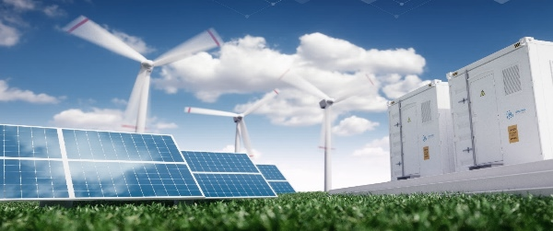
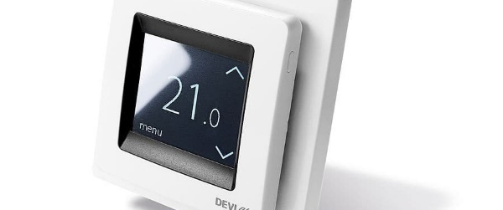
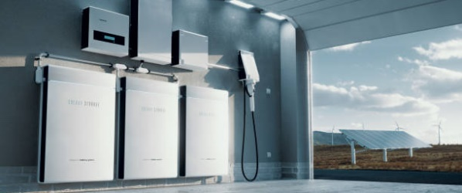
The FUTURE brings requirements DHS will have to adapt - these requirements are not exclusive to the new DHS but also apply to existing ones
Changing characteristics
Multi Source
Flexibility
Low temperature
Prosumers
Networks will increasingly move from single source base-load production (typically CHP), to multi source systems, this allows DHUs to leverage (cost) benefits of different energy sources at any given time.
Networks will increasingly rely on integrating a variety of clean energy sources as well as sector coupling, requiring more flexibility due to the increasing volatility in supply. This allows the integration of cleaner but also more volatile energy sources.
Through improved technologies and lower heat losses, networks will operate with a lower supply temperature. Hydronic optimization of secondary side is critical. Current commissioning of heating systems are inefficient.
DH networks will be an open system where all actors could be producers or consumers of heating energy. Increasing need to integrate district energy with buildings: Better balance grid and Utilize surplus heat. Utilize thermal storage capacity in buildings.
District heating systems/networks are faced with a huge challenge. How to answer on future configuration of the networks, which should be able to operate according to low electricity prices at certain times, and according to lower heat production prices driven by demand/offer than electricity prices?
How to enable the most from renewable sources? How to integrate heat pumps in DEN in the most optimal way?
Networks need to be flexible and dynamic-driven, enabling switch from one to the other scenario.
Challenge for designers to properly dimension systems. Digitalization increases integration complexity. Demand for modules and more integrated systems (HydronicS Machines) to improve energy efficiency, speed up installation and reduce complexity – SCALE, SPEED and SOLUTIONS.

Slide 8



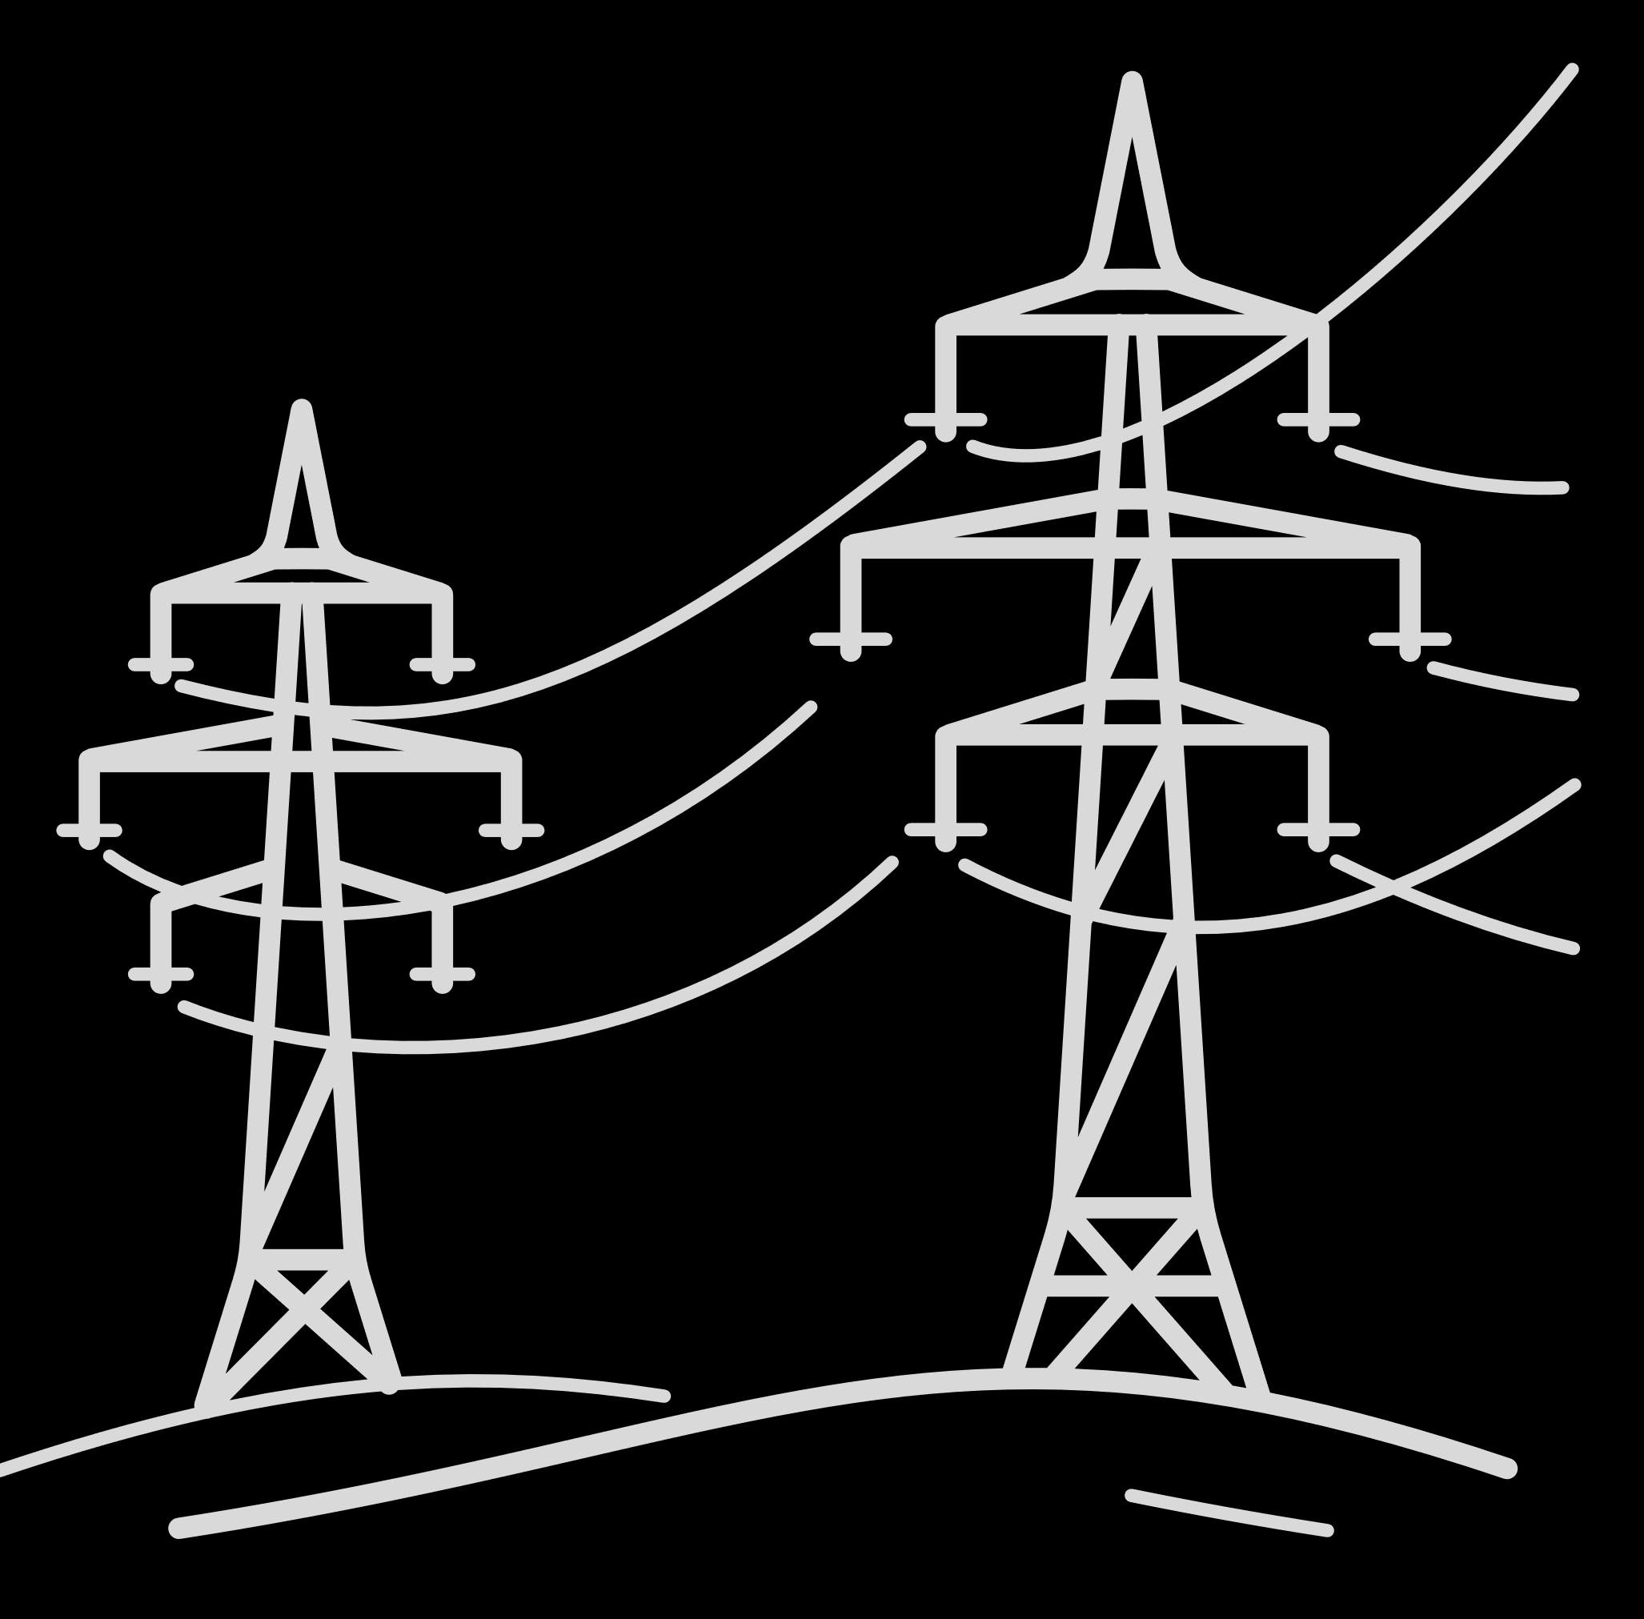

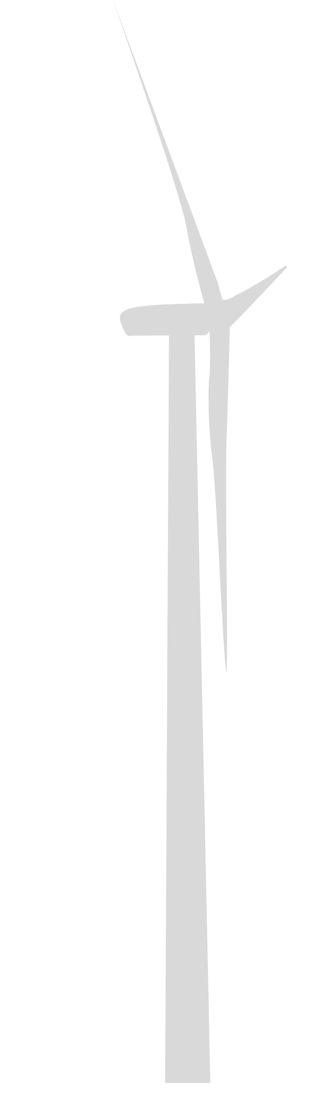













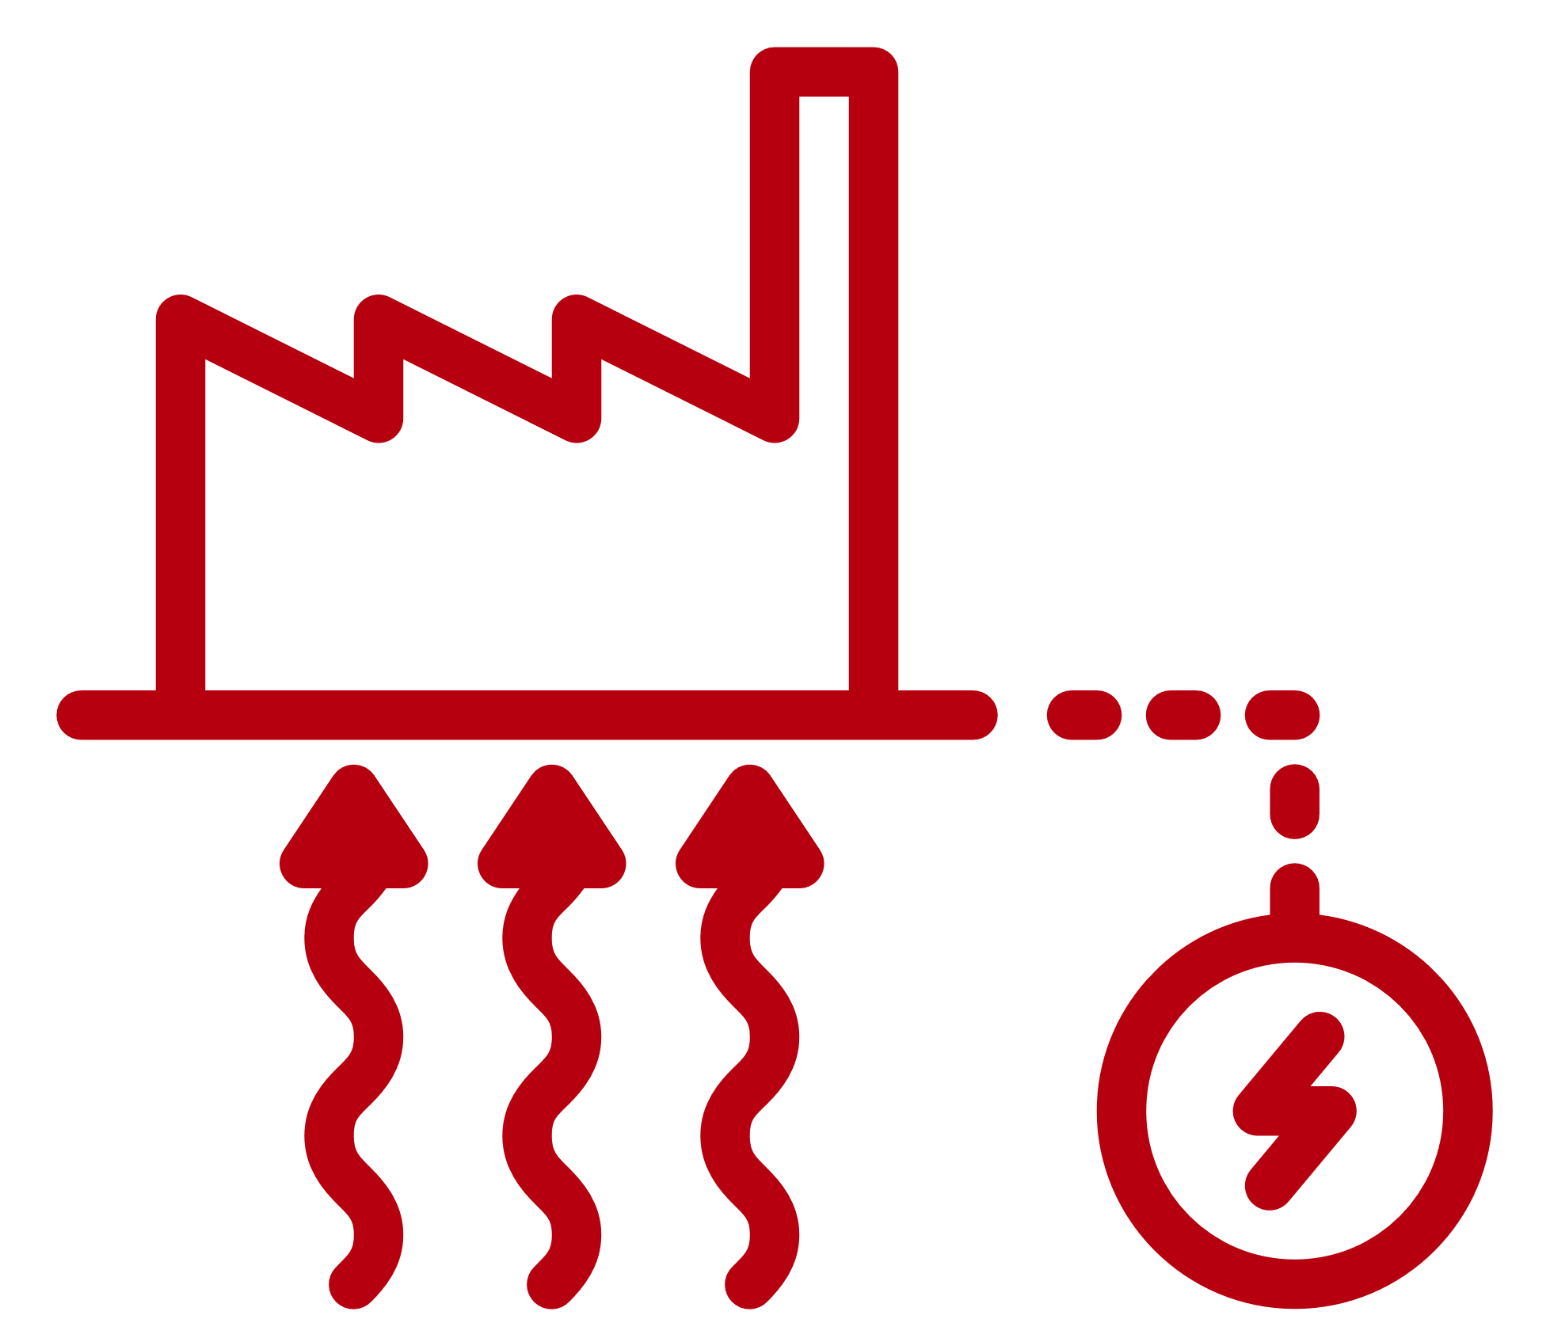


Without INTEGRATION, there is no decarbonization
and no future of the energy sector...
Gas and oil
Biofuel
Cogeneration CHP with coal/gas
Wind
Power-to-Heat
Solar-thermal with seasonal storage
Biofuel CHP (backup)
Waste incineration
where DEN is a key
INFRASTRUCTURE...
Biomass
Photovoltaics
Wastewater treatment
and HP is a key DRIVER.
Excess heat/Data centers
Hydropower
Industrial heat pumps
Industrial waste heat
Notes:
8

Slide 9
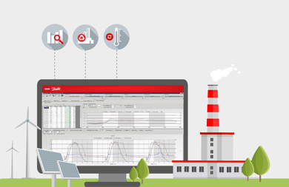
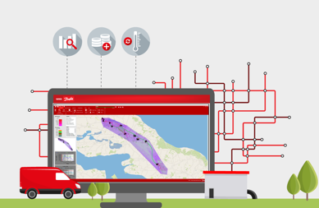
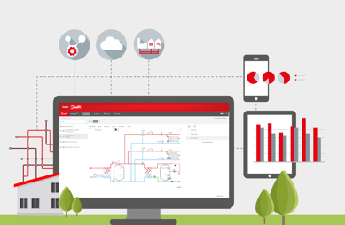
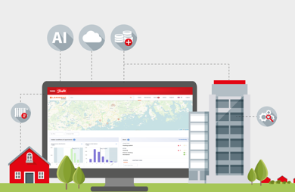






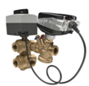










Why Danfoss HydronicS Machine?
A complete portfolio of digital components, subsystems and services for end-to-end optimization as a HydronicS Machine.
Leanheat® Production
Leanheat® Network
Leanheat® Monitor
Leanheat® Building
Data API HUB
AI Engine
Primary Side
(Planning, Network operation, Production)
Secondary Side
(Buildings)
Heat
exchangers, line components
Motorized valves
Self acting
diff. pressure controls
Smart substations
Intelligent controllers
Heat
meters
eTRV
NovoCon®
Notes:
So why did Danfoss decide to develop SW as part of our total product portfolio? This was a strategic decision as part of our digitalization strategy. Danfoss wants to be seen not only as a component and HW supplier, but also as a solution provider. Our SW portfolio of products are mainly focusing on energy optimization. We offer the following solutions:, LHP, LHN, LHM and LHB. For this session we will focus on LHP.

Slide 10





03 HEAT PRODUCTION
primary fuels, CHP, RES, excess heat, waste incineration, wastewater treatment, heat storage
02 HEAT DISTRIBUTION
02
network, pump stations, heating substation, heat storage
03
01
what shapes
district heating systems
04 LEGISLATION
local heat supply regulations and decrees, national energy laws and regulation, EU directives, consumer protection law, DHS ownership, infrastructure ownership
01 HEAT CONSUMPTION
04
heating and DHW installation (housing, office buildings, hospital centers, sports centers, public buildings)
05
05 MARKET & DECISION MAKERS
prices, tariff system, city ​​administration, national regulatory agencies, international banks, DH company management, association of building and apartment owners, building manager
Notes:
10

Slide 11
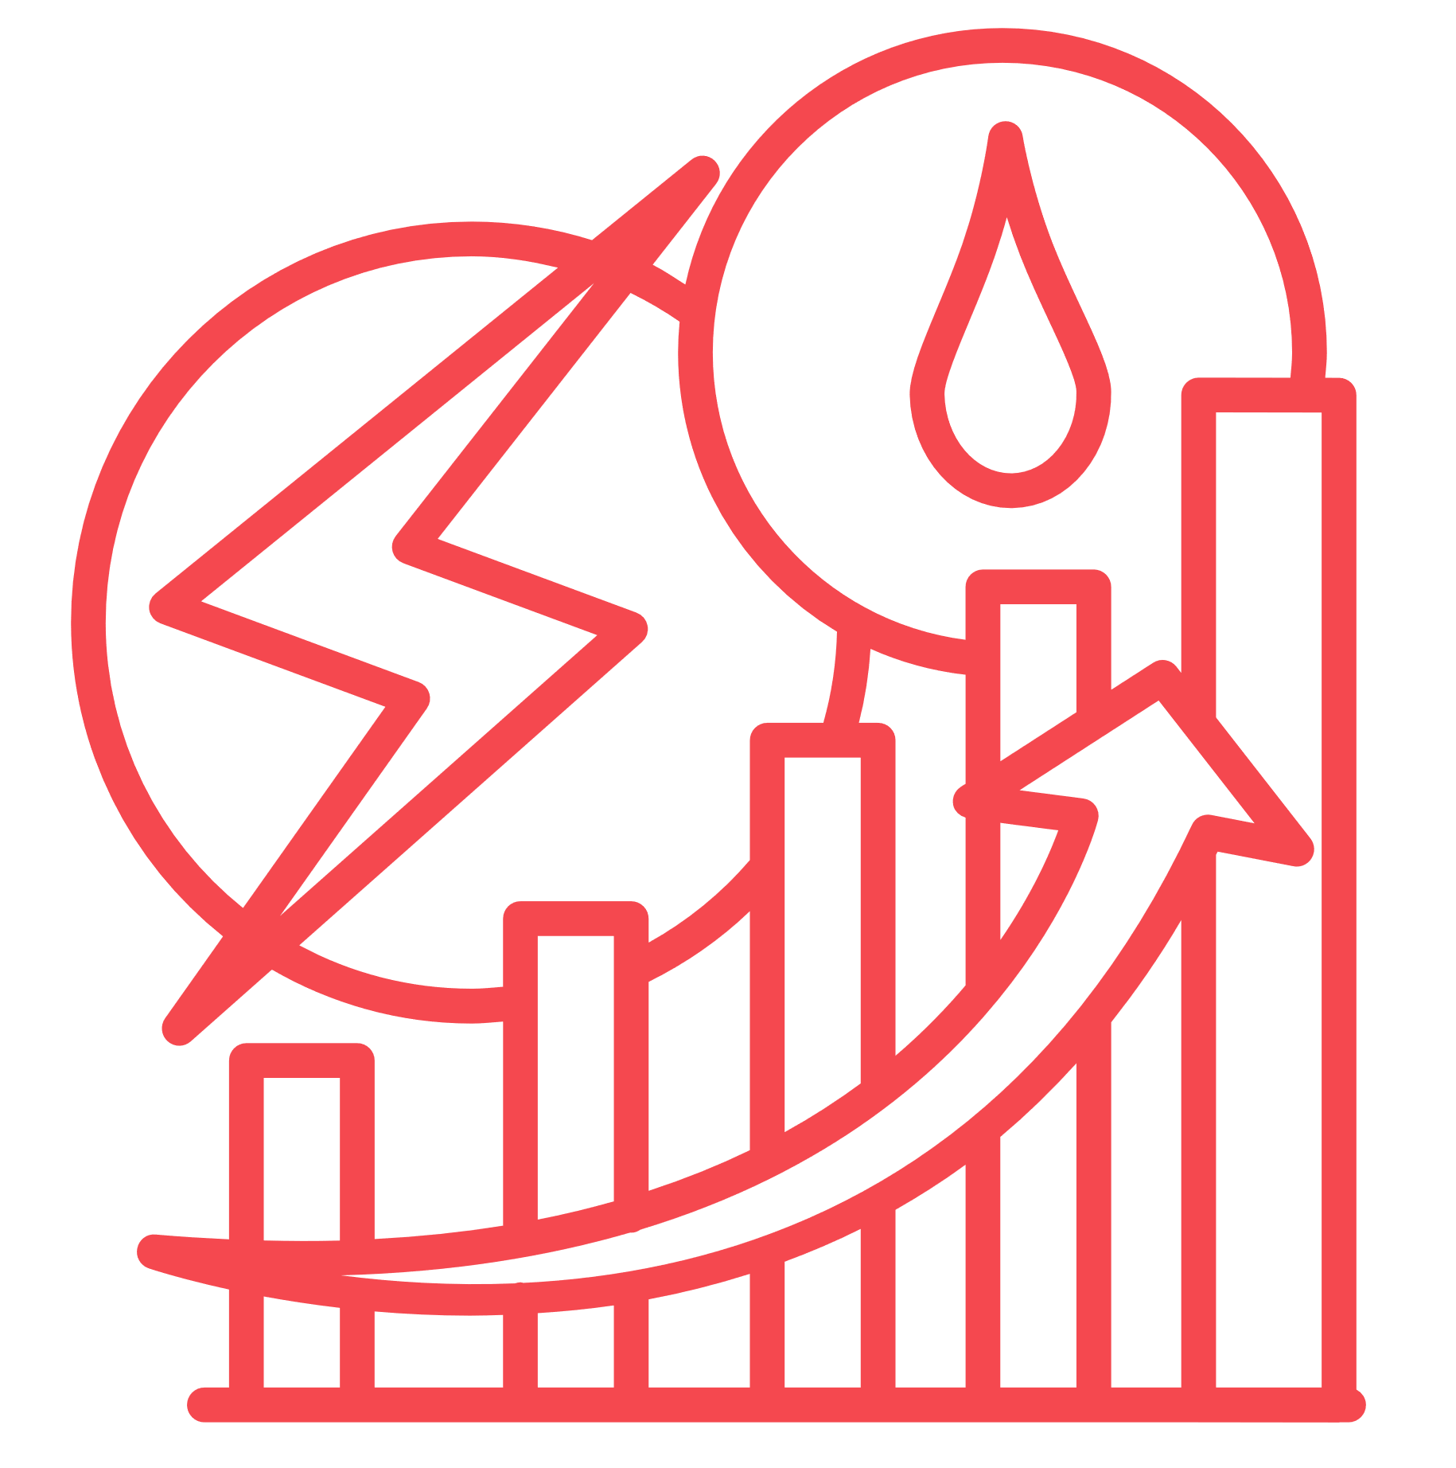



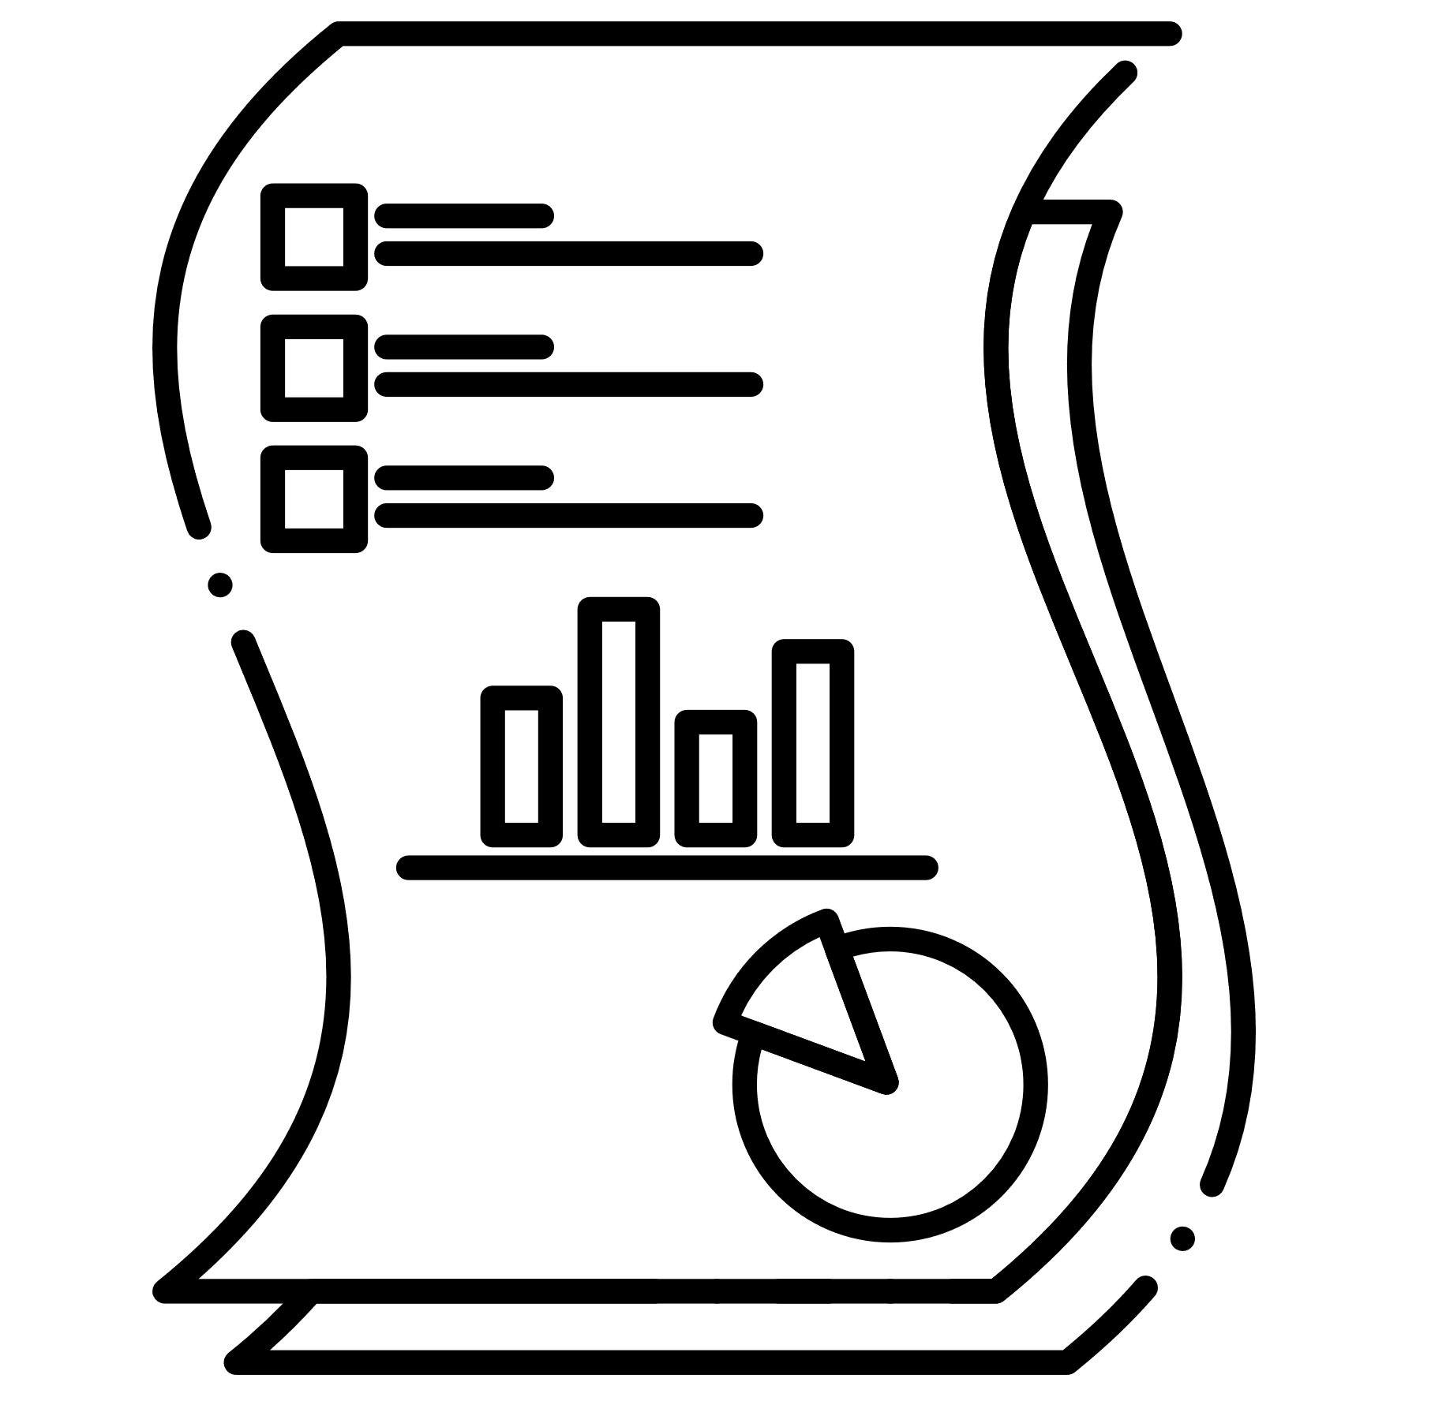


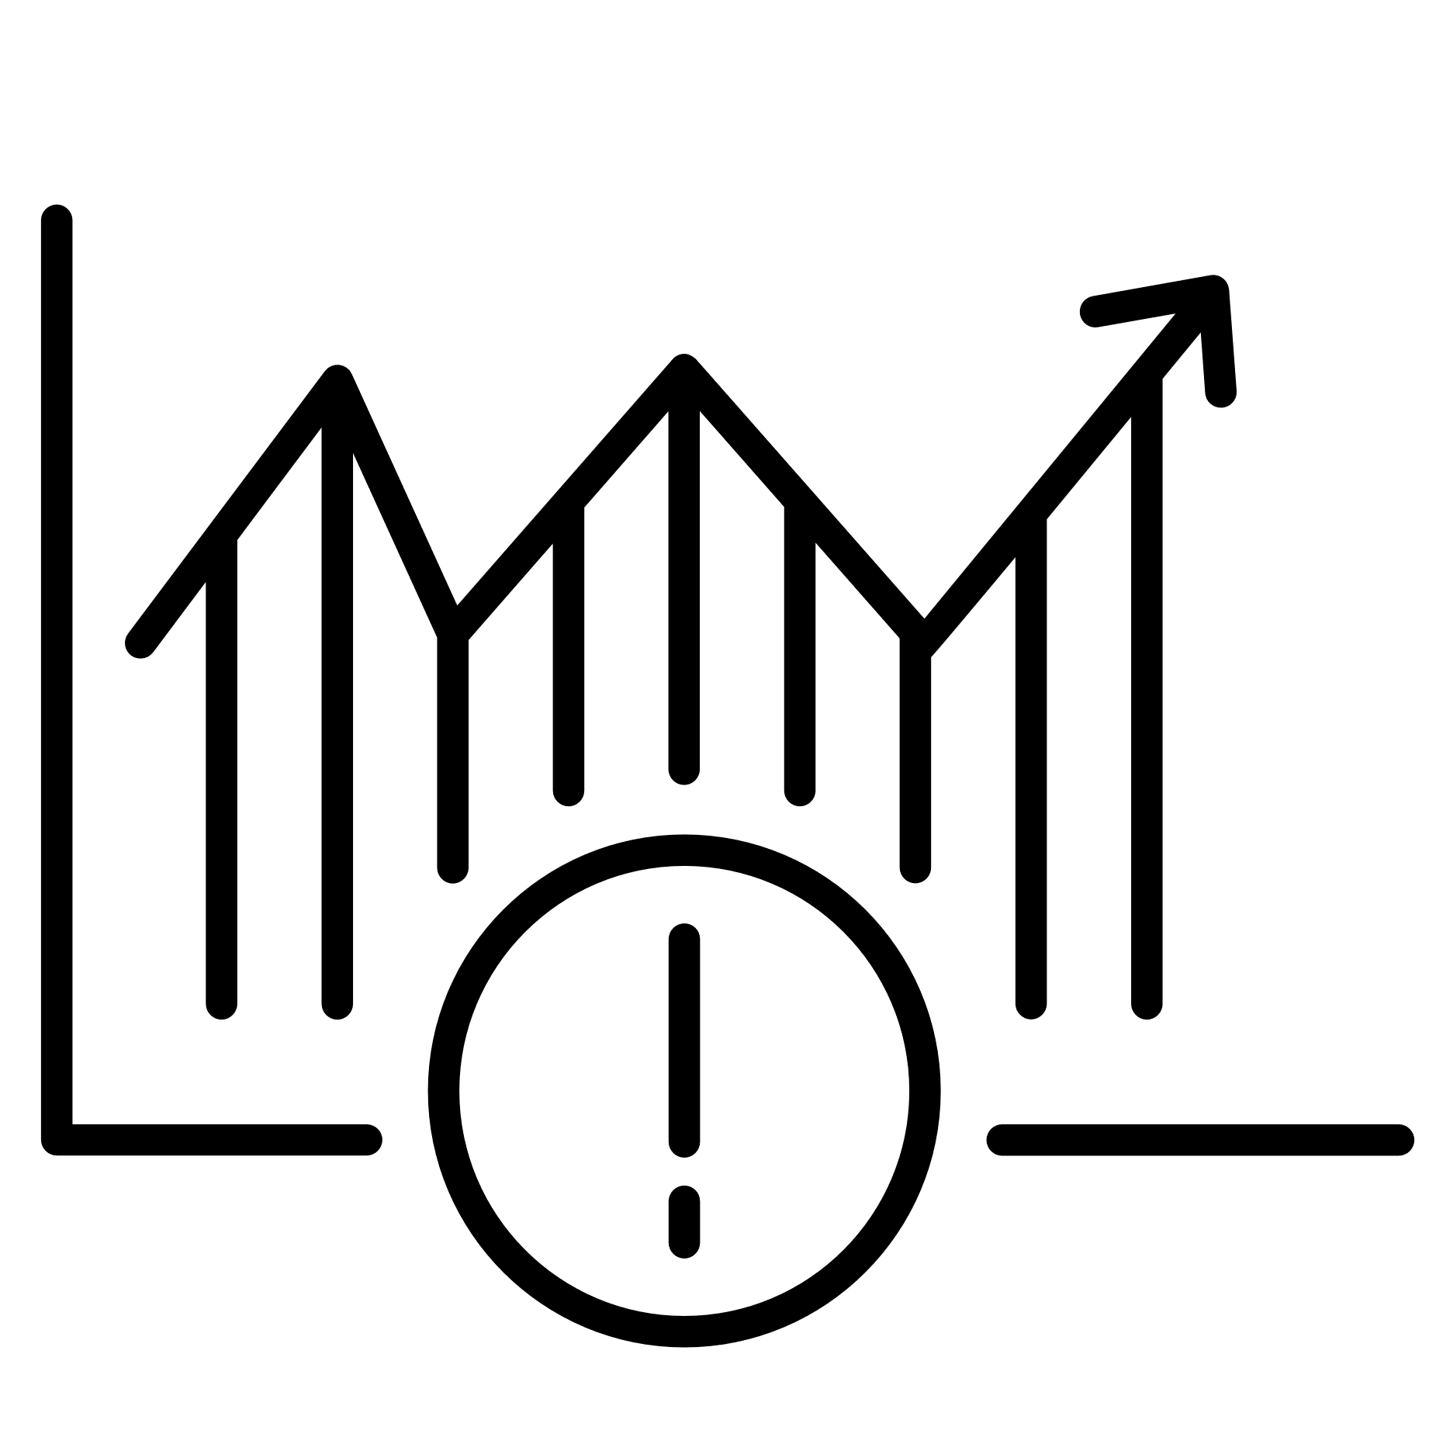
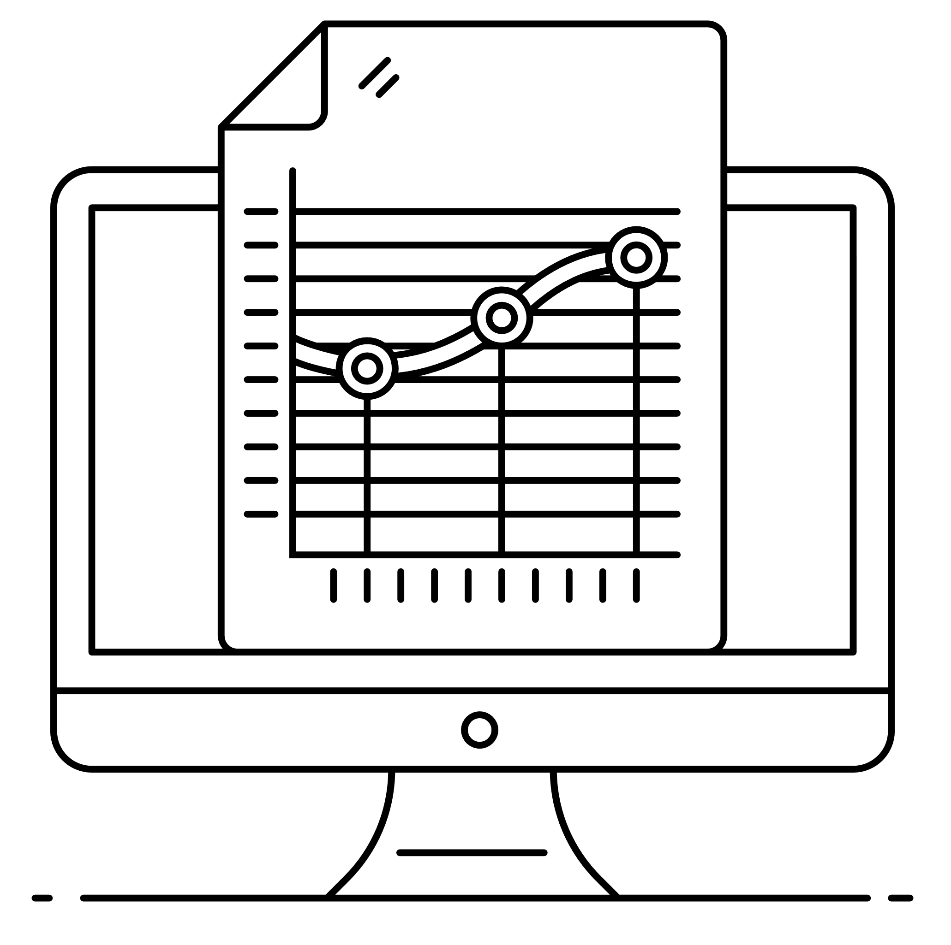
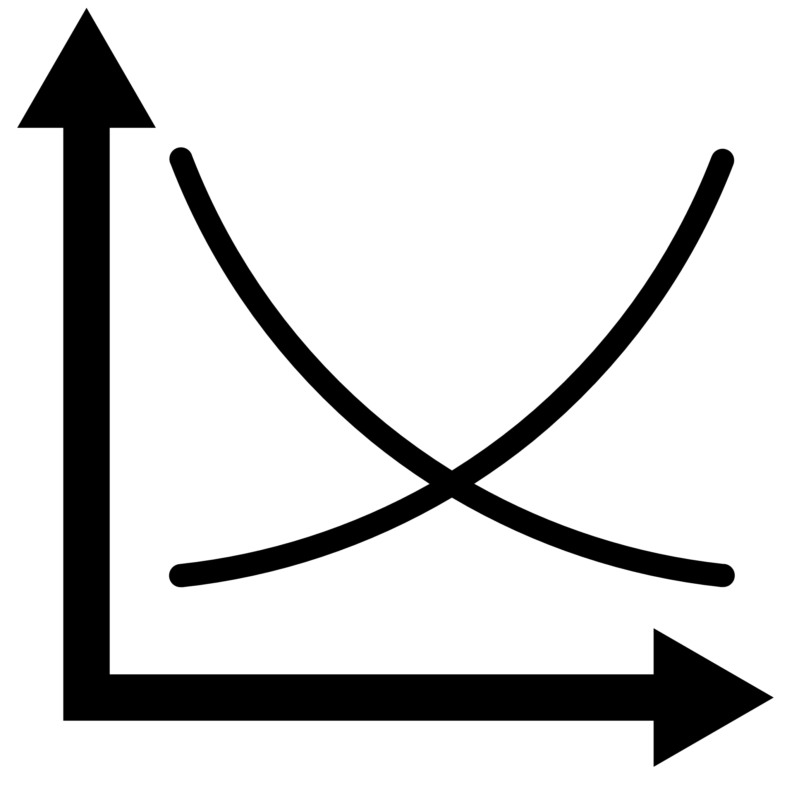

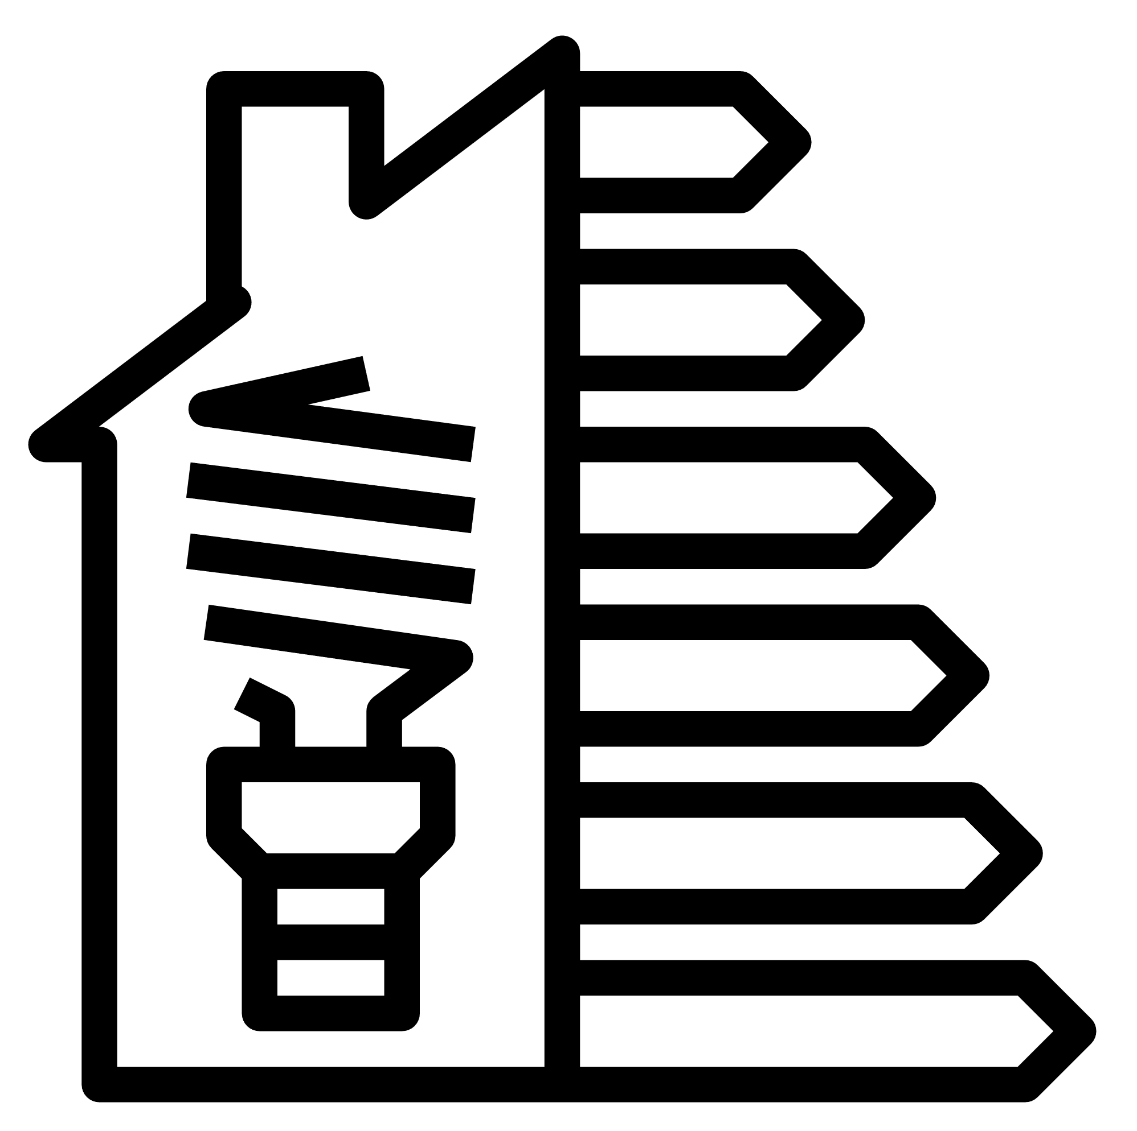

Heat consumption
legislation and regulation
building renovation status (yes/no, building physics, heating installation, ...)
Maintenance, balancing, commissioning
energy audit
obligation to provide 20°C±1°C
Danfoss HydronicS Machine
holistic approach
required heat and DHW
heat consumption profile
heat supply and demand
methodology for calculating the required thermal energy
quantity vs quality
customer satisfaction
characteristics of the building (year of construction, type, purpose, geometry,...)
system efficiency
customer engagement
building energy ratings
AI-controlled building
Notes:
Danfoss is providing comprehensive solutions and knowledge support to make transition and achieve sustainability.

Slide 12
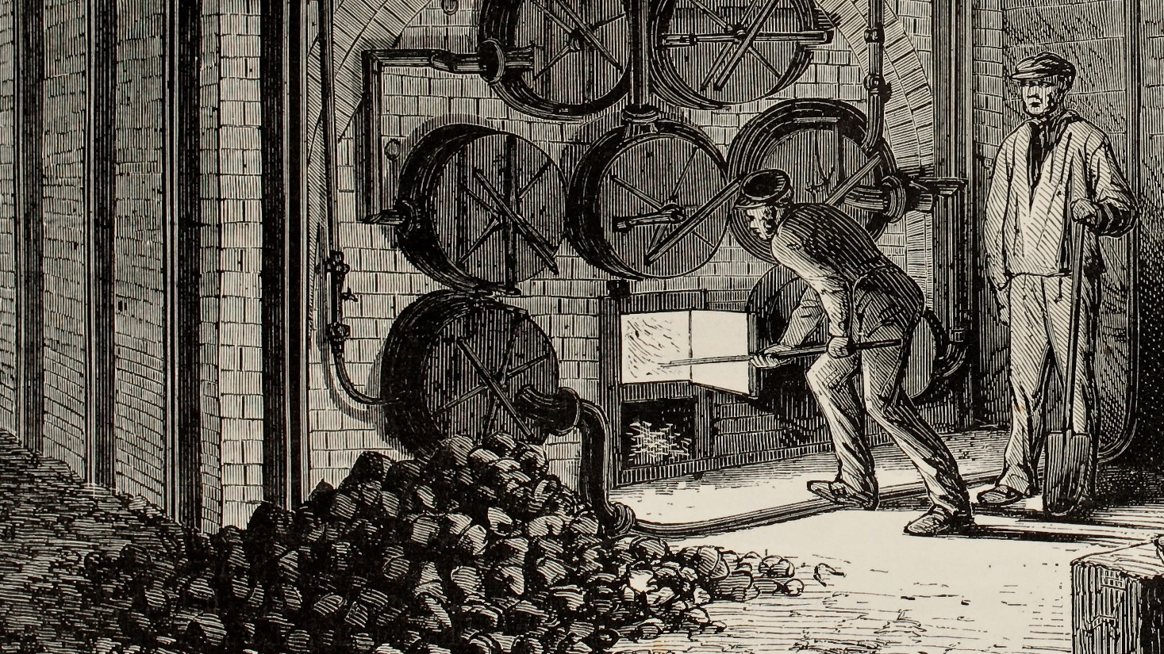






Before modern heating systems
1970 -
Janitors manually adjusting
the heating level
Weather compensated control
using pre-defined heating curves
Heating control of centrally heated buildings
Today
Danfoss Leanheat® Building
1990 -
Traditional weather compensated control
with remote monitoring

Slide 13
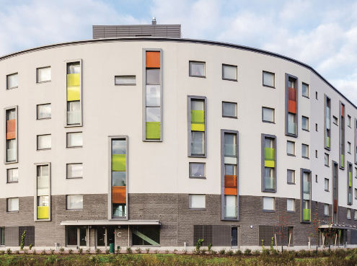




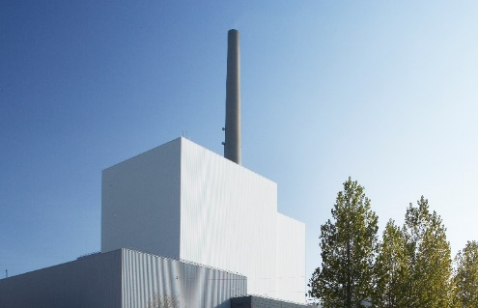

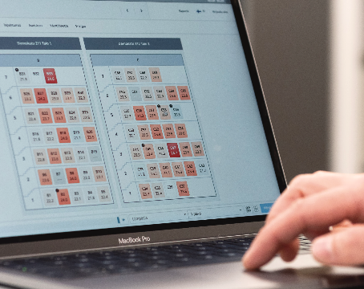



Danfoss Leanheat® Building in a nutshell
Improves
the energy efficiency
of properties
Artificial intelligence
based IoT solution
Increases
the operational efficiency of district heating companies
Monitors, controls and optimizes
Creates
a healthier indoor climate
Notes:
Danfoss Leanheat^{â} Building is an artificial intelligence based IoT solution
that monitors, controls and optimizes the indoor temperature and humidity of district heated buildings.
The solution improves the energy efficiency of properties, increases the operational efficiency of district heating companies and creates a healthier indoor climate for residents.

Slide 14
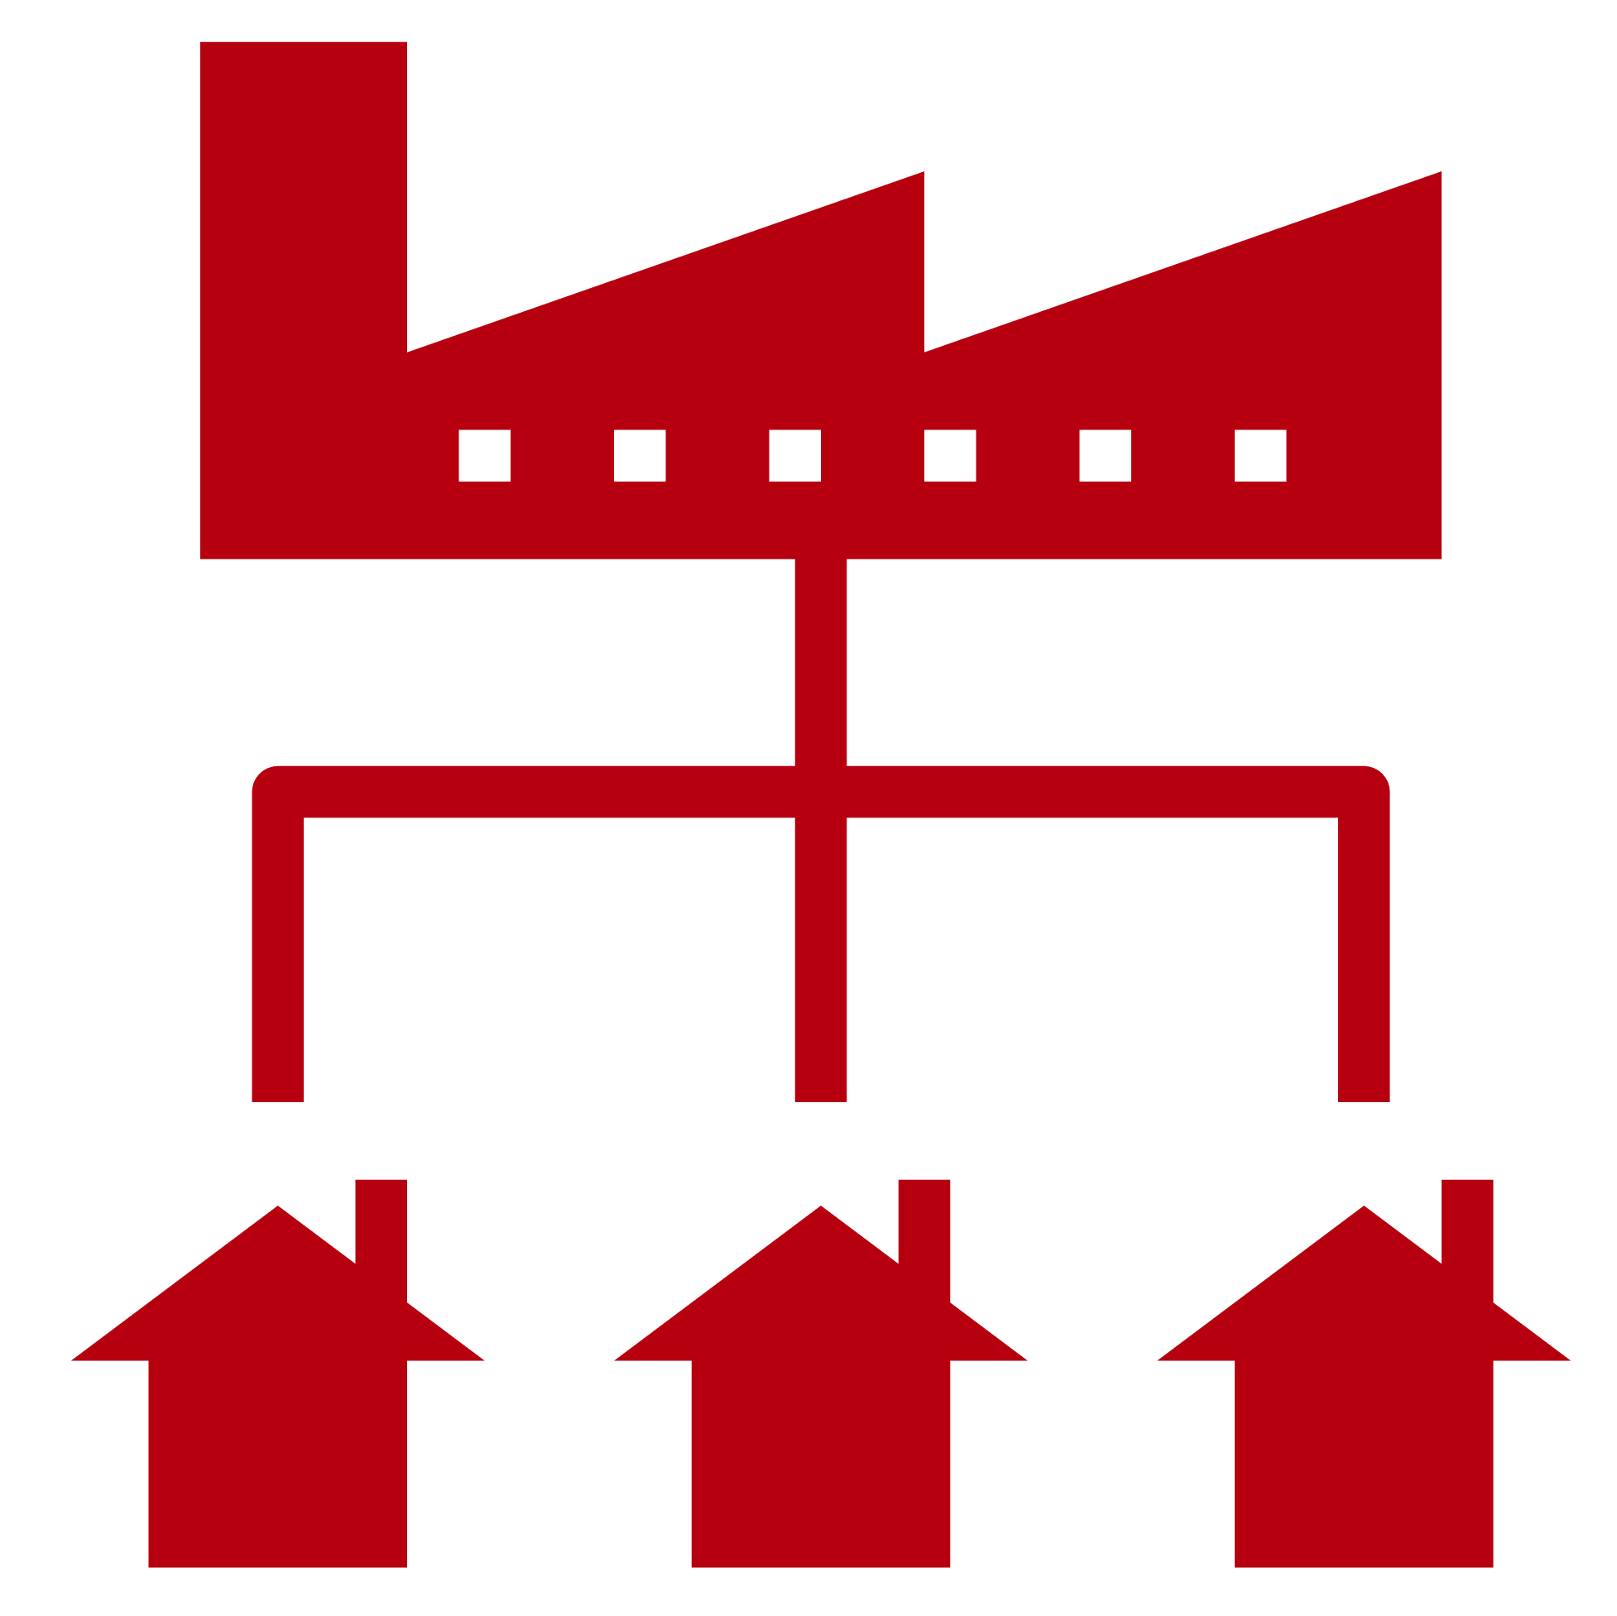


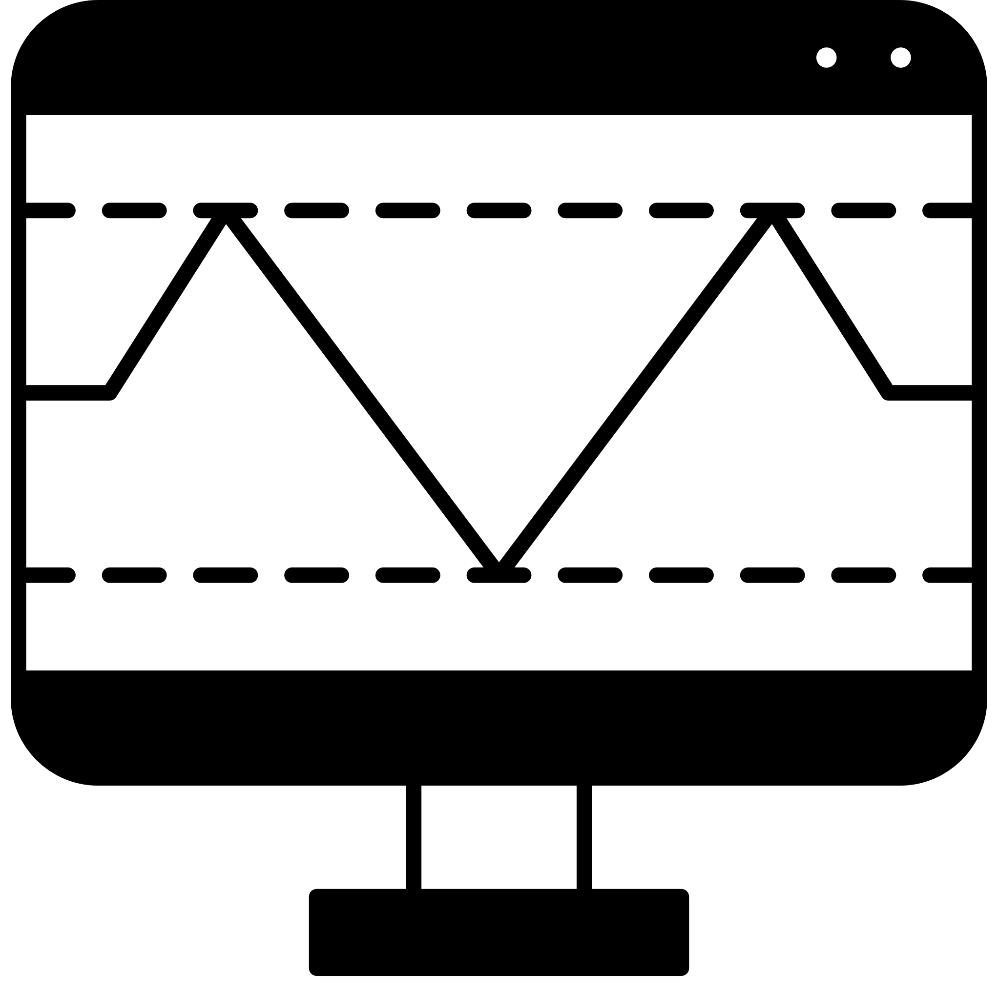







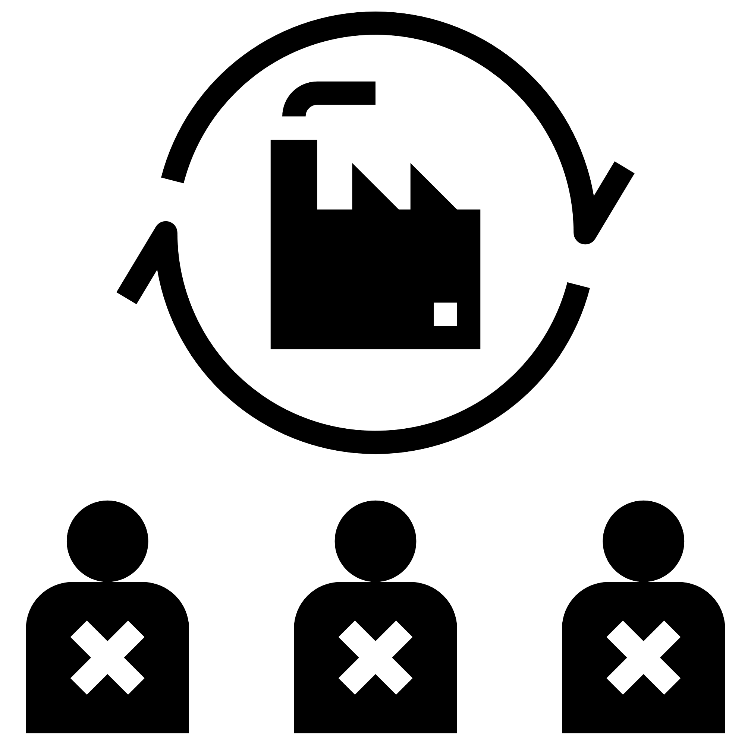

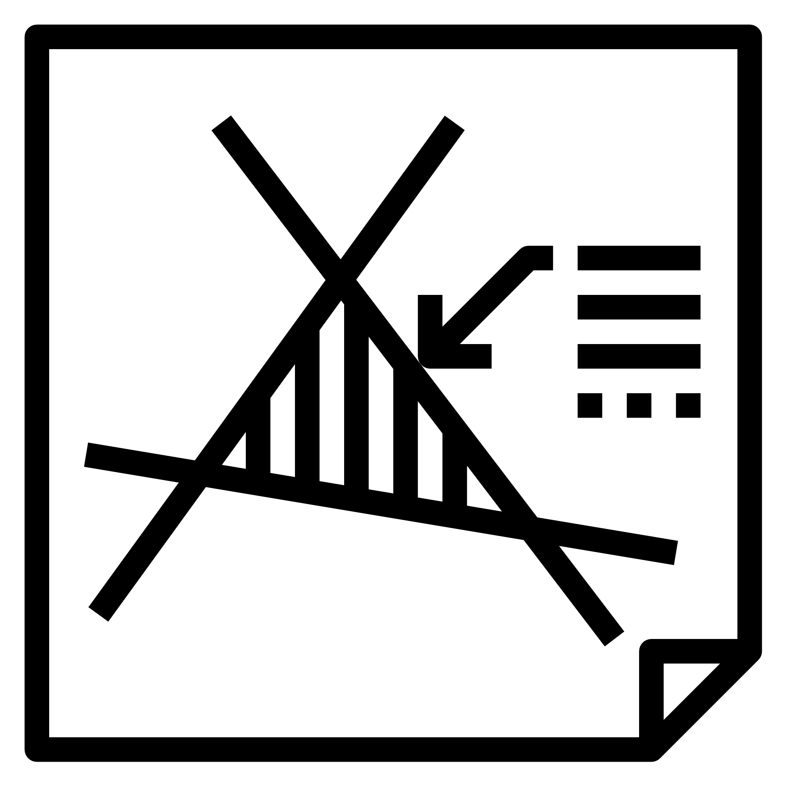
Heat distribution
legislation and regulation
primary energy source prices, availability, reliability
renewable energy
Heat production
network expansion, new connections
GHG emission targets, Carbon boarder tax (CBAM)
Danfoss HydronicS Machine
comprehensive approach
asset management and measurements in real time
network flow rate and capacity
digital twin
the age of the pipes, network sectioning, network balancing
on-line control and optimization
energy availability
characteristics of the production units (efficiency, flexibility, heat storage, …)
the most economical schedule of production units
units' availability, technical limitations
ensure the best energy price
Notes:
Danfoss is providing comprehensive solutions and knowledge support to make transition and achieve sustainability.

Slide 15
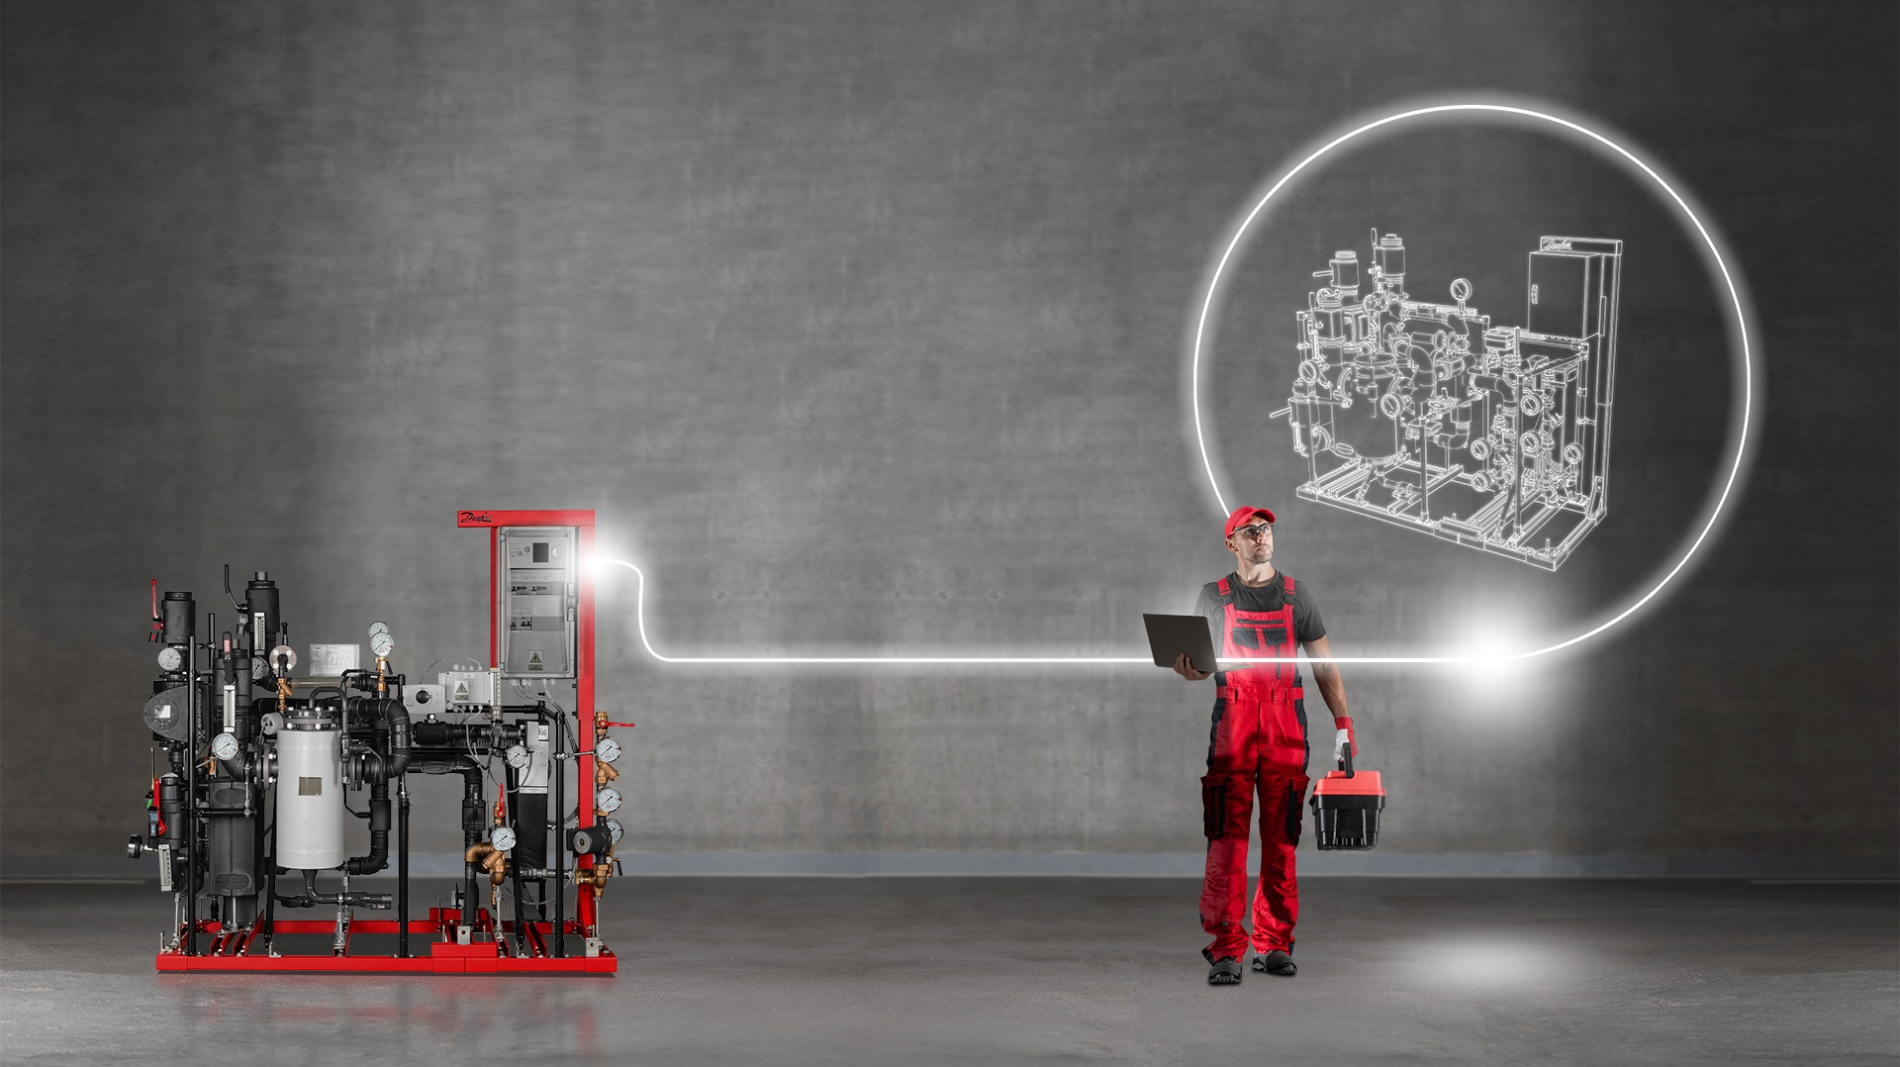
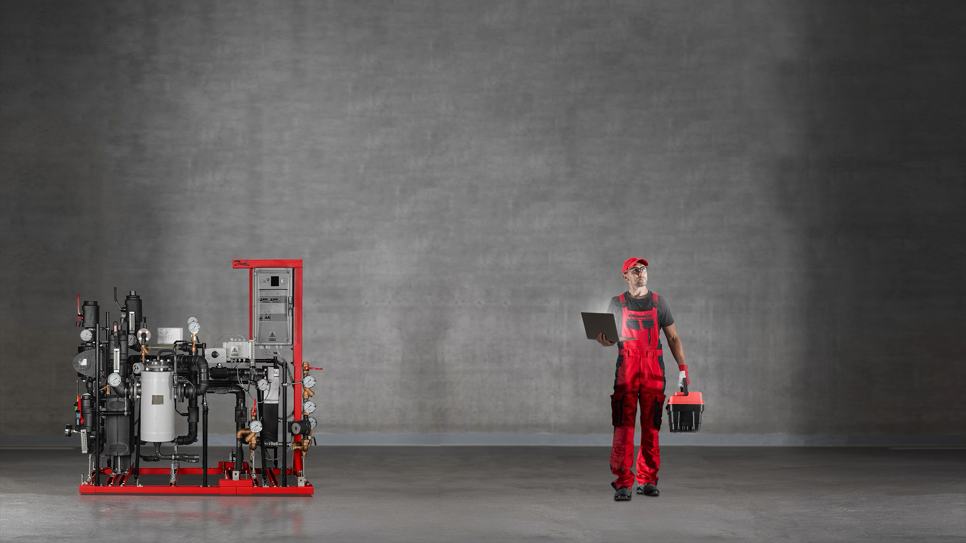
Enter a new dimension of district energy with
Titan™ by Danfoss
Digital sub-systems connecting digital components and services
Danfoss TitanTM combines best-in-class substations with digital twin technology
Intuitive, reliable, and continuous cloud commissioning
Best-in-class settings ensuring longer station lifetime
Optimum ΔT unlocking data-driven energy efficiency
100% Danfoss component-based station ensuring the highest quality and reliability
Titan™
by Danfoss

Slide 16
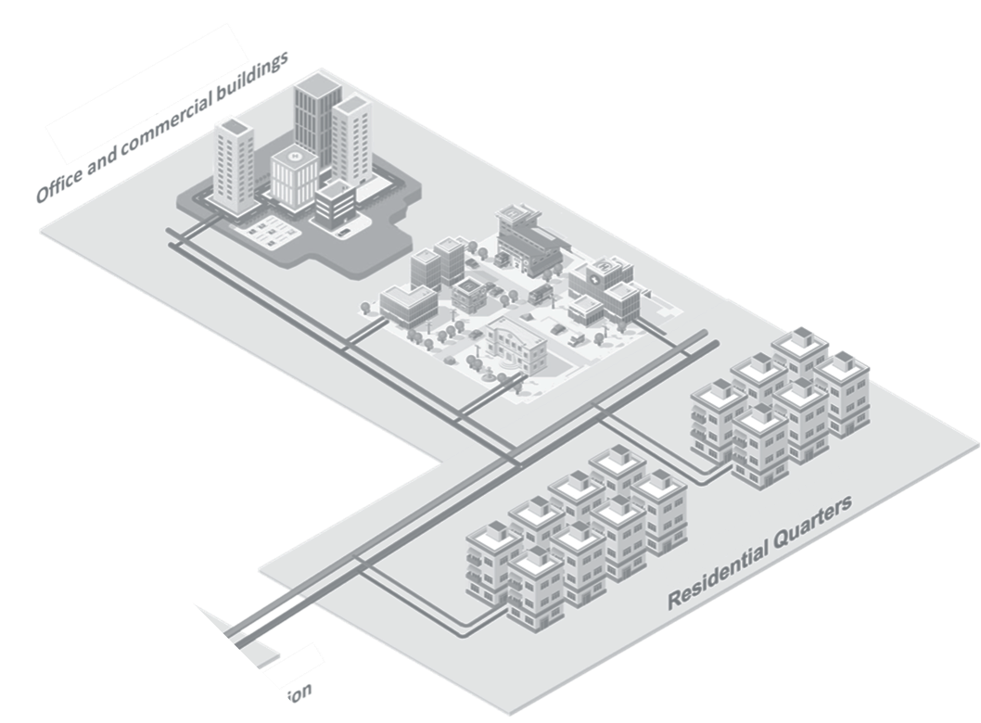
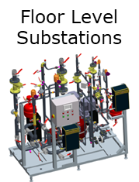



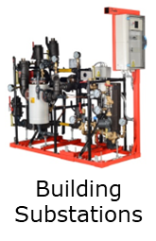
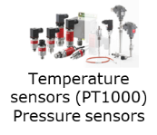


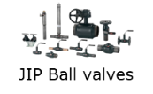
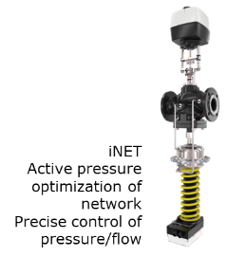



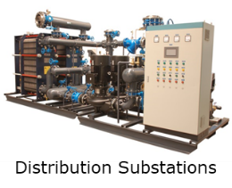


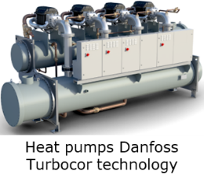

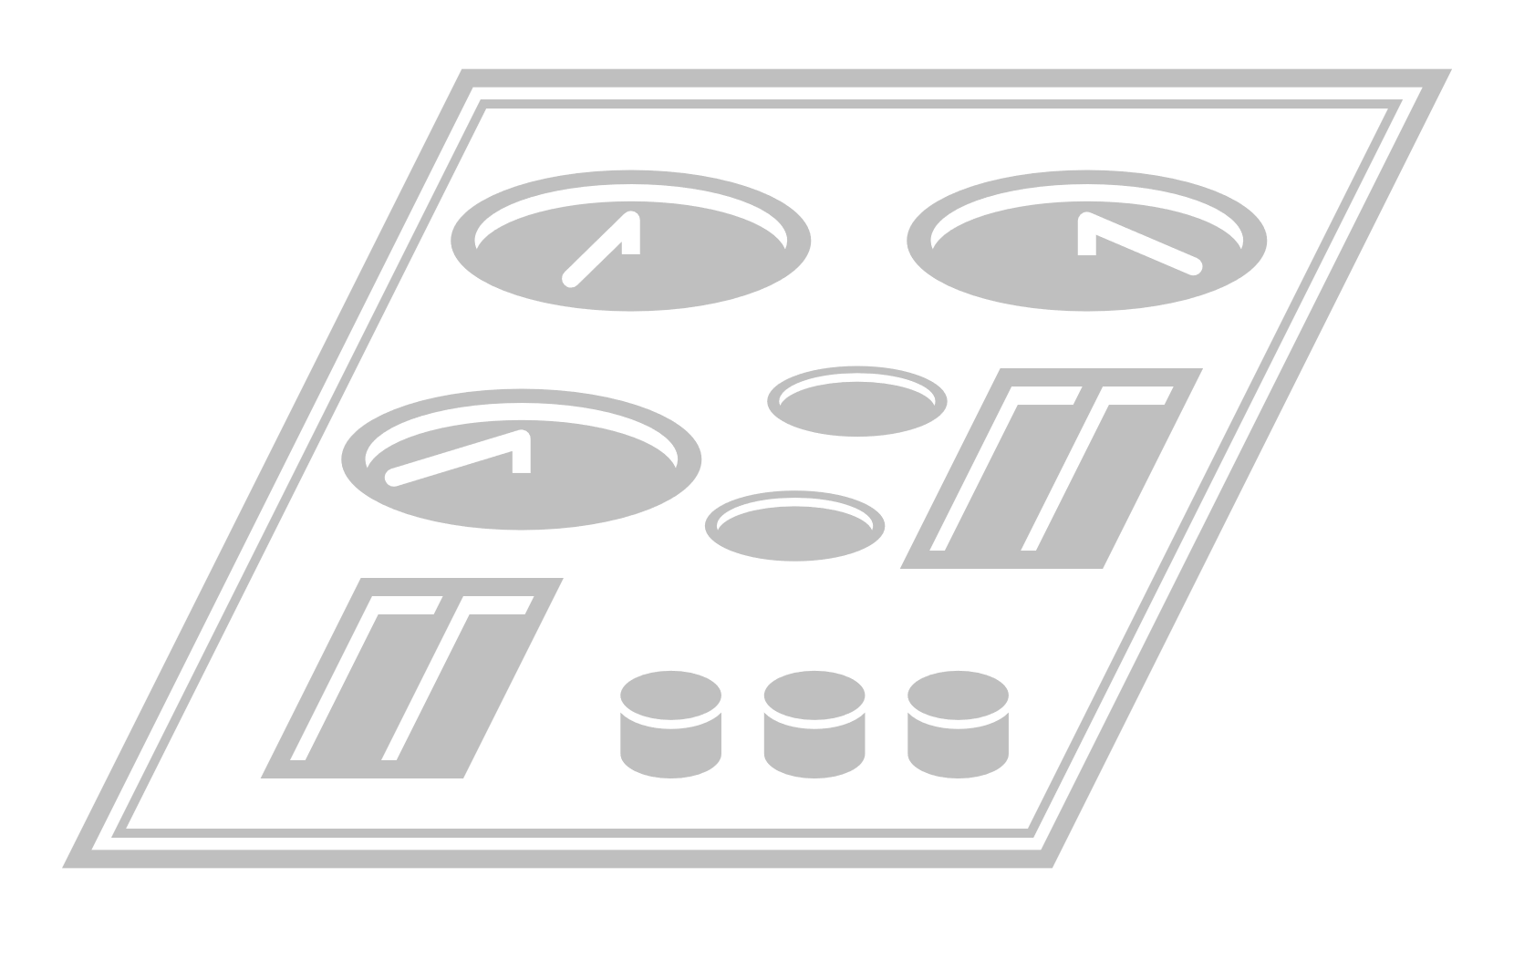



WWHP for different applications
in DEN supported by digital.*
Monitoring & Optimization tools
Peak shaving
demand response / demand side management
RT data monitoring and predictive maintenance
Self-commissioning and continuous optimization
Secondary loop/heat exchange unit
Virtual Heat Storage (VHS)
Primary DH network
Compact pre-assembled heating stations
Hydraulic portfolio
Heat station controls
High quality Ball valves
Sensors
Network optimization
Leanheat Building
Leanheat Monitor + TITAN
Leanheat Production
Oil-free WWHPs
Max. supply hot water temperature 67°C (75°C）
Large ΔT scenario suits DH network
Industrial waste heat
DHN return pipe
Geothermal
Hydronic Heat Exchangers (optional)
Indoor heating solution
Hydropower
Flat stations
Floor heating, fan coil and radiator solutions
Metering
Hydraulic balancing
Monitoring & Optimization tools
Calculation of best economical energy production mix
Supply temperature optimization in DHC networks
ΔP optimization in networks / lower pumping costs and dT improvement
Wind
Excess electricity
Leanheat Production
Leanheat Network
Leanheat Monitor
Wastewater/Sewage treatment
Excess heat/Data centers
* components, subsystems, services, solutions
Photovoltaics
Seasonal heat storage
Notes:
Together with heat pumps, Danfoss provides a complete range of advanced solutions and products, from production and distribution to final consumption. This includes software solutions for modeling, designing and optimizing district heating systems.

Slide 17
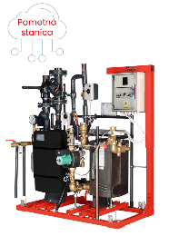
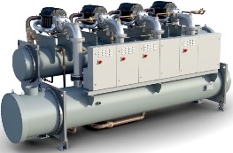
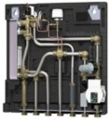


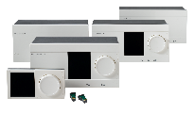
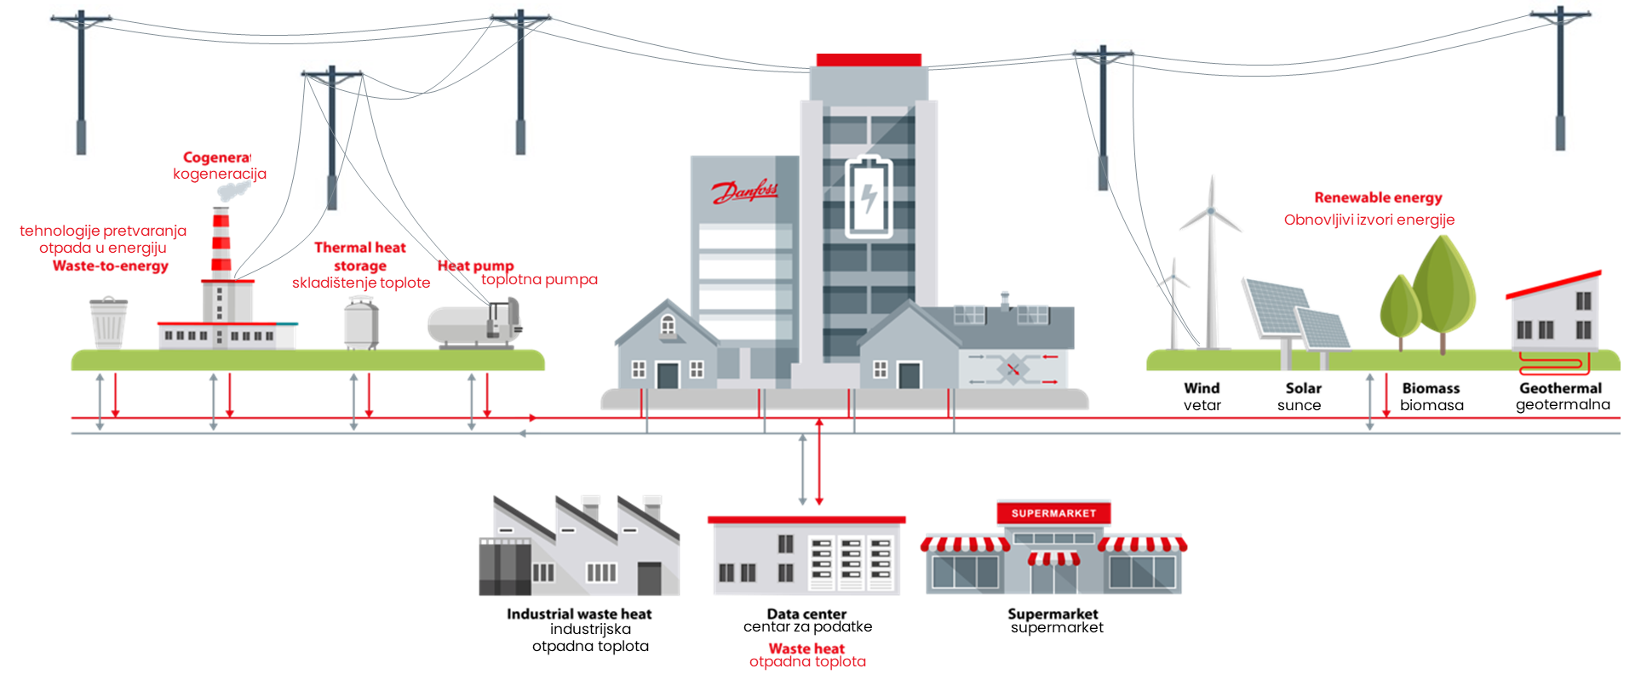

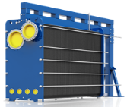
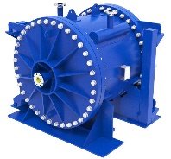
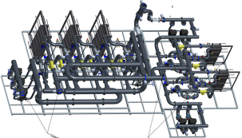
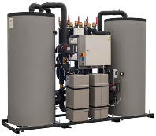


Monitoring & Optimization tools
Symbiosis System
Water-Water Heat Pumps
Processes
Wastewater
Excess heat
Excess electricity
Indoor heating solution & Hydronic Stations
Floor heating, fan coil and radiator solutions
Metering
Hydraulic balancing
Self-commissioning and continuous optimization
Monitoring & Optimization tools
ΔP optimization in networks / lower pumping costs and dT improvement
Peak shaving
demand response / demand side management
Constant data monitoring and predictive maintenance
Calculation of best economical energy production mix
Supply temperature optimization in DHC networks
Virtual Heat Storage (VHS)
Evo Flat MSS
Leanheat Building
Leanheat Monitor + TITAN
Leanheat Production
Leanheat Production
Leanheat Network
Leanheat Monitor
WWHP Turrbocor
Smart HDS
NovoCon® Digital actuators
ECLs
Danfoss Ally™
Symbiosis System
Water-Water Heat Pumps
Geothermal
Biogas
Active pressure optimization of network
Precise control of pressure/flow
iNet
WWHP Turrbocor
Hydronic Heat Exchangers
Heavy duty, efficient heat transfer for energy reuse
Heat recovery units
Intended for supermarkets, with an exchanger that converts CO2 heat energy into water heat energy, stores it, and sends it back to the system if necessary if there is a need for heating. Taking heat from the DHS, as well as sending the excess heat energy back to the district heating system.
2-way HDS
2-way (bidirectional) HDS, with 2 separate circuits: a circuit that takes heat energy from the network and a circuit that sends its own produced heat energy to the network.
GPHE
Spiral HE
Advanced components
Temp. sensors (PT1000)
Pressure sensors
Shut off valves
2-way HDS
HRU
Notes:
HydronicS Machine
17

Slide 18
Welcome to Hydronic Intelligence™
made easy with the Hydronic Machines™
Notes:
18

