Slide 1
9th biannual Danish District Heating Sector Visit to Vrnjačka Banja Seminar & workshops, 18 to 20 April, 2023 https://www.youtube.com/watch?v=_wQOzvw3ZZo

Slide 2
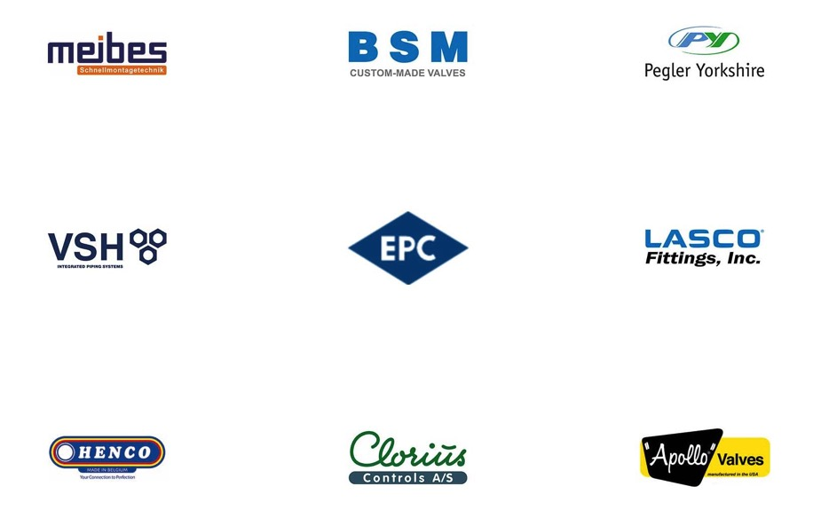









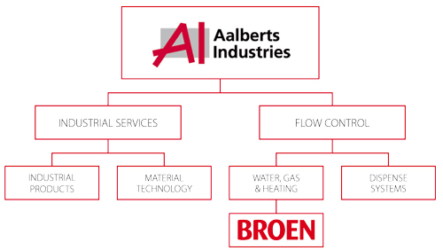

Part of Aalberts Industries (NL) Winning with People
Milestones Aalberts Industries
16,000 employees across 3 continents
150 locations in more than 20 countries
10 focus end markets
+2,694 mEUR revenue (2017)
Listed at EuroNext Stock Exchange, NL (AALB)

Slide 3
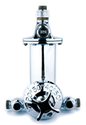
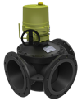
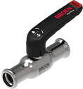


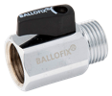
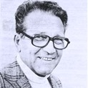

Our Story and Heritage Global leaders in valve technology – How did we get there?
Technology footprint
1950 PARCEO shower automat
1960 BROEN Ballofix®
1982 BROEN Ballomax®
BROEN Ballorex®
2004 New Ballofix®
2006 New 3-way valve Clorius Controls
2017 New BROEN valve platform
1948
BROEN was founded by Poul Broen
1993
Acquired by Aalberts Industries (AALB.AS)
1995
BROEN Russia
BROEN US
1997 BROEN SA (PL) (DZT valves)
1998 Acquisition of Clorius Controls
2003 BROEN China
2008 BROEN Oil&Gas
(ZAWGAZ and ARMATURA, PL)
2015
BROEN LAB divested
Business footprint

Slide 4
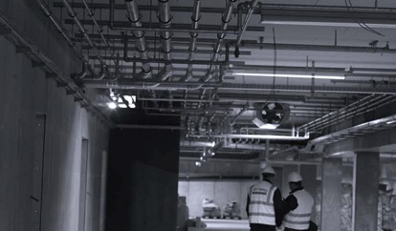
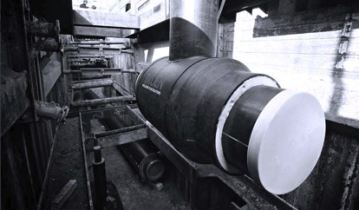
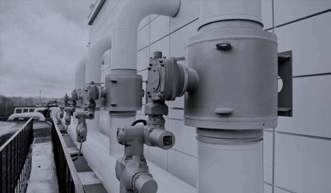
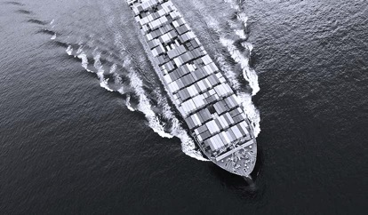
Our End Markets Where we add value
BUILDING INSTALLATIONS
DISTRICT ENERGY
NATURAL GAS
MARINE & POWER
Complete solutions for the distribution and control of flow in HVAC installations in residential, commercial and industrial buildings.
Distribution and transmission of district energy in residential, municipal and commercial applications.
Ball valve technology made to order for distribution and transmission of gas in energy applications.
Temperature and pressure regulation in maritime, offshore and energy applications.
BROEN Full Flow
BROEN Ballofix®
BROEN Ballomax®
BROEN Clorius

Slide 5
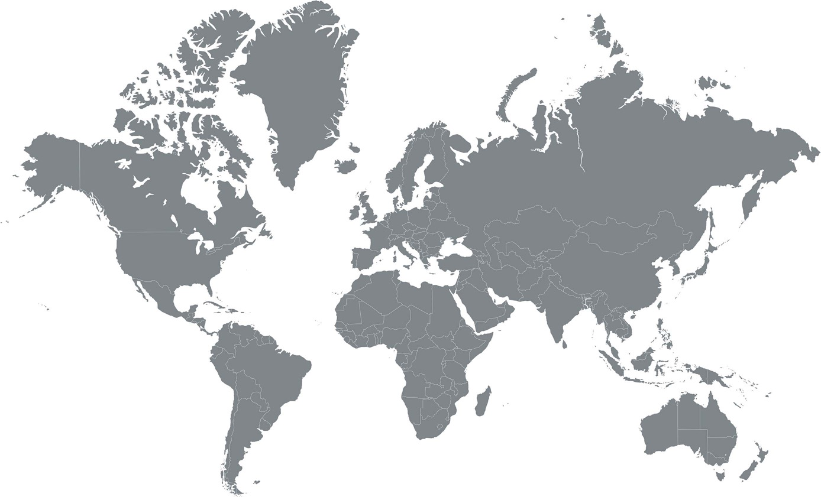
Our Global Footprint We focus our approach
Locations
Legal Headquarter in Denmark
Sales and Production Sites BROEN A/S, Assens (DK) BROEN SA, Dzierżoniów (PL) BROEN Natural Gas, Suchy Las & Rogoźno (PL) BROEN LLC, Kolomna (RU) BROEN INC., Houston (US) Clorius Controls, Dzierżoniów (PL)
Sales Offices BROEN Assens BROEN Stockholm BROEN Helsinki BROEN SEI, Rumania BROEN Beijing BROEN Moscow BROEN Clorius, Shanghai

Slide 6
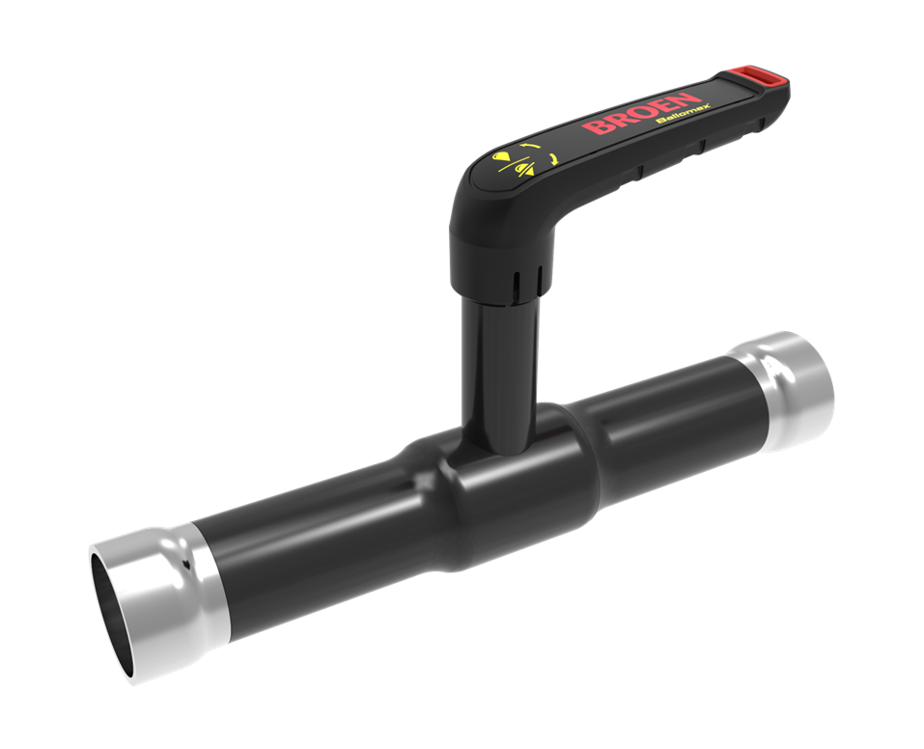

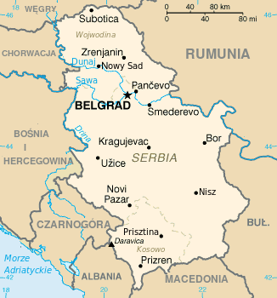

Our business partner in Serbia
Sedište / headquarters:
Dušana Vukasovića 80/22 11070 Novi Beograd, Serbia tel. +381 11 3347-542 +381 11 3347-582 mob. +381 63 27 47 75 www.komo-yu.com

Slide 7
Business Area District Heating and Cooling Energy

Slide 8
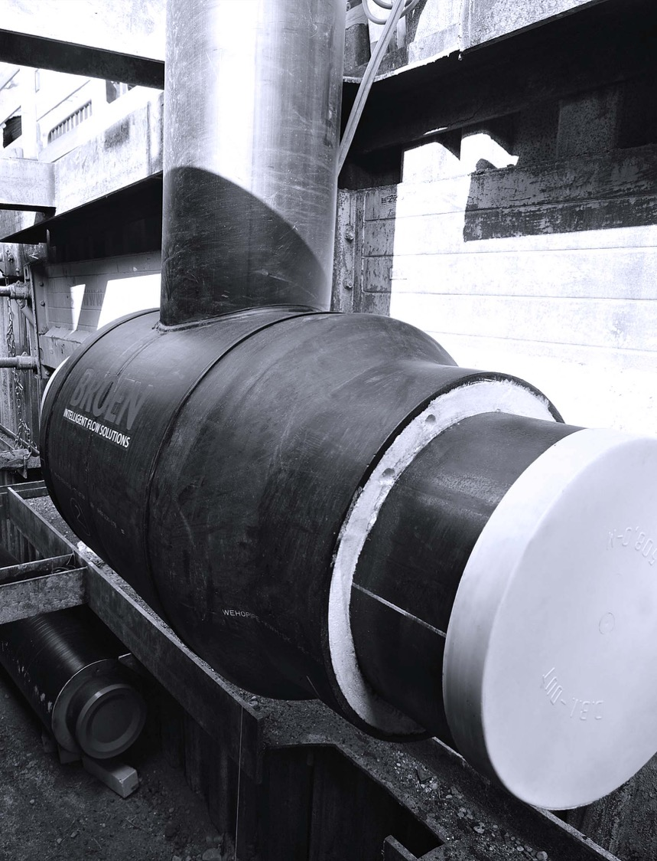
District Energy
BROEN offers a comprehensive range of BROEN Ballomax® ball valves and butterfly valves - combined with a range of actuators, gears, flanges, extension spindles and hot tapping tools.
Clients we serve
District energy companies
Contractors, consulting engineers and OEMs
Application examples
District heating and district cooling
How we add value
Proven quality, safety and reliability
Low cost of ownership
System and product knowledge
Energy efficiency is one of the greatest challenges of our time and for district energy BROEN delivers the proven answer of how to meet the globally rising demand for energy efficiency.

Slide 9
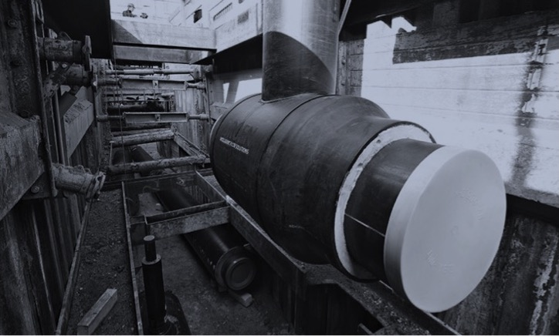
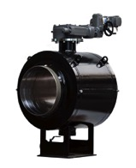
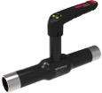
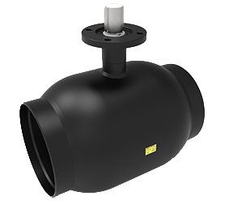
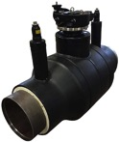
District Energy Scope of Supply – Energy Efficiency Designed to Last
Based on the innovative heritage of Danish district heating the BROEN Ballomax® ball valves are key components in district energy grids worldwide.
The line of Ballomax® ball valves is available in a range of different designs and dimensions – also for tough underground conditions according to EN488:2015-EHP003
( Certificate number 08/02 IMA Dresden Germany )
Full bore or reduced bore | DN10 to DN1400
Floating or trunnion mounted | Up to PN 40
Handle operation | Electric, pneumatic or hydraulic gear
BROEN Ballomax® - Designed to last
CE marked valves acc. to PED 2014/68/EU – Module H
Leakage tested EN12266
We add value with high quality solutions and reliable valve technology for district energy applications worldwide

Slide 10

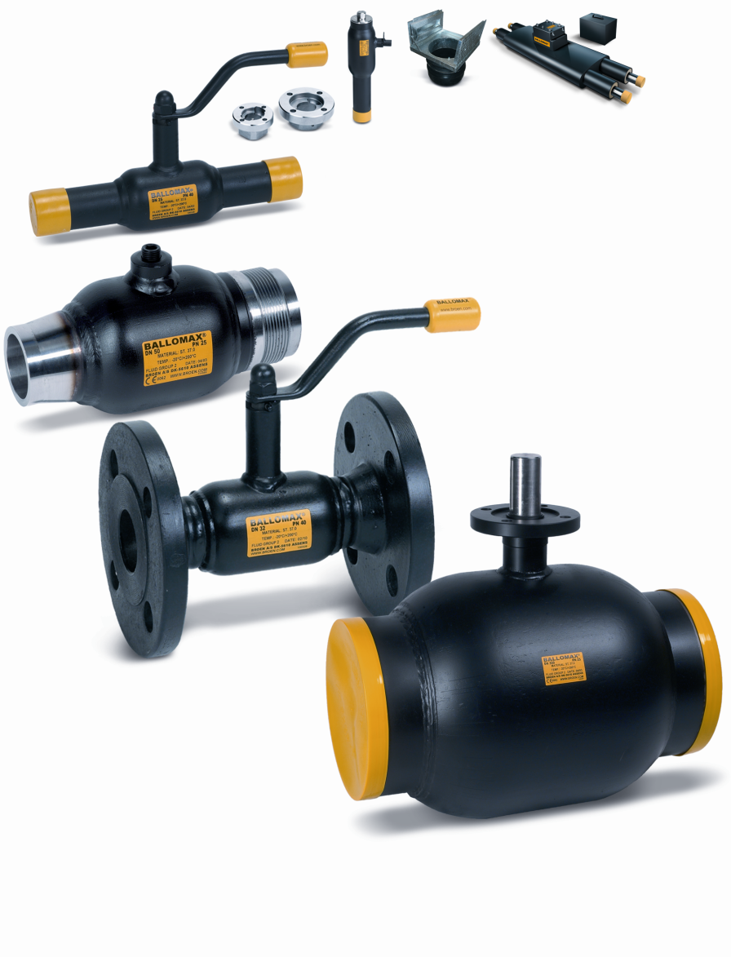
Rely on intelligent flow sectioning
District heating standard range
Natural focus on operational reliability
Hot tapping
Spring compensated
High Quality
Ergonomic grip
ISO 9001 certified
ISO 14001 certified
EN 488 certified
DN 10 – 1400
CE certified according to PED
Certificate of Quality System Approval
N°CE-0062-PED-H-BRO 001-17-POL-rev-A

Slide 11
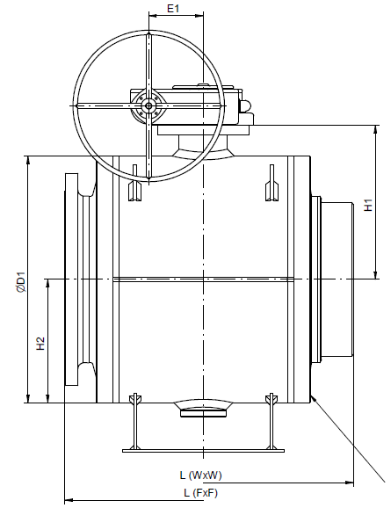
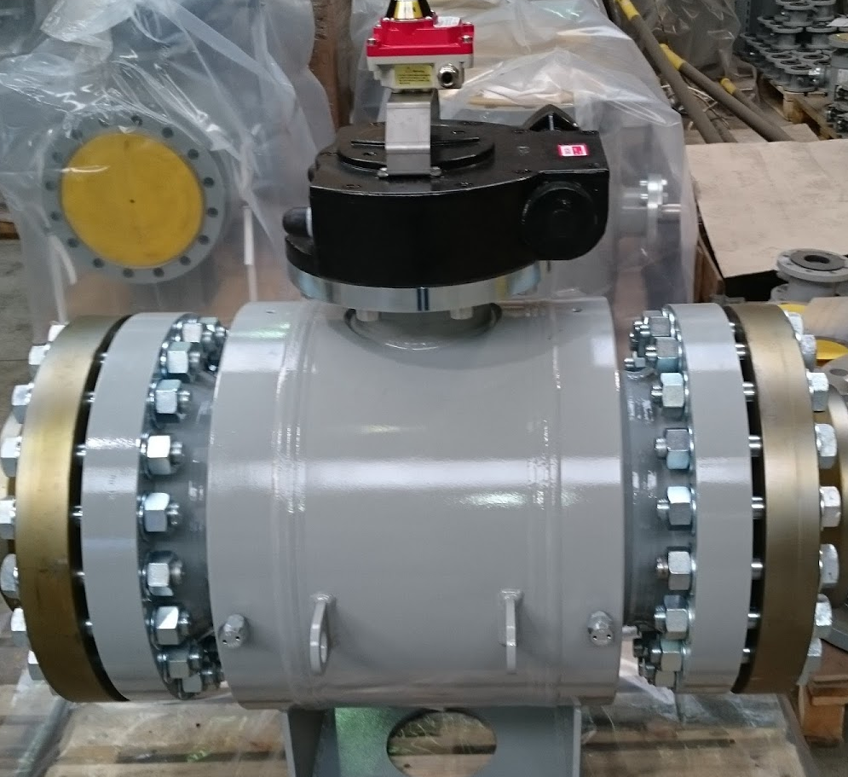
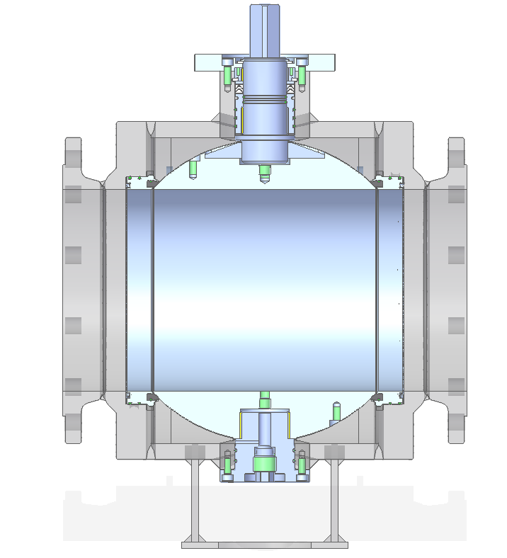
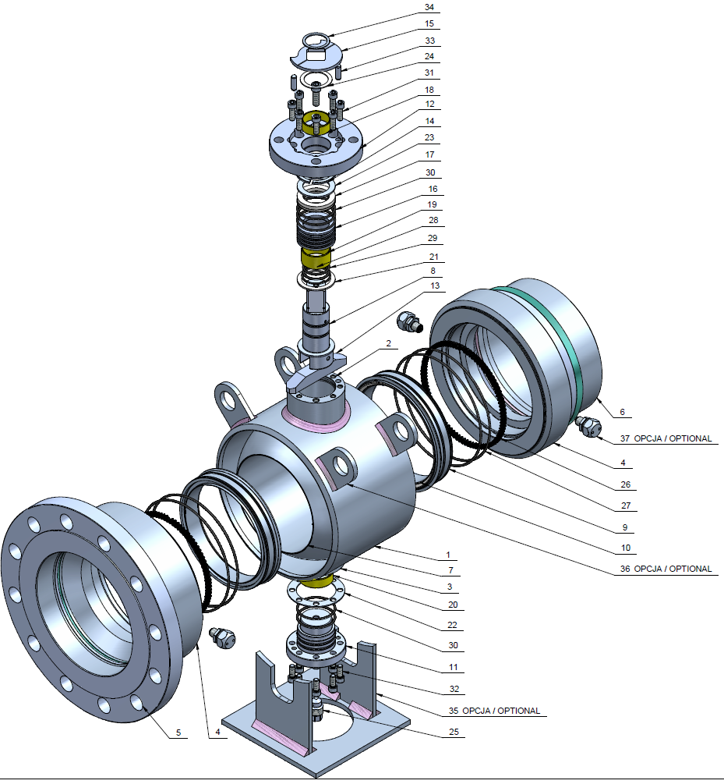
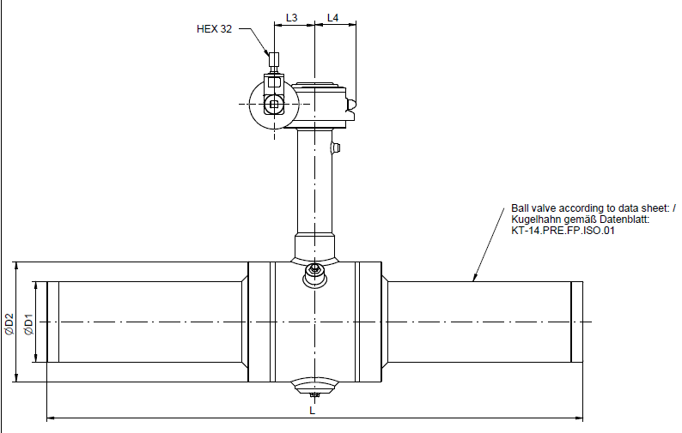
Trunnion mounted valves
Stem
ISO flange
Body
Stem sealing system
Flange end
or
Butt-welding end
Ball sealing system
Ball
Trunnion
Plug
Trunnion sealing system
Base

Slide 12
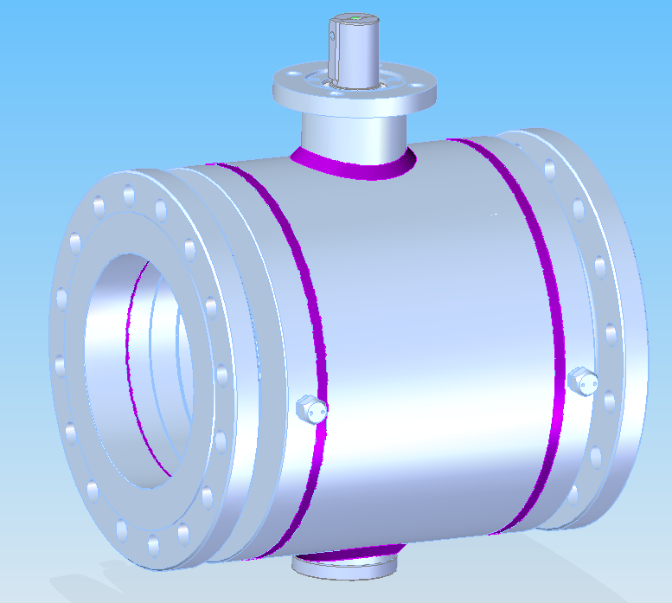
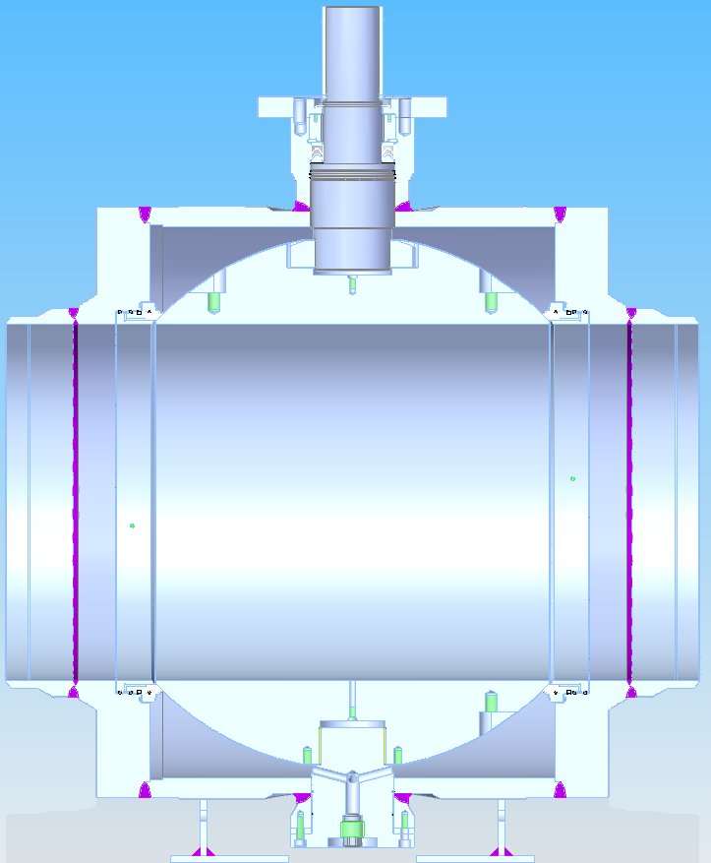
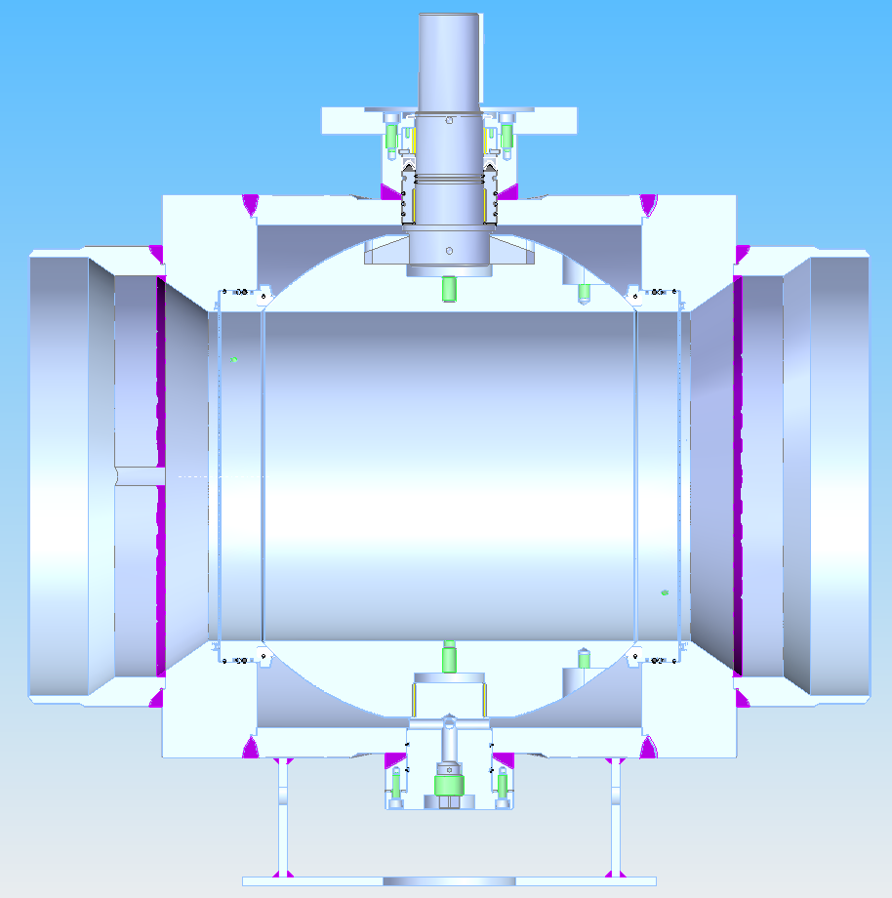
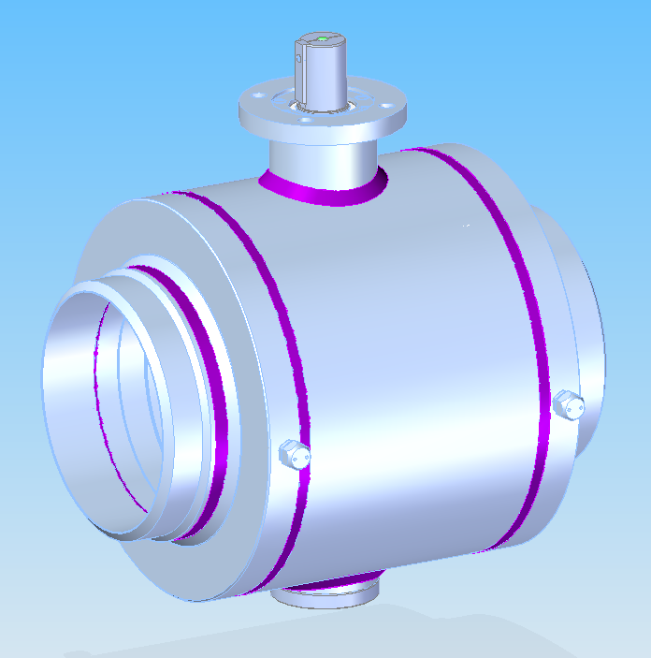
Types of ball valves’ bore
Flanged valves
Flange connection according to:
EN 1092-1
Or acc. to client’s requirements
Facing types of flanges:
B1
Or acc. to client’s requirements
Full bore | Reduced bore
DN100 ÷ 1000 | DN150 ÷1000
Length of flanged valves according to:
EN 558
Or acc. to client’s requirements
Butt-welding end valves
D Pipe
D Bore
D Pipe
D Bore
Dimensions and shape of butt-welding ends acc. to:
EN 12627
Or acc. to client’s requirements
Length of butt-welding end valves:
EN 12982
Or acc. to client’s requirements

Slide 13
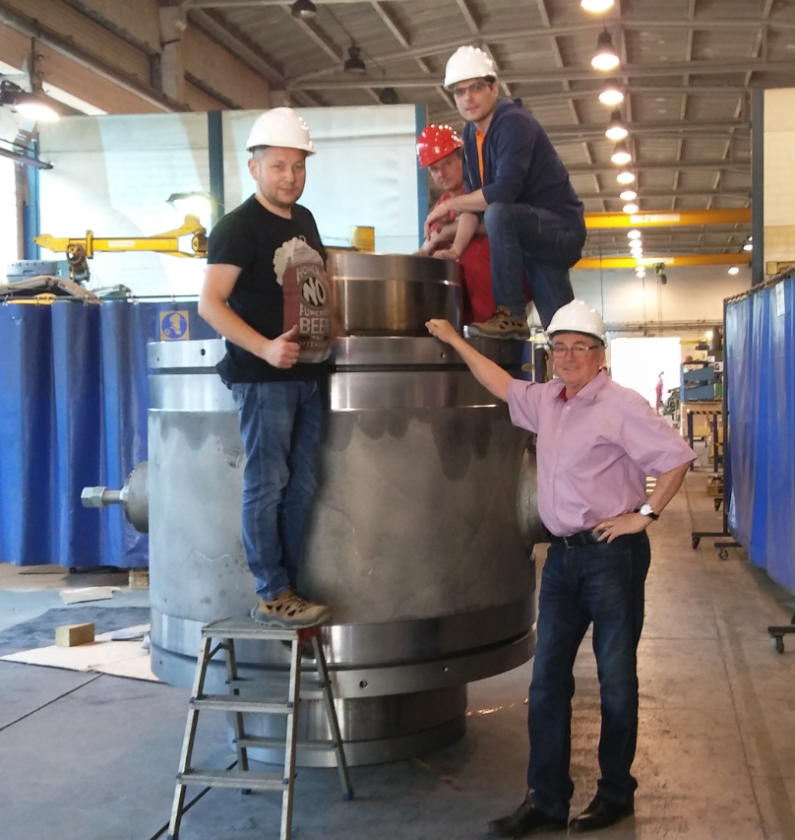
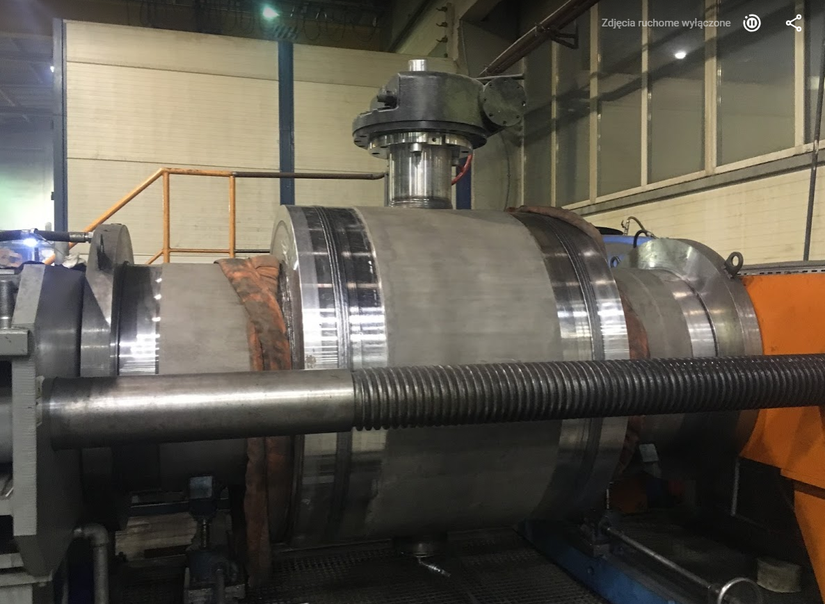
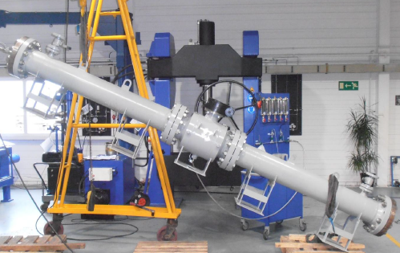
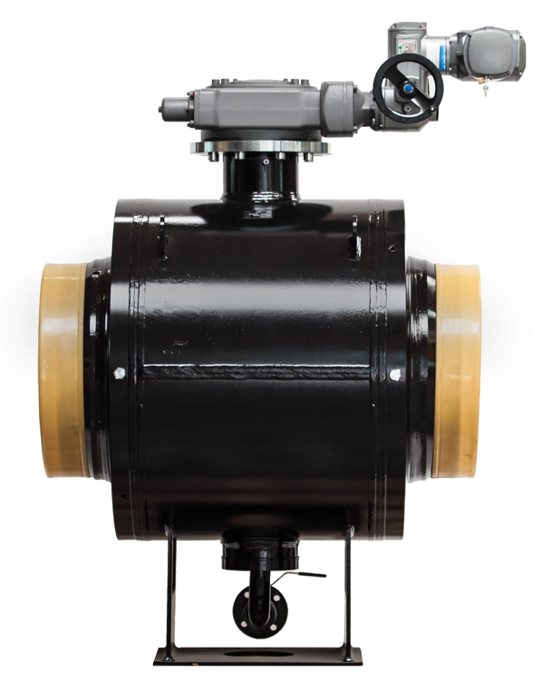
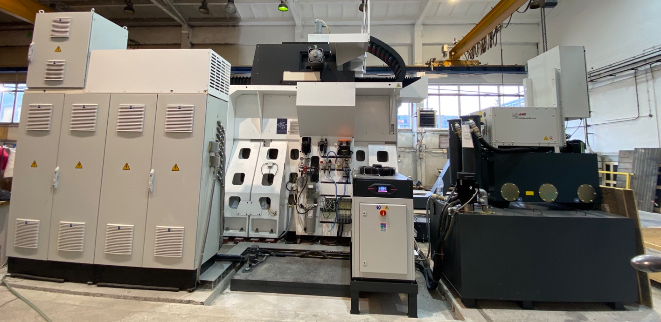
What we did
DN900 PN25 EN488 FULL BORE
DN1000 CL600 FULL BORE

Slide 14
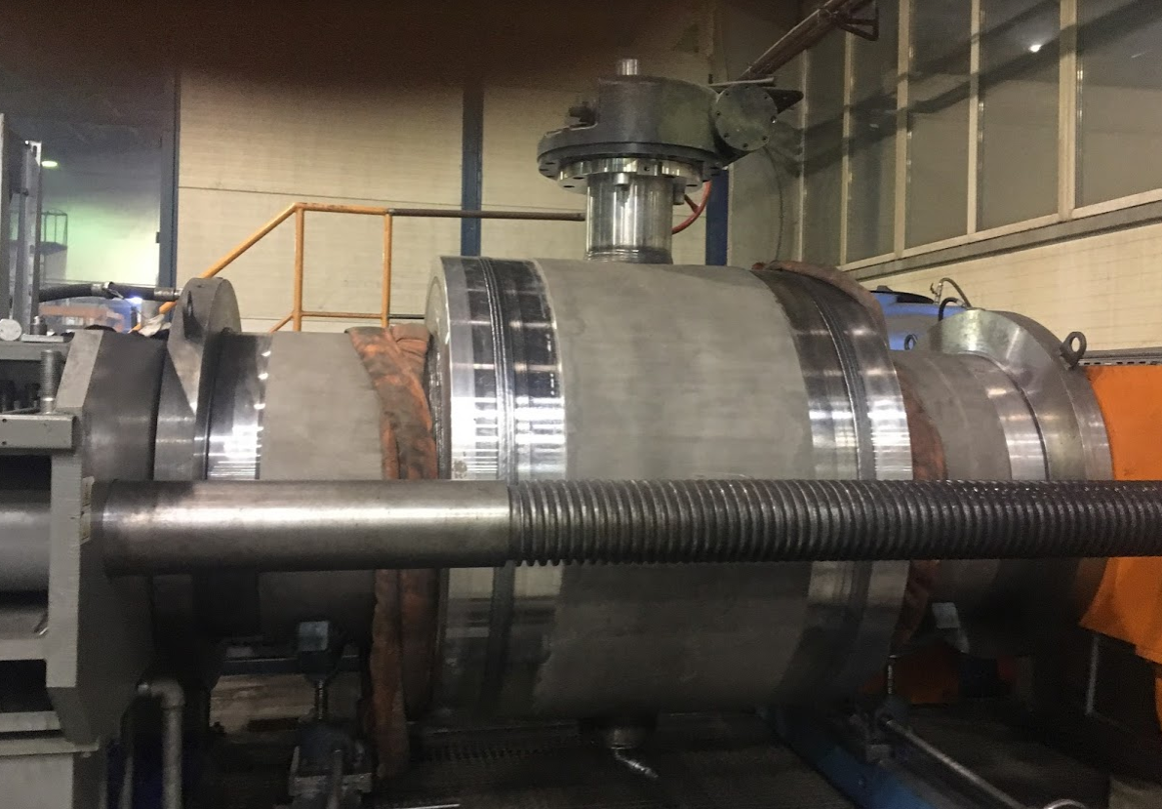
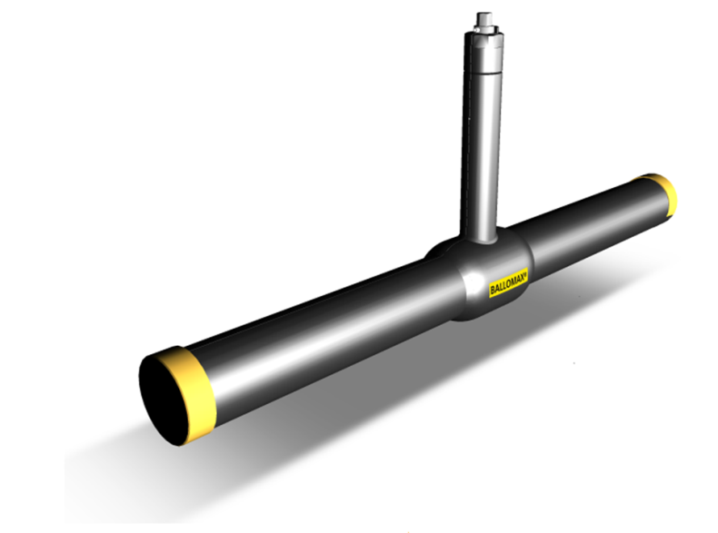
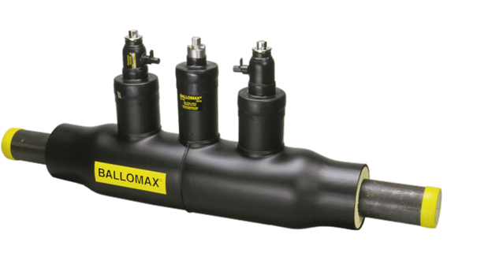
Underground valves - EN 488
– BROEN Ballomax® ball valves for pre-insulation
The key features for BROEN Ballomax ball valves are :
• Improved lifetime and minimal maintenance
• Safety and reliability
• Stainless collar for improved quality and lifetime
• DN25-1000
• PN25
• PED 2014/68/EU - Module H
• EN 12226 Part 1 and 2
• EN 488:2015 (EHP003)
Test station
DN900 Full bore
PN25
Weight 8835 kg
Medium – hot water
Standard EN488

Slide 15
Underground valves - EN 488
– BROEN Ballomax® ball valves for pre-insulation
Technical features:
• Modern and safe structure, not requiring an additional service
• 100% quality control (according to PN-EN 12266:2012 norm)
• Ball made of stainless steel
• Fully welded ball valve for underground service according to EN 488.
Isolating valve for heating systems, district heating, cooling and industrial purposes
• Spindle double sealing - O-ring (EPDM), VITON
• Application: heat distribution, networks, air conditioning and industrial installations
(group 2 media - water, air, oils, etc.). Not suitable for steam
Accessories for underground valves - EN 488
Service ball valve DN25-50, PN40/25/16
Flex extension - DN20-150
Flex extension - DN80-300
BROEN-Gear Portable gear DN80-400
BROEN-Gear Bevel gear DN150-500

Slide 16

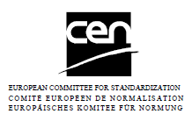

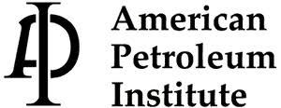

Ball valves’ manufacturing specification
Ball valves
Split Body
Pressure Equipment Directive (PED) 2014/68/UE
API 6D with monogram
API 6D without monogram
NACE MR 0175 / EN ISO 15156

Slide 17
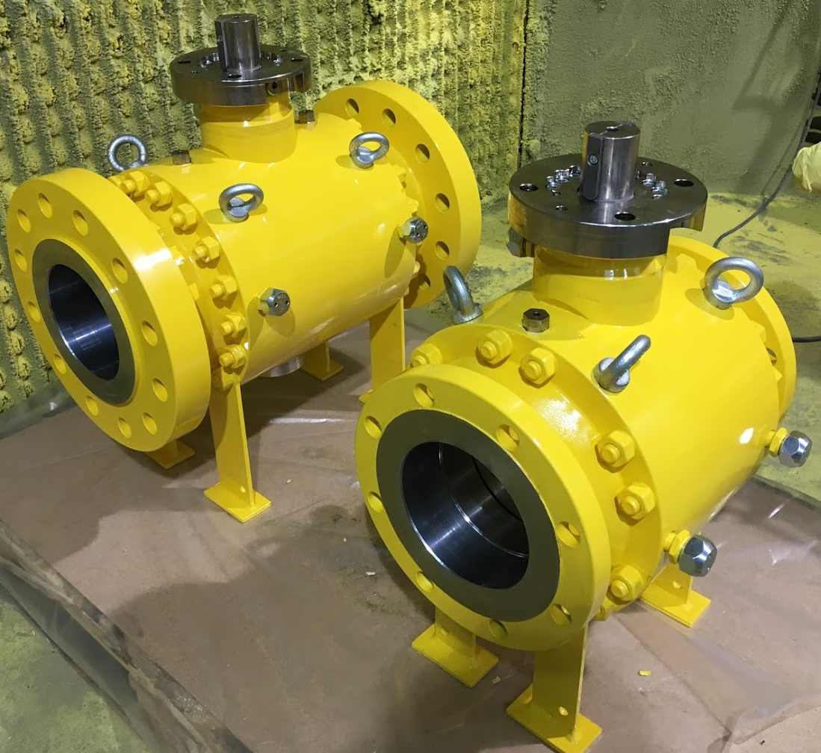
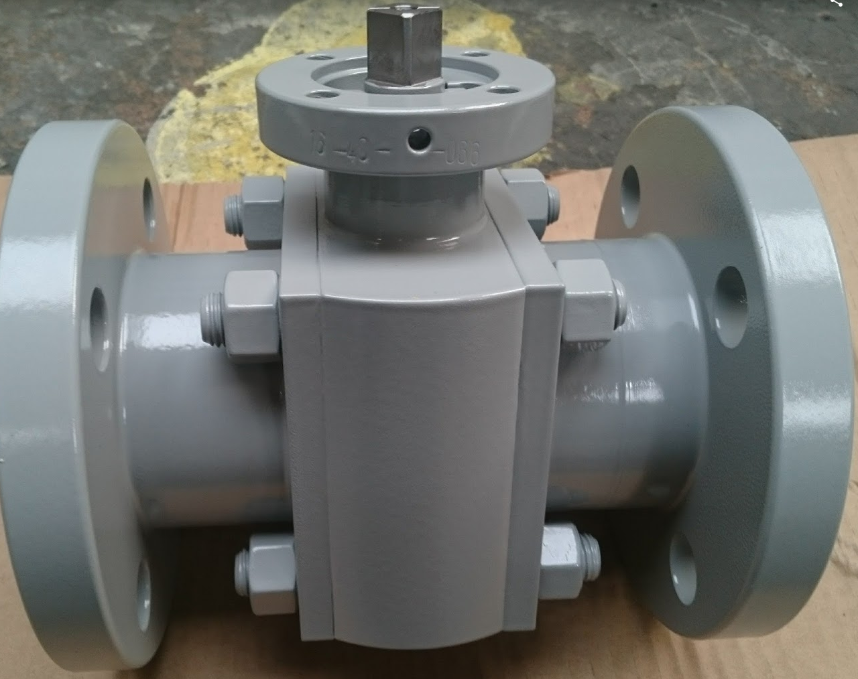
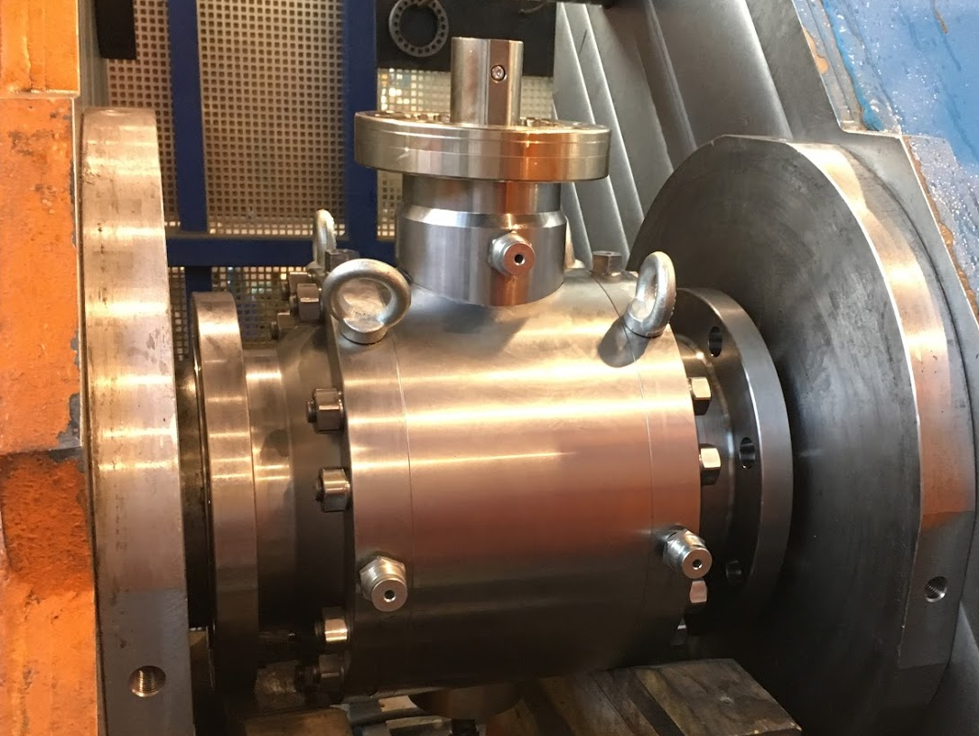
Range
Ball valves
Split Body for water
Size range:
DN50 ÷ DN300
NPS 2” ÷ 12”
Pressure range:
PN16, PN25, PN40
Temperature range:
-29 ÷ +150⁰C

Slide 18
Business Area Ballomax NG - next generation valve technology for district heating and district cooling
®

Slide 19
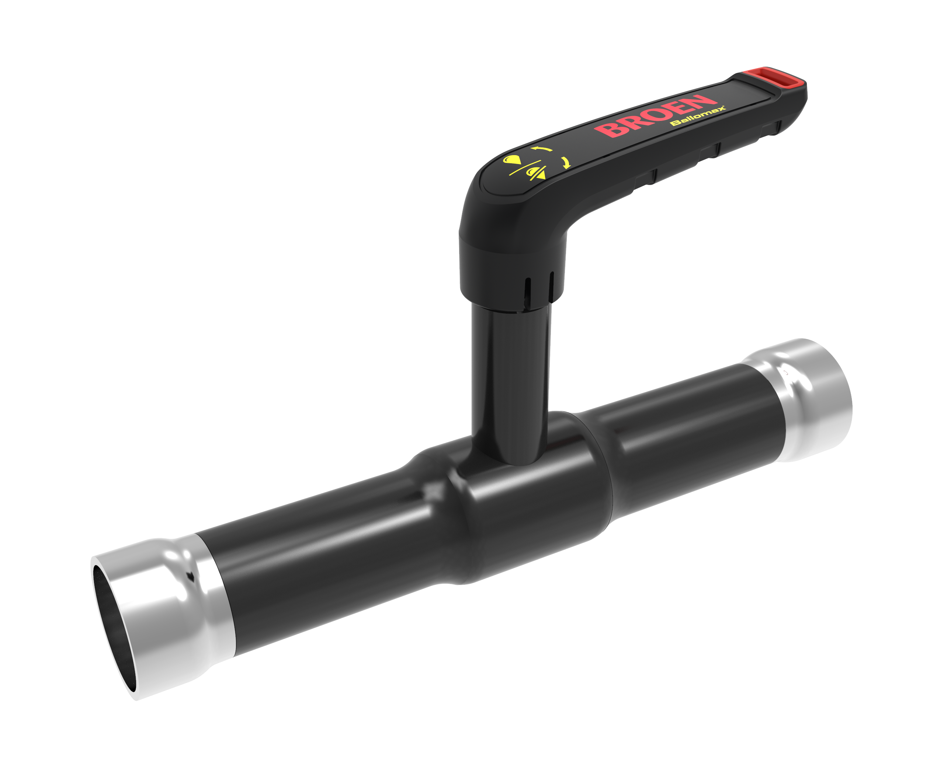
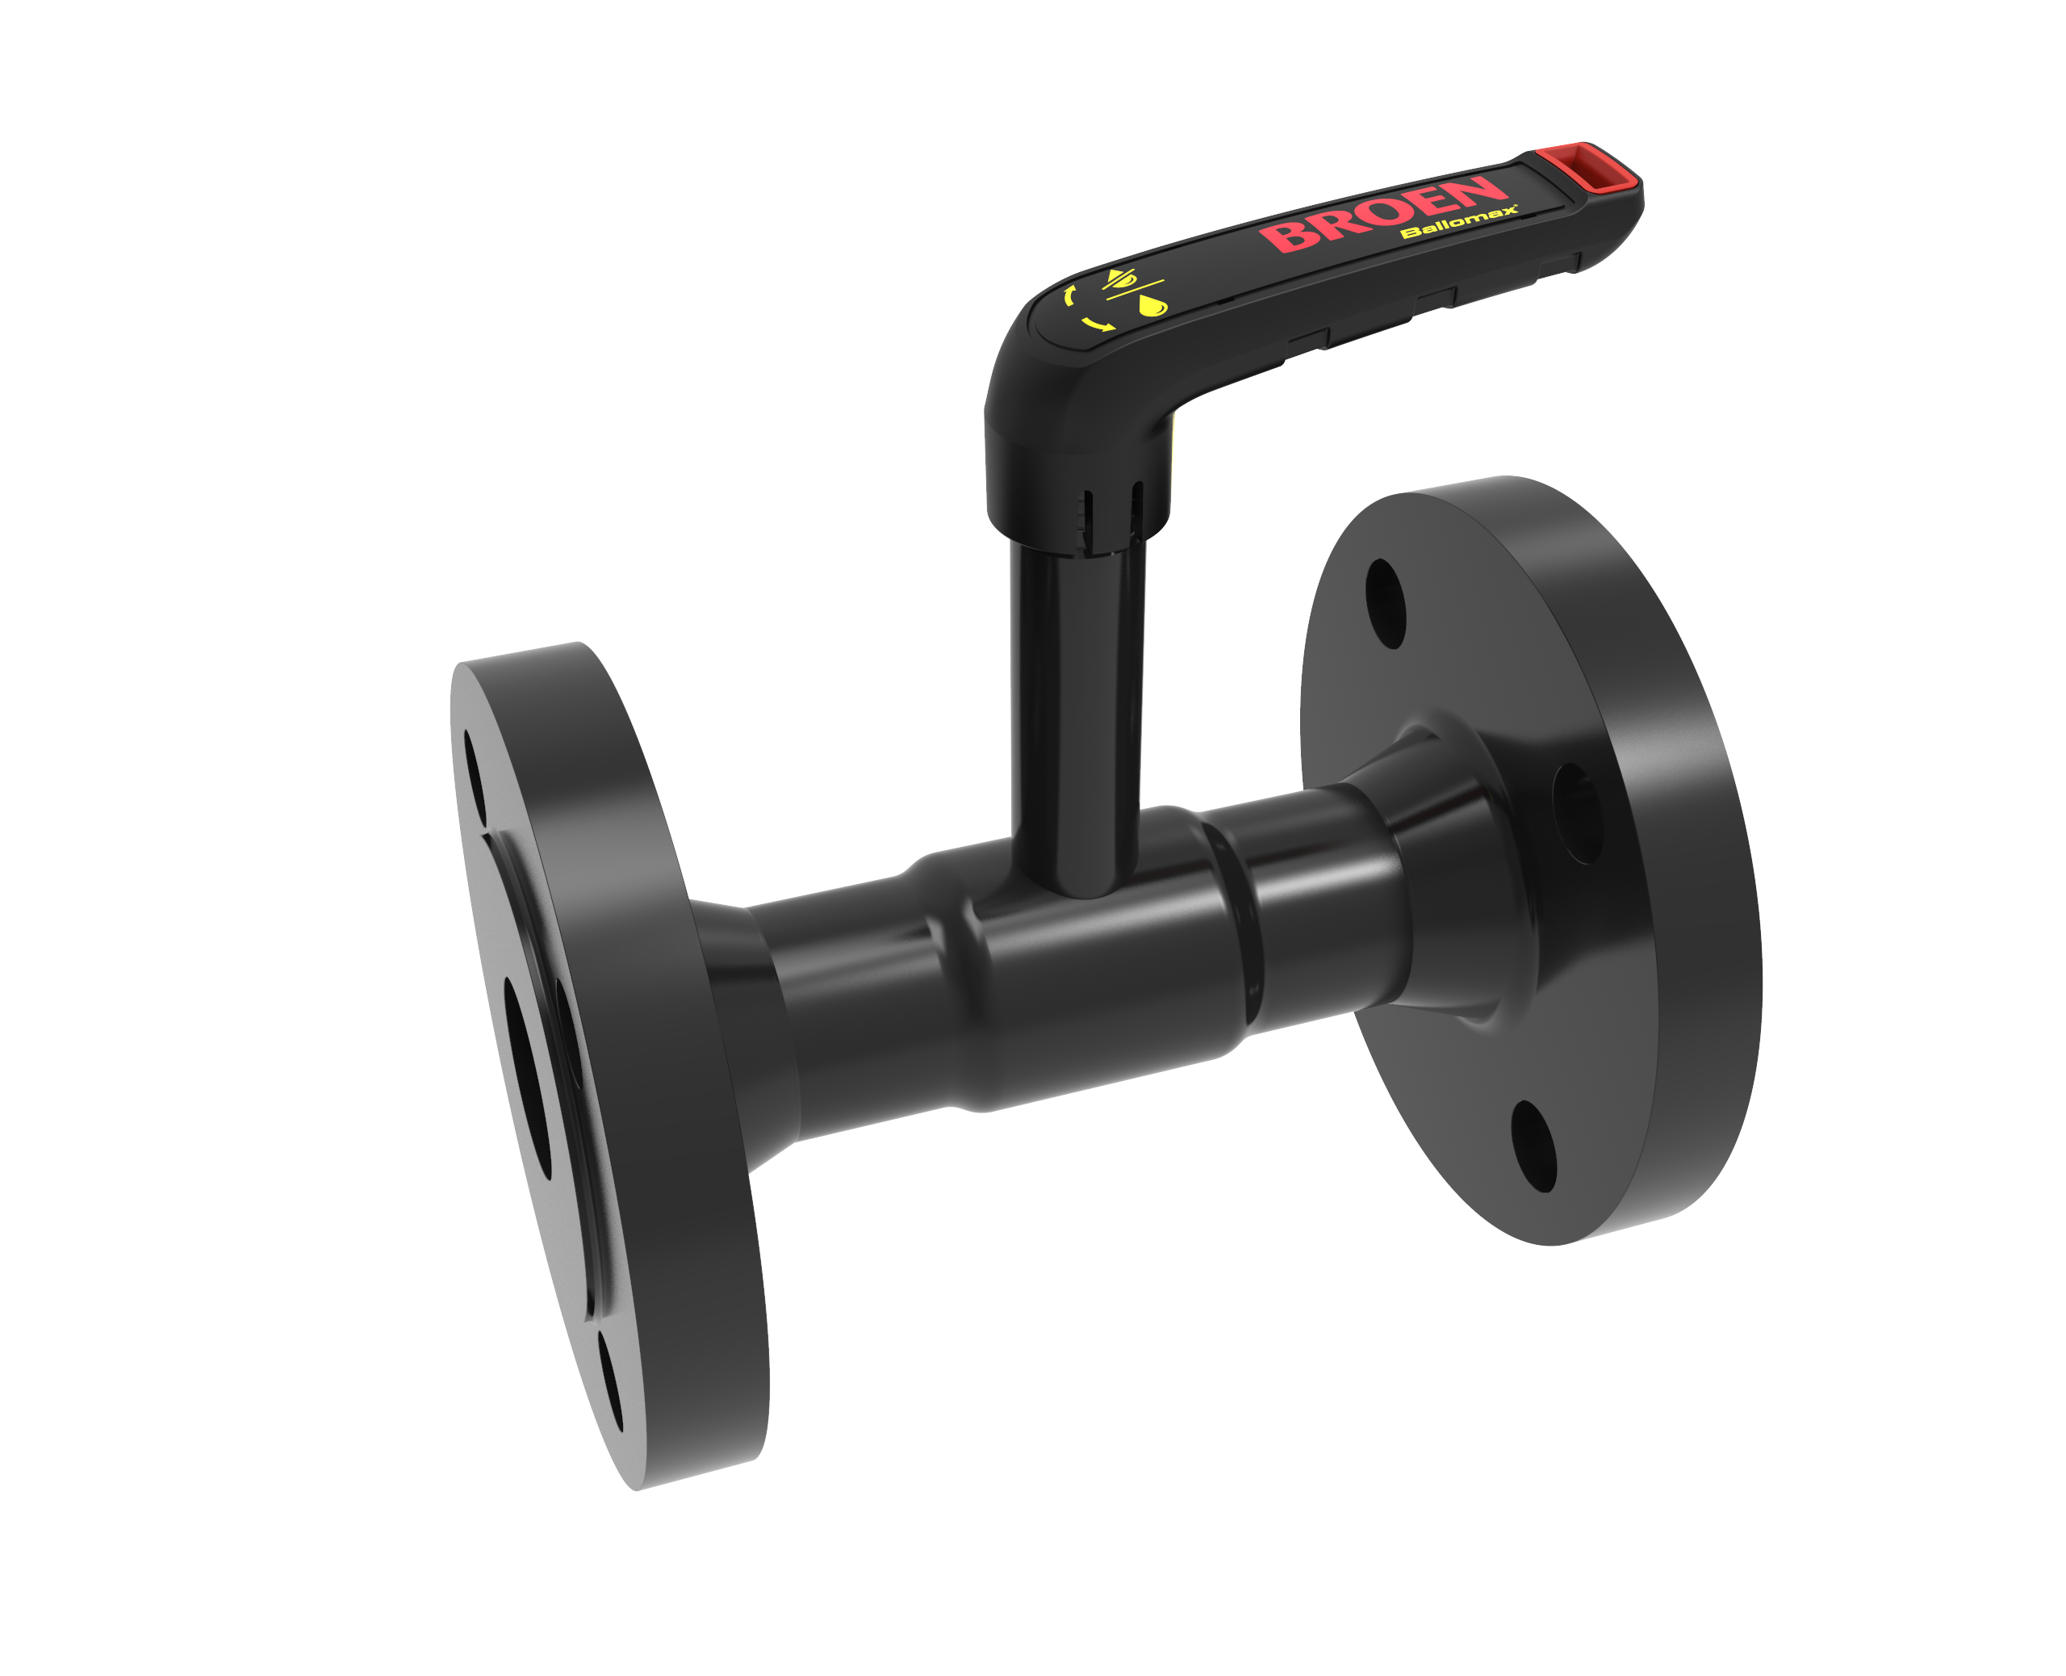
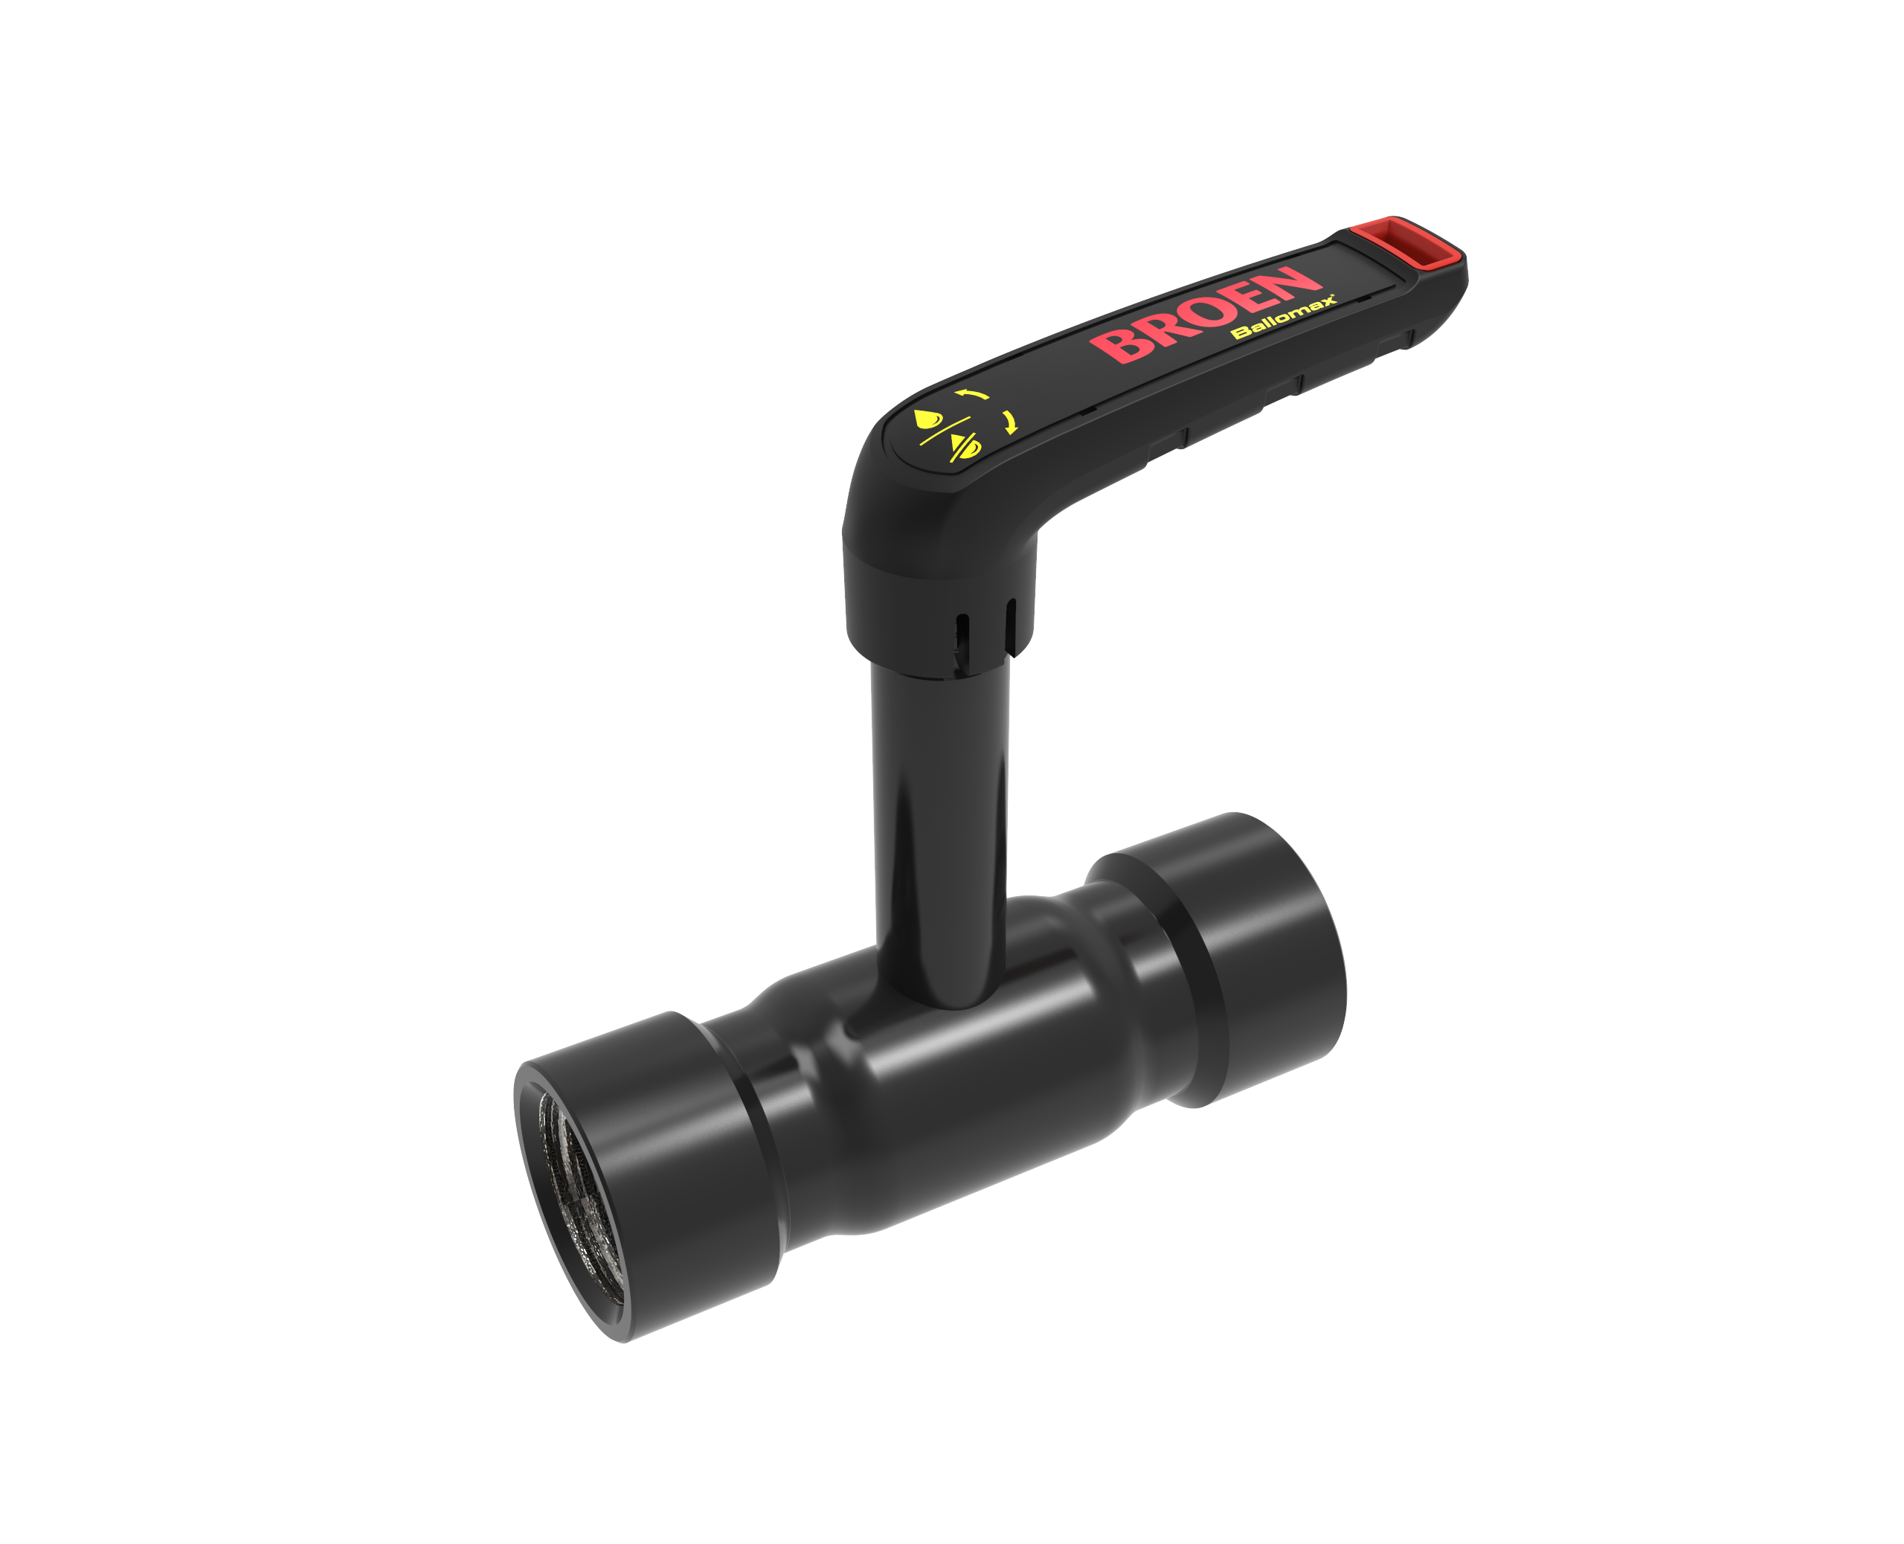

Next generation valve technology!
BROEN now introduces the next generation valve technology for district Energy and district cooling
Energy efficiency designed to last!
Compact full flow design
Optimized full bore valve
Traceability - individual valve identification
Patented Danish design – produced in Denmark
Range:
BROEN Ballomax® NG is offered in different variants for use in district heating systems
DN15-65 reduced bore, DN 15-50 full bore
PN25
Design temperature: -20°C to +200°C
Operation temperature: -20°C to +150°C
Powder coating (black)
Flange, thread or weld
Applications
Heating
Cooling
Industrial applications

Slide 20
Next generation valve technology – USPs.
Compact full flow design
The compact valve body in one piece offers the best opportunities in the market to insulate the whole pipe system – matching requirements in modern efficient district heating systems.
Clips
With interchangeable color clips you can easily visualize forward and return or hot and cold water flows. Furthermore the clips are designed to be able to attach a label to the handle.
Handle
The ergonomic handle is designed for easy operation of the valve and is produced in glasfiber reinforced nylon welded around a metal core. The handle can be mounted in both flow directions with no tools required
Energy efficiency – designed to last A full flow construction means less pressure drop, less noise and less energy consumption. The high Kv value secures optimal flow. The construction requires less torque and actuation to operate, which again means less wear on the sealing material. The construction secures a long lifetime.
Spindle
All valves are available with long spindle. The long edition is an integrated part of the valve ensuring proper insulation around the spindle.
The spindle is laserwelded to the body
Connection technologies
The valve is available with either flanged, welded or threaded connections. The model with welded connections is a true one-piece valve body
Lasermarking
All valves are clearly marked with information about size, material and pressure class.
Patented seat construction
The patented spring supported seat design secures optimal tightness and operation of the ball due to less torque and actuation required. This converts into less wear on the sealing material and a long lifetime.
Unique valve identification
All valves are individually marked with a unique valve number and a QR code with information about process-, quality- and distribution data – for each individual valve. Production and process data is documented and photos of laserweldings available on request. All valves are leakage tested before leaving the factory in Denmark.

Slide 21
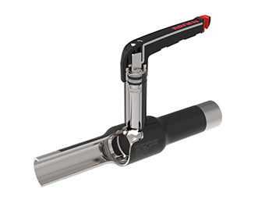

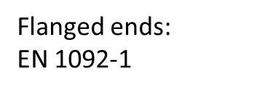
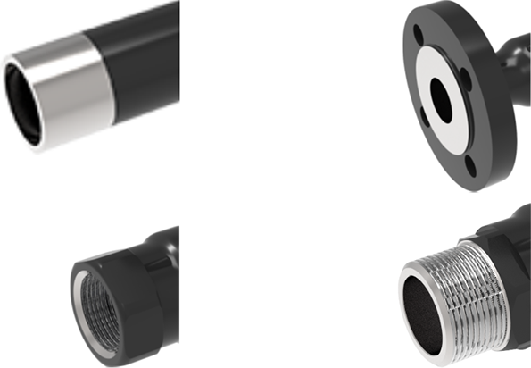
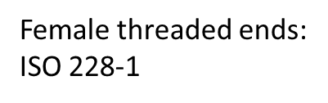


Next generation valve technology - materials
Metal reinforced handle Fiberglass reinforced nylon – around a steel core
Friction ring
Plast - PTFE
O-ring
Rubber - EPDM
Spindle
Stainless steel – 1.4401
Sealing Plast - TFM™PTFE
Ball
Stainless steel 1.4021
O-ring
Rubber - EPDM
One piece valvebody
P235GH – EN102017-2
BROEN Ballomax® NGvalve DN10-65: Applications
Media: Water Pressure: Max 25 bar
Temperature: -20 °C to +150 °C
Design Temperature -20 °C to +200 °C
Patented spring supported seat
Stainles steel 1.4401

Slide 22


BROEN Full Flow Scope of supply - Leaping forward in valve technology
The line of BROEN Full Flow valves will be available in 2018 in a range from DN10-DN65 in stainless steel or galvanized steel in any type of connection technology – up to PN25.
BROEN Full Flow covers valve technology solutions for applications in the segments:
Water
Heating
Cooling
Industrial
Compact, cold pressed, laser marked, and laser welded – the new BROEN Full Flow valve technology platform is ready to take the next leap in valve technology.
We now raise the bar and offer you the next generation in valve technology – delivered with the proven BROEN brand quality

Slide 23

Next generation valve technology!
Manufacturing a modular construction
The valve is manufactured on a completely automated manufacturing line in Assens Denmark. The welding, the pressing, assembly and testing is done by robots. The manufacturing of a complete valve is done in two production cycles.
During the first manufacturing cycle the raw valve body without connections is manufactured. In the second cycle the right connections are added to the valve body either as threaded, weld and flanged connections to match each individual order. In this way you can produce valves for stock in the first cycle 1 and then react fast to market demands in 2. step.
Each valve is leakage tested before it leaves the factory. After this test the valve is lasermarked, the handle is put on and it is packed in bags and boxes – and made ready for shipment.
Optimized flow
Optimized flow design
The new BROEN Ballomax® is designed as full bore. With the sleeve in the ball the result is an optimum flow through the valve and higher Kvs values – even in a compact valve body.
The result of the construction includes a small gap between the housing and the inlet to the ball. This gap is necessary to allow the seat to move and has to be flexible. Tests have shown, that the gap provides no obstacle and therefore no influence on the flow through the valve. The gap is not a problem regarding build-up of impurities from the media and neither does vortex build up in this area.

Slide 24

Next generation valve technology!
Stem construction
The stem is available in a long version for the new BROEN Ballomax® - an advantage, when there are requirements about the insulation of the valve.
The o-rings can be replaced and spare o-rings come in a special spare part kit with tools.
Friction Ring Plast PTFE + C
Ring Plast PTFE + C
Ring Plast PTFE + C
Spindle EN 1.4401
Spindle guide EN 1.0345
O-ring EPDM
O-ring EPDM
Lock ring Steel

Slide 25


Next generation valve technology!
Testing
Typetest acc. to EN 12266-1+2
Lifetime test acc. to Kiwa BRL-K604/06
The development of the new BROEN Ballomax® included fatigue testing the valve to simulate the operation of the valve for an entire life time.
The valves were also tested in hot and cold water to see the tension between the different materials.
A number of valves were put into test with an open/close cyclus to simulate the day to day operations of a life time and afterwards the valves were inspected, to monitor possible anomalies.
Tests were carried out to see if the gap in the valve would mean anything regarding flow or clocking up the inlet. These tests showed that the flow was not affected by this gap due to the design of the seat suppport ring. The gap also were also not affected in terms of clocking up in the inlet with residues from the media.
Even though each valve is leakage tested during the first cycle of manufacturing, a few samples are tested in every shift to secure the welds of the valve. This test is done by the personel at the production line.
Outlook
The valve portfolio of BROEN is currently being updated in order for us to keep a leading position in the valve market - for both Building Installations and District Energy.
BROEN has significantly improved the ranges DN10-65 and DN250-500. The aim is to make them even better and secure that they fit tomorrow’s demands in district energy. BROEN is manufacturing these valves from a modular design platform with all the benefits from this principle.
Next step is to update the mid range DN80-200 to complete the update of the whole range and confirm our leading position in valve technologies.

Slide 26
Ever since BROEN was established our passion for valve technology has been our core competence. Our brand is our promise.
https://www.youtube.com/watch?v=_wQOzvw3ZZo

Slide 27

Next generation valve technology!
Compact and full flow design
The valve is manufactured from applying pressure to a pipe. The benefit of this is a compact valve body design matching the requirement of insulation of piping systems, but it still features a full flow design. The valve body is smaller in diameter than the equivalent body in the current BROEN Ballomax® valve.
New Ballomax – 1050002031 2101
Current Ballomax – 9410040050 010

Slide 28


Next generation valve technology!
Wall thickness of the new valve body
Even though the valve body on the new BROEN Ballomax® is smaller, it still has the same wall thickness as the old BROEN Ballomax® acc. to EN10216-2.
This means e.g., that the thickness of the DN50 valve body remains 2,9 mm.
Compact - but still designed to last!
New
Old

Slide 29



Next generation valve technology!
Spring adjusted seat support
The seat support of the new BROEN Ballomax® is designed to create a spring effect for the seat ring. The seat support is made so that the outer diameter is slightly bigger than the pipe. Combining this with the liquid gasket makes a solid and durable tightning of the seat support.
The other end of the seat support is situated towards the connetion end.

