Slide 1

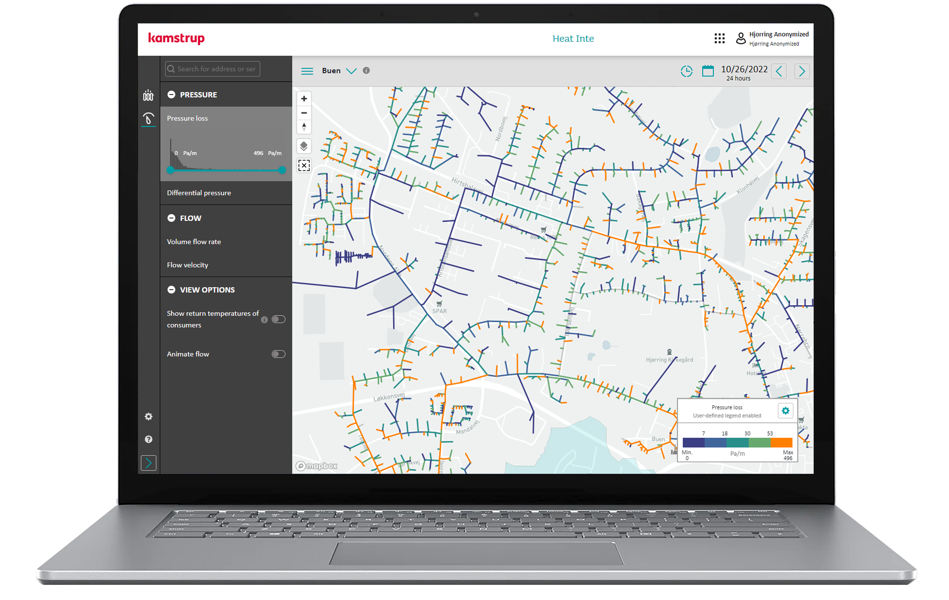
Kamstrup Heating Solutions
Danish District Heating Sector Visit to Vrnjačka Banja

Slide 2


Kamstrup has 75+ years of experience combined with the highest of ambitions and continuous strategic investment
in pushing the limits
for innovation.
Notes:
First of all thank you very much for the opportunity to present some of our solutions during these delegation days.
My name is Thomas Tryk and I work as a Key Account Manager for Kamstrup, focussing on our distributor sales.
We in Kamstrup have more than 75 years of experience within the metering business. We constantly strive to deliver ambisious and innovative solutions to the market. In order to gain the best possible insights in different markets, we sometimes need local knowledge. For this reason we have teamed up with Termonet.

Slide 3
Kamstrup are locally represented in Serbia with a long-term partnership with Termonet
Notes:
Therefore I am happy to introduce my colleague Bane from Termonet.
Termonet and Kamstrup has been working together for more than 25 years supplying heat/cooling meters and solutions to the Serbian market.

Slide 4


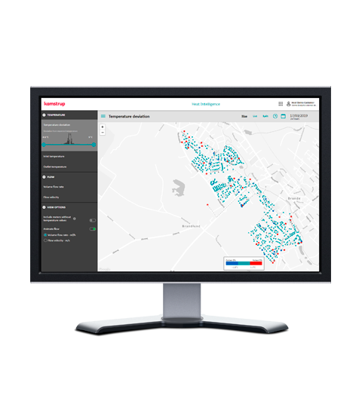
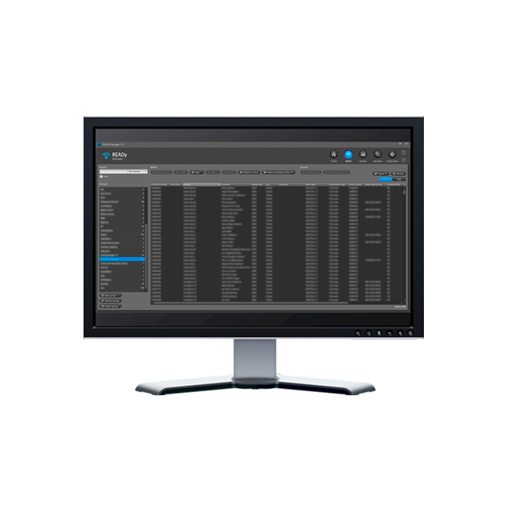
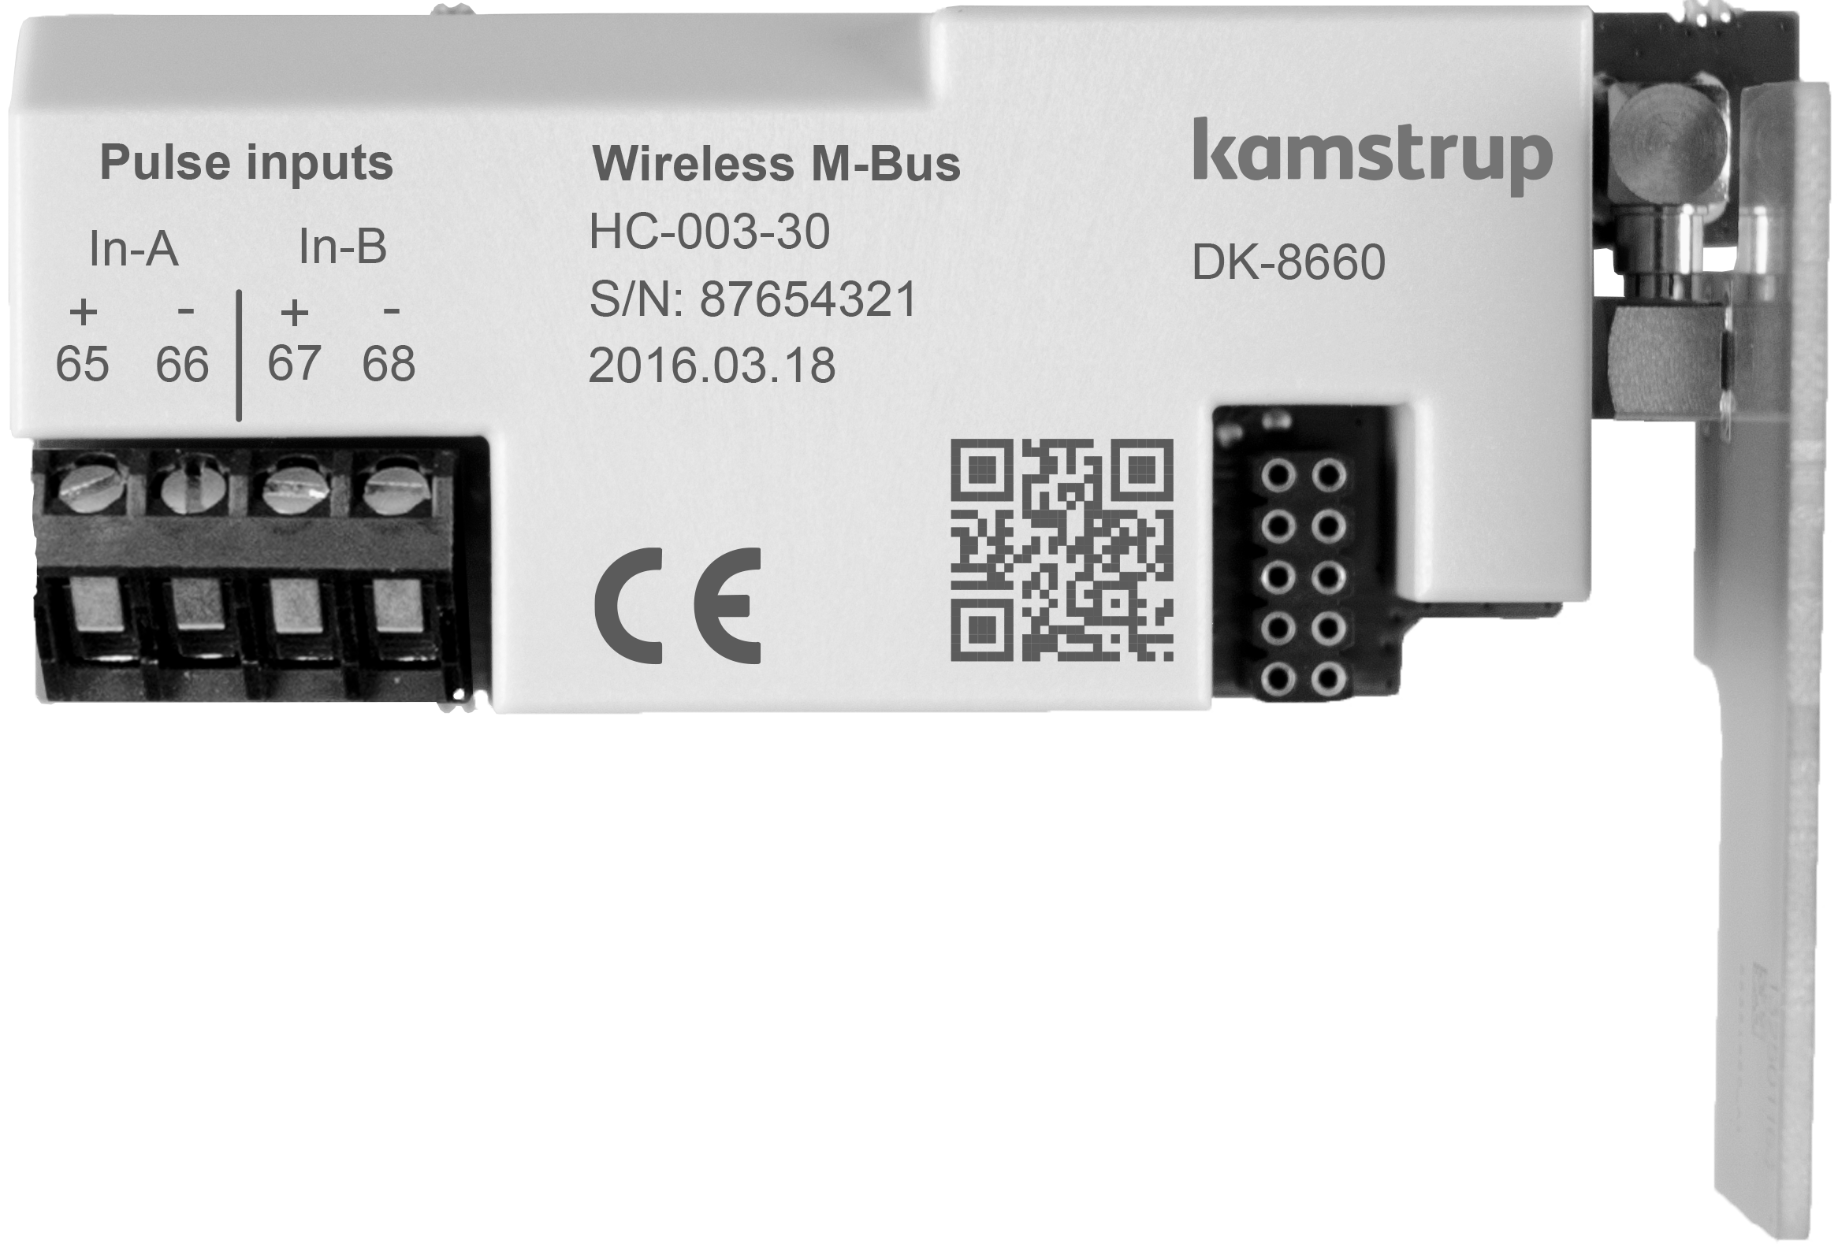
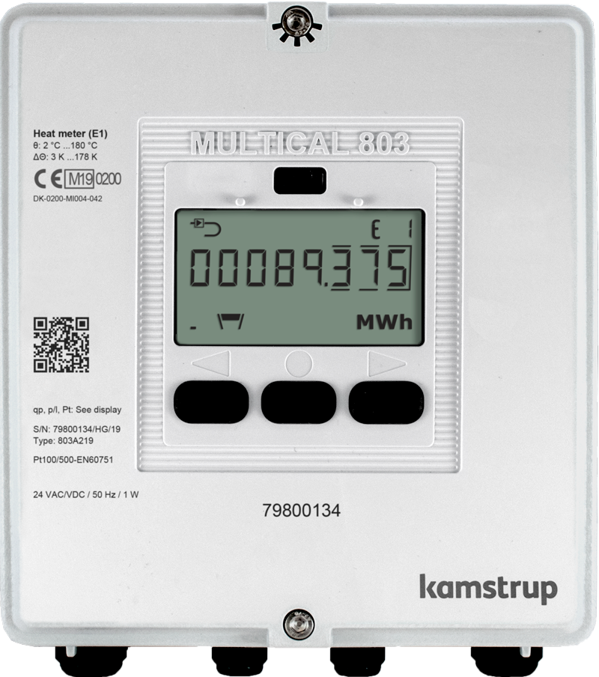
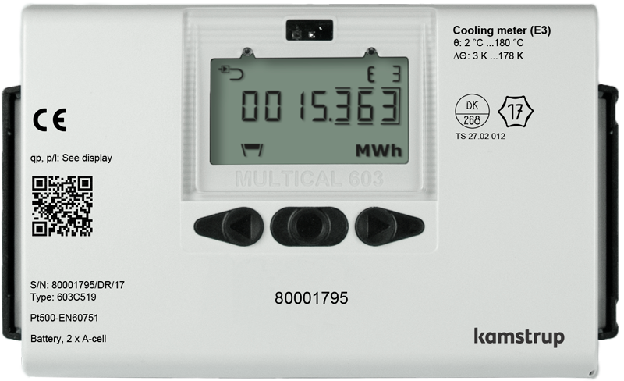
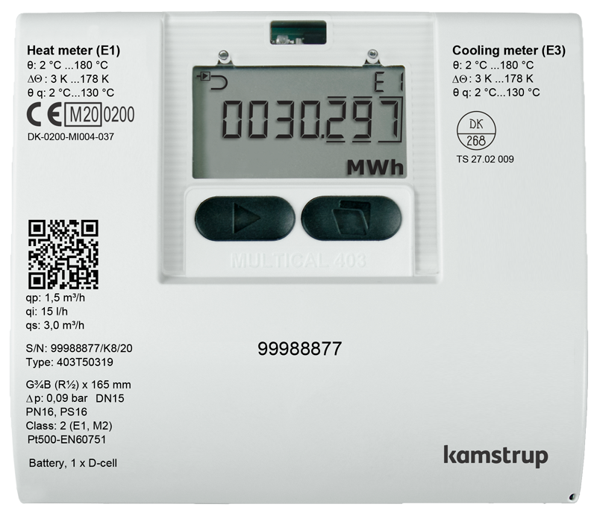

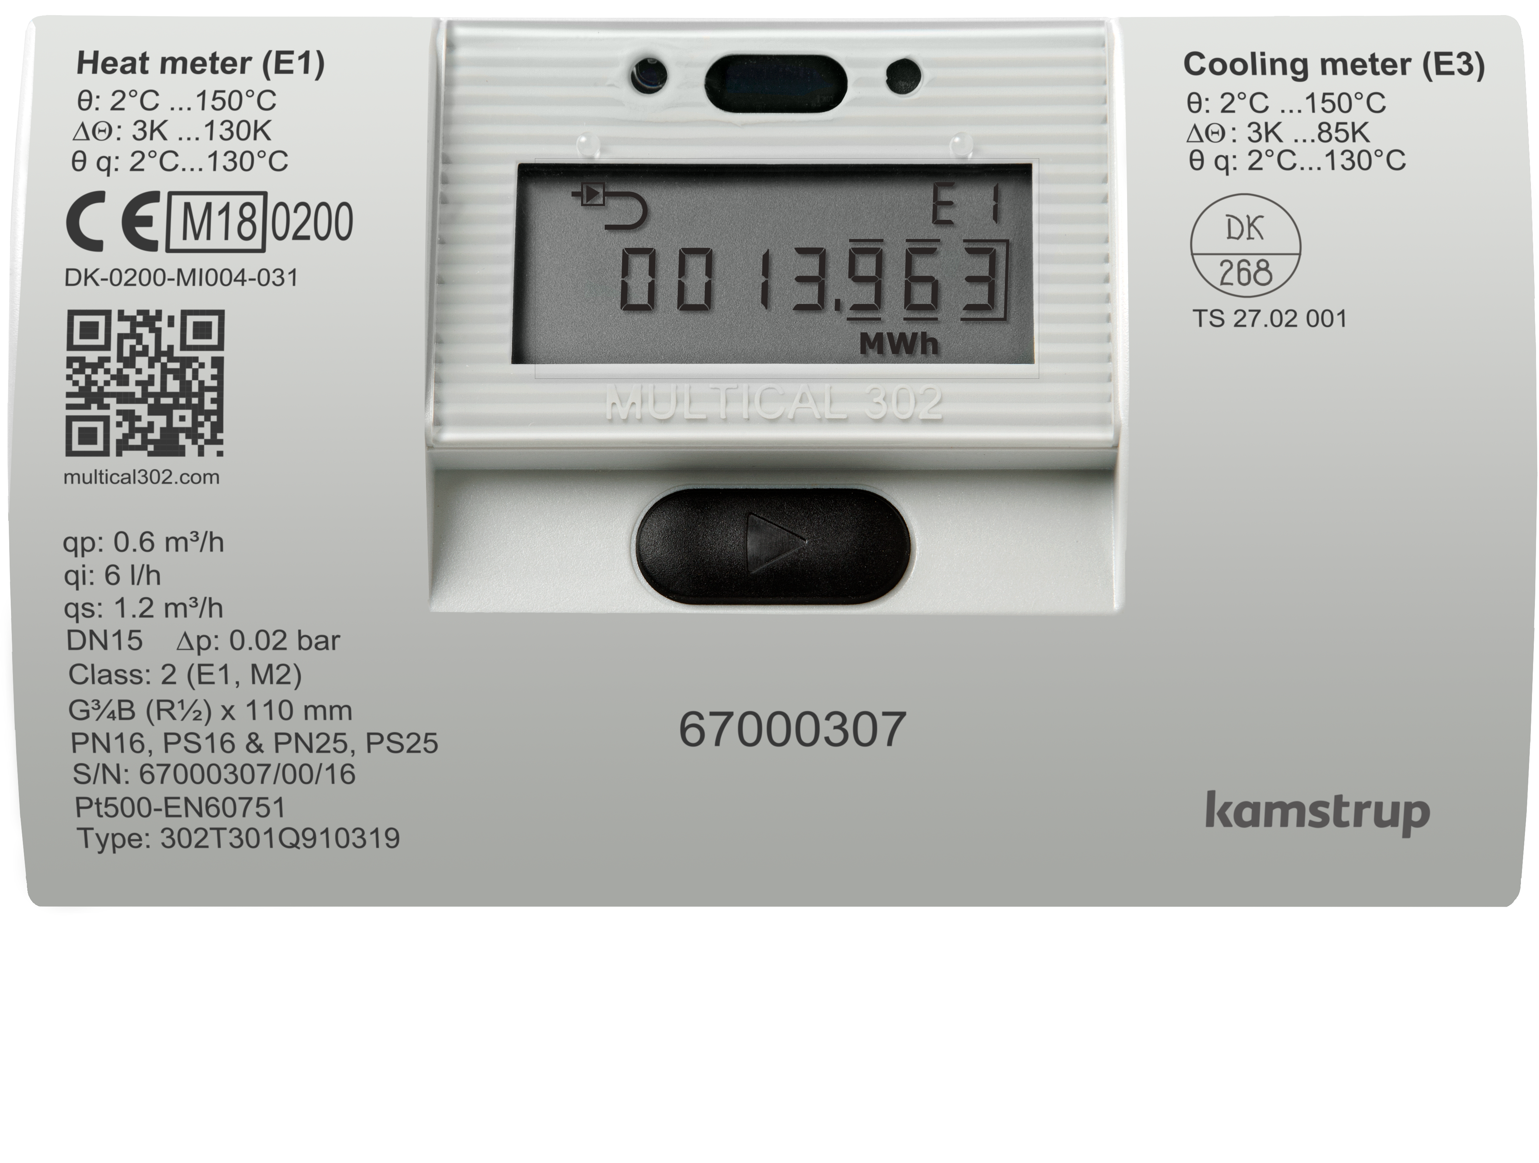
Value chain overview – how are we positioned with our offerings?
District Heating Value Chain​
Production
Transmission
Substation
Distribution
Heat
installations
Buildings
End-user
Kamstrup
offerings
Analytics
Meter data
management
Communication
Meters
Innovation at the core. We continuously look at expanding our offerings and innovation weigh heavy on our agenda.
Notes:
As mentioned we are constantly trying to improve and offer solutions that reflects the global trends.
Currently we are offering the MULTICAL® generation 3 series meters with Ultrasonic flow sensors. But we offer more than just high quality meters. We offer a broad range of communication modules, with everything from Modbus/Bacnet to wireless communication with m-bus and point-to-point communication with NB-IoT.
Besides that we have our meter data management platform called READy and our newest analytic software called Heat Intelligence.

Slide 5


Communication
Kamstrup offers a NB-IoT module compatible with MUTLICAL® 403, 603 and 803 meters.
The NB-IoT module operates on existing networks from Telekom operators on a subscription based principle
No need for concentrators, base stations, so basically a plug-and-play solution
We offer 2 solutions:
Full READy solution
Support for third-party MDM
The NB-IoT module can be battery or main supplied depending on the customers needs
Notes:
Kamstrup offers a Narrow-Band IoT module and solution. The module is compatible with MC403, MC603 and MC803 meters.
The NB-IoT module operates on existing networks from Telekom operators on a subscription-based principle… which means
No need for concentrators, base stations, so basically a plug-and-play solution
The NB-IoT module can be battery or main supplied depending on your needs

Slide 6
Communication
We have various datagrams available, but also offers to create customer specific datagrams
Battery supplied meter with up to 10 registers in the datagram
High Power supplied meter up to +20 registers
The data transmission intervals are:
15 minutes
60 minutes
1440 minutes
We have expected battery lifetime of up to 16 years on MULTICAL® 603 with daily transmission
Notes:
We have various datagrams available, but also offers create customer specific datagrams
We can offer up to 10 registers in the datagram on battery operated meters and up to + 25 in High Power supplied meters
The data transmission intervals are 15, 60 or 1440 minutes, meaning quarterly, hourly or daily data transmission.

Slide 7
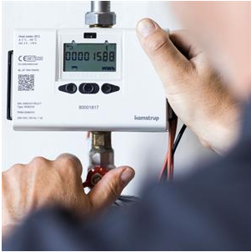
Put your heat meter data in the driver’s seat
The district heating agenda changes these years:
District heating distribution networks are being expanded rapidly and plays an important role in the climate agenda
District heating energy sources is moving towards low temperature sources like heat pumps and solar panels
Improving energy efficiency in distribution networks and end-user installations is a “must” in order to meet future challenges
Your heat meter data can help you to spot opportunities to:
Reduce heat loss e.g., identify poor return temperatures, and find bypasses in the network that should be removed or adjusted
Lower temperatures e.g., spot pipe sections that doesn’t perform well
Optimize pressure and flow e.g., identify bottlenecks or pipe sections with unnecessarily high differential pressure
With Heat Intelligence you will put your heat meter data in the driver’s seat
Notes:
Looking at the agenda for district heating, we are experiencing that distribution networks all over Europe are expanding rapidly and is playing a big role in the climate agenda.
District Heating energy sources is moving towards low temperature sources such as heat pumps and solar panels
Improving energy efficiency in the distribution networks and end-øuser installations is an absolute ”must” in order to meet future challenges.
So the data from your meters can help you to:
Reduce heat loss by identifying poor return temperatures and find bypasses in the network that needs to be removed or adjusted.
Lower temperatures by spotting pipe sections that isn’t performing well.
Optimizing pressure and flow by identifying bottlenecks or pipe sections with unnecessarily high differential pressure

Slide 8
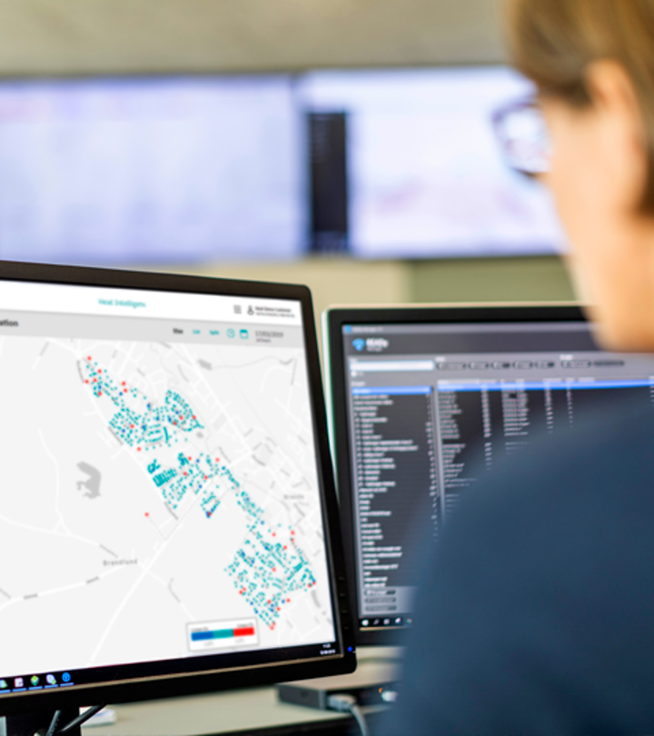
Heat Intelligence – what it is
Digital and cloud-based tool - no installation needed
Uses data about temperatures and water flow from all meters in your distribution network
Operates with a digital twin of your distribution network, based on GIS data about pipes and meters everywhere in your network
The twin calculates how your distribution network should perform – in terms of temperatures, flow and pressure – if everything worked perfectly
By comparing the “should perform” data with the actual received data Heat Intelligence helps to identify problems and optimization opportunities in your distribution network, for example unknown bypasses, bad performing pipe sections and household installations not working as they should
Notes:
So what is Heat Intelligence:
It is a digital cloud-based software solution
It uses data about temperatures and water flow from all the meters in your distribution network
It works as a digital twin to your network, based on GIS data about pipes and meters in your network
The software calculates how your distribution network should perform – in terms of temperatures, flow and pressure in a ”perfect world” scenario
By comparing the ”perfect world” scenario with the actual real life data, heat Intelligence helps to identify problems and opportunities for optimization in your network. That could be bad performing pipes, unknown bypasses etc.

Slide 9
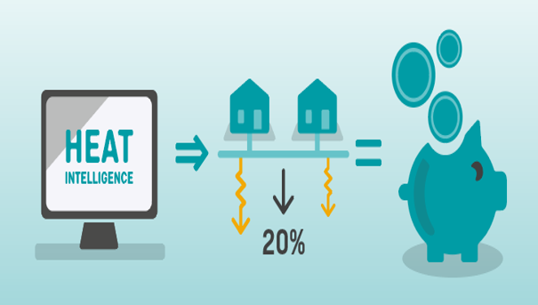
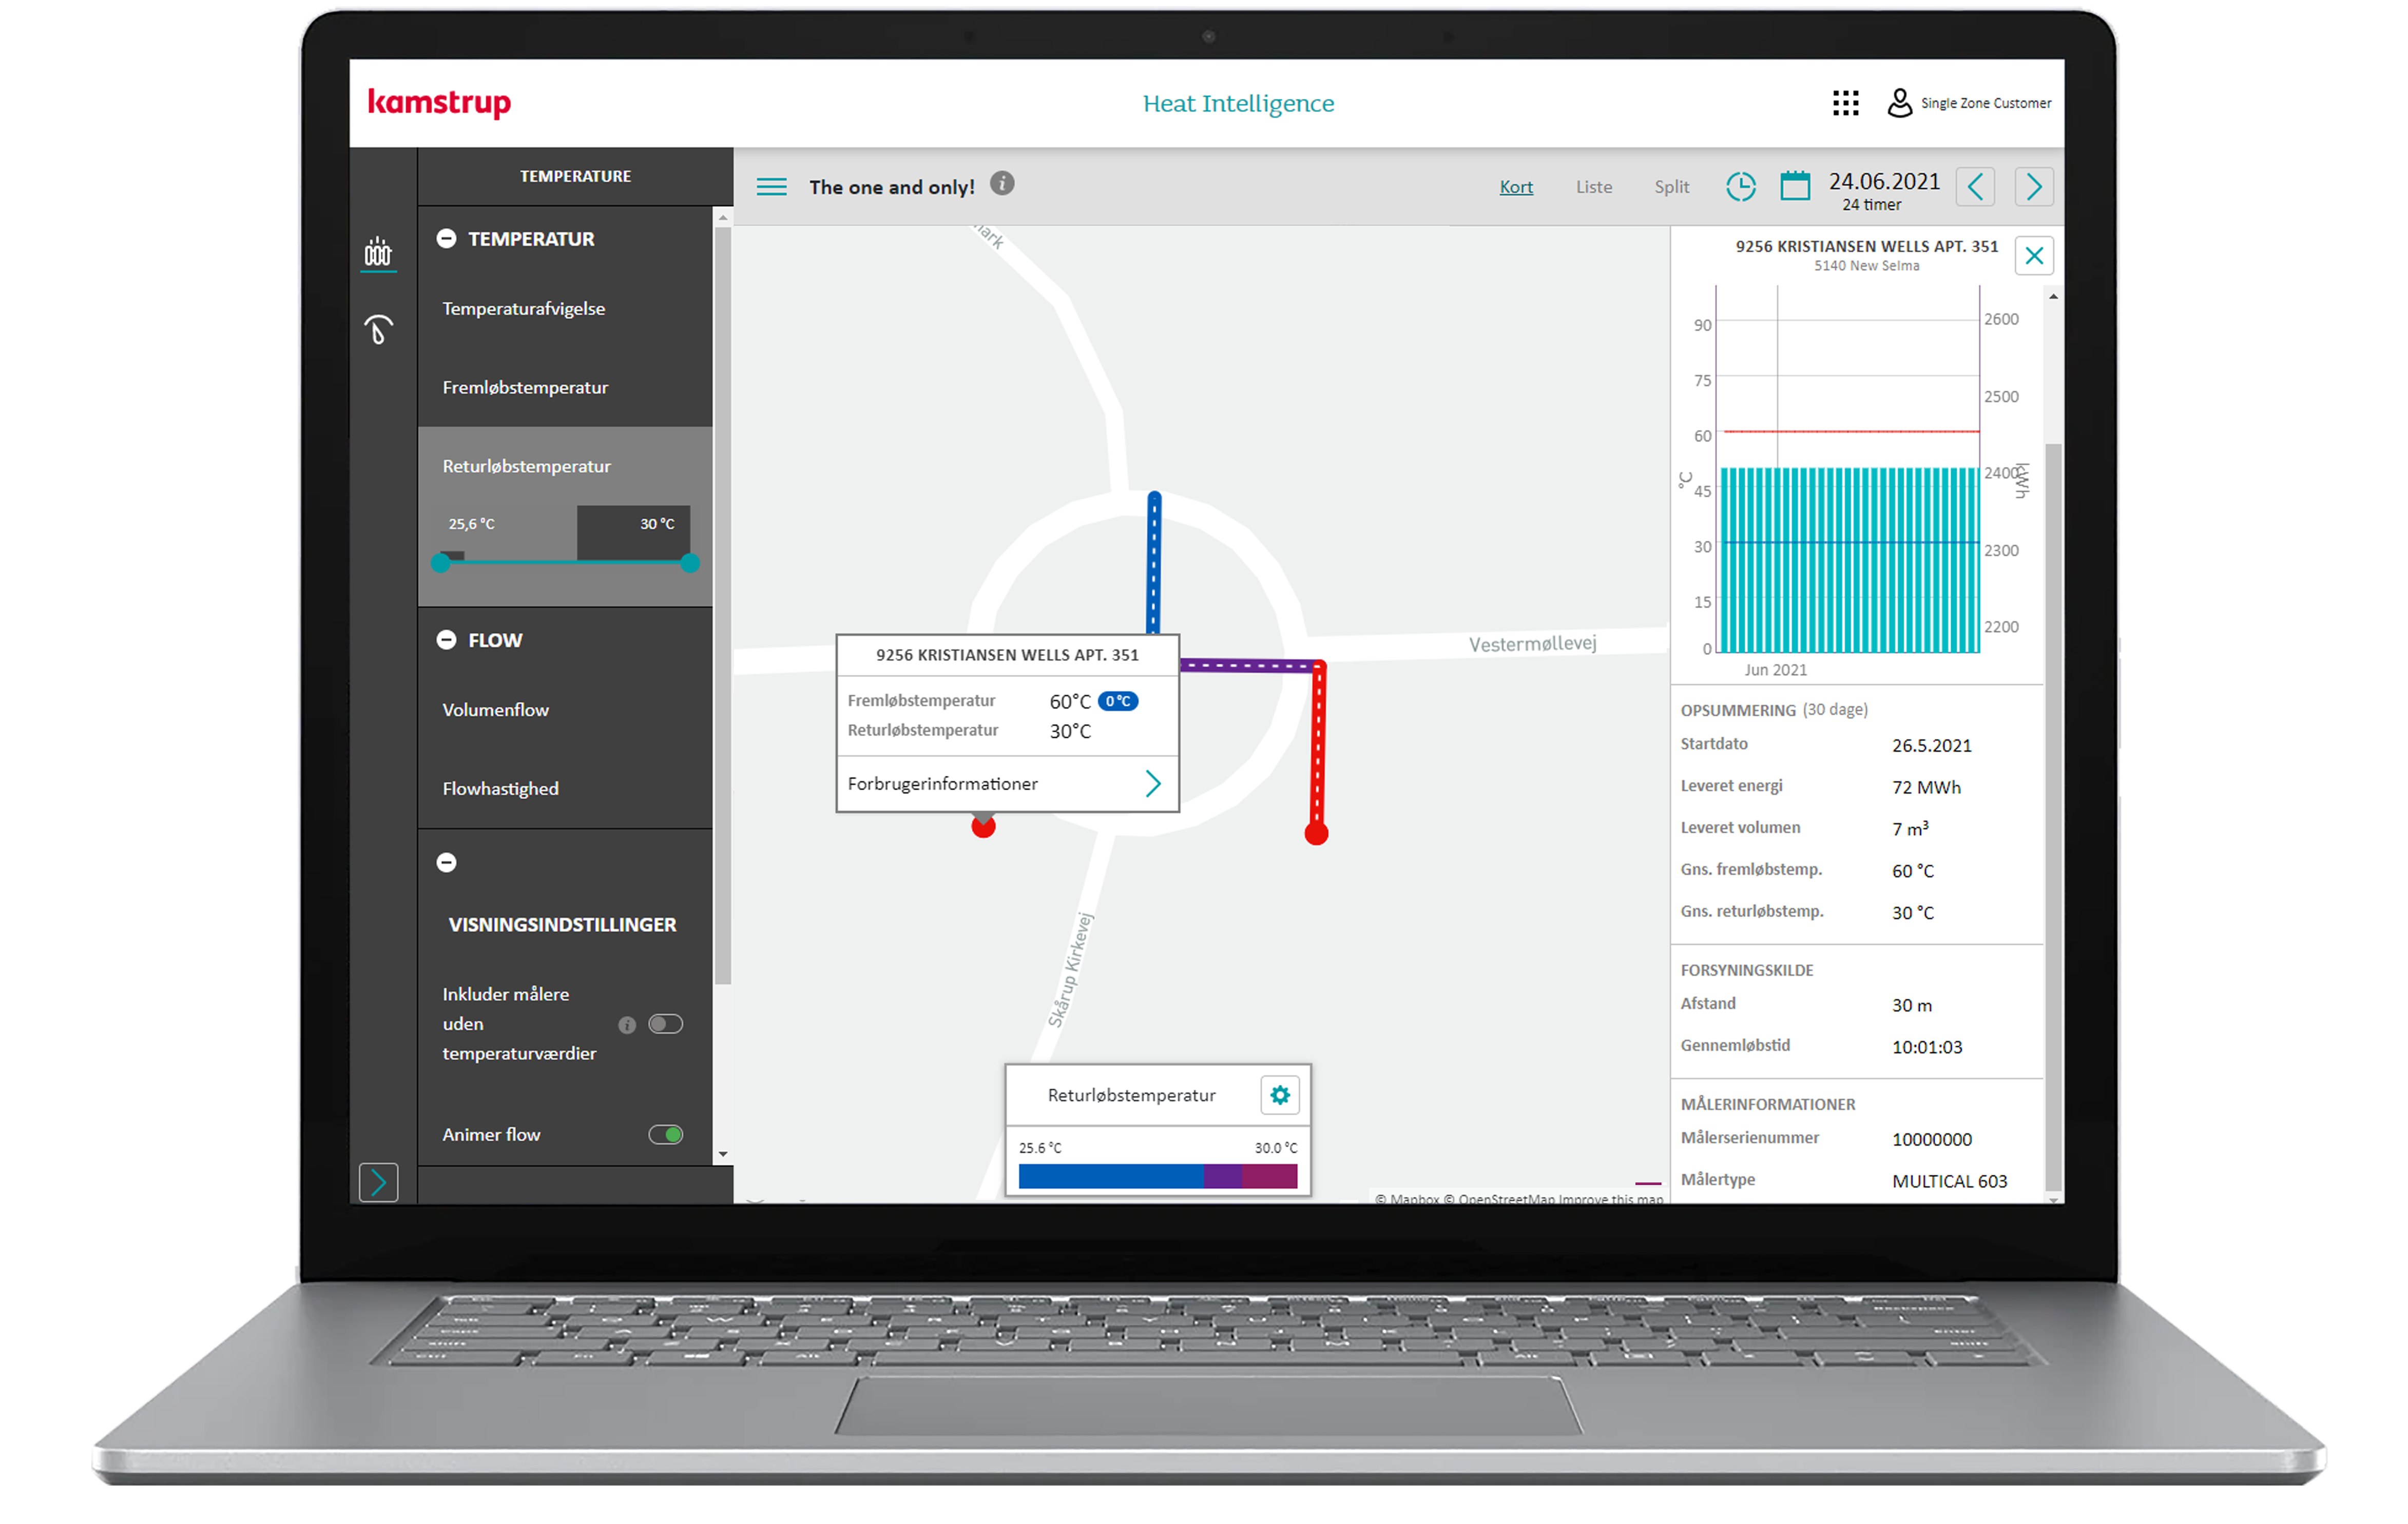
Reduce heat loss - Identify poor return temperatures
Is high return temperatures at your agenda?
How do you identify households with high return temperatures indicating that something might be wrong with the heat installations?
What could you gain from identifying it?
With Heat Intelligence you can identify households where the data indicates that heat exchangers or valves might be defective or not optimally adjusted, leading to unnecessary heat loss
Notes:
Heat Intelligence allows you to identify households with high return temperature and dive into data showing not only the return temperature but also the volume of hot water delivered over time. By doing that you can identify households with insufficient cooling which might be caused by for example a defect heat installation.

Slide 10


Reduce heat loss - identify unknown bypasses
Is unknown bypasses on your agenda today?
How do you identify bypasses that should be removed or adjusted?
How much energy could you potentially save if unnecessary bypasses were removed or adjusted?
With Heat Intelligence you can find households with unexpected high forward temperatures which could be caused by a bypass that should be removed or adjusted because it leads hot water around the household and back to the utility plant without delivering energy to the household
Notes:
Unexpected high forward temperatures and low difference between forward and return temperature may indicate an unknown bypass. Use Heat Intelligence to find bypasses which should be removed or adjusted.
With Heat Intelligence you can find households with unexpected high forward temperatures which could be caused by a bypass that should be removed or adjusted because it leads hot water around the household and back to the utility plant without delivering energy to the household

Slide 11
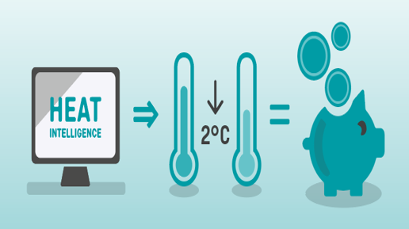
Lower temperatures - identify bad performing pipes
Do you have “Bad pipes” in your distribution network?
How do you identify such pipe sections for example for prioritization of pipe network maintenance work?
How much could you lower the forward temperatures if problems with bad performing pipe sections got fixed?
Identify sections with unexpected low forward temperatures which could indicate for example that pipe insolation might be damaged or not existing
Notes:
Unwanted low forward temperatures may be caused by a network section with pipes that are not performing sufficiently due to e.g. damaged insulation. Identifying and repairing or replacing such a section reduces unnecessary heat loss.

Slide 12

Optimize pressure - identify pressure issues
Is energy consumption for pumps on your agenda?
How do you identify opportunities for reducing flow and thereby saving energy for pumps?
How much could you potentially save if you were able to turn down the pumps, reduce flow and still deliver enough heat to the users?
With Heat Intelligence you can search for pipe sections with very high-pressure loss which could indicate a bottleneck that should be solved. Or you can find households with unnecessarily high differential pressure which indicates that you should consider to turn down the flow and thereby save energy for pumps.
Notes:
A distribution network is being developed over many years with constant changes in heat consumption everywhere in the network and new households being added.
This may cause low pressure in different parts of the distribution network so that the utility can’t ensure sufficient heat to all of the households in the network.
With Heat Intelligence, you can search for households with too little differential pressure and you can search for pipe sections in the network with too low pressure or too much pressure loss.
Identifying and repairing such bottlenecks in the distribution network will help you deliver sufficient heat at a lower forward temperature, thereby saving energy

Slide 13
Your heat meter data helps you to cut costs and emissions
Let Heat Intelligence help you to:
Reduce heat loss for example by identifying households with poor return temperatures or by finding bypasses in the network that should be removed or adjusted
Lower temperatures e.g., spot pipe sections that doesn’t perform well
Optimize pressure and flow e.g., identify bottlenecks or pipe sections with unnecessarily high differential pressure

Slide 14
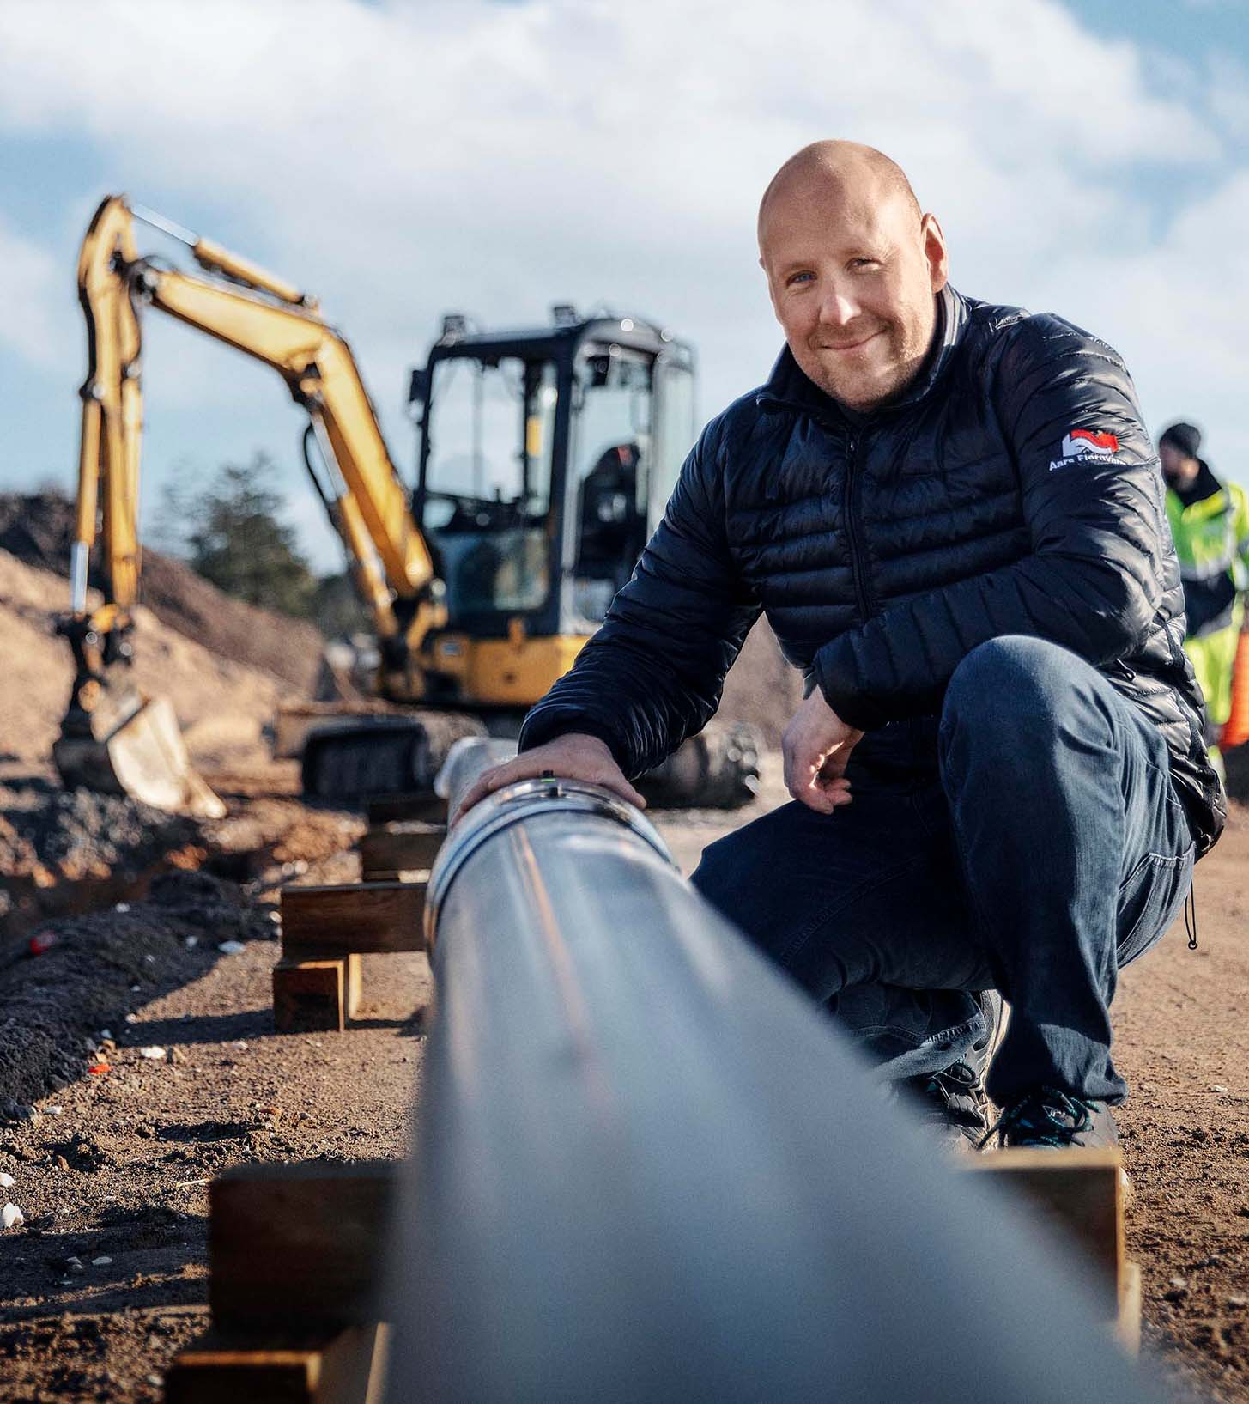

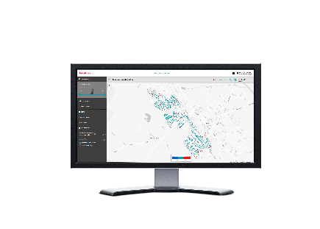

Aars District Heating
From 200 to 16 bypasses
7.8 MWh
less annual heat loss per customer in low-performing areas
10 °C
unexpected heat loss in few meters
"With Heat Intelligence, we can prioritise pipe replacement based on where it will have the biggest impact – and deliver the most value for money“.
Kasper Neve, Engineer at Aars District Heating
Solution
Heat Intelligence
Intelligent heat meters
14
Notes:
Kasper and his team focussed on bypasses, a common source of heat loss and increased return temperatur. They suspected that most of the bypasses in the distribution network were unnecessary and identified locations where the forward temperature was higher than it should be.
“The tool was able to identify the bypass locations where the forward temperature was higher than it should be according to the calculation model,” says Kasper.
Temperature deviations are often caused by a bypass near the meter. Here the utility could test the need of each bypass by turning it off — meaning that the number would go from roughly 200 to 16. As a result, this would lower the return temperature by up to 1.5 °C, in some areas, while also reducing the forward temperature.
Heat Intelligence also helped Aars identify an area in the network that was performing poorly. Temperature deviations in the area showed that temperature delivered to the customers was significantly lower than expected.
This was caused by the old service pipes’ wet insulation, caused by diffusion of water vapor over the years. With Heat Intelligence, Kasper Neve could identify the day in which each pipe was replaced. A comparison of forward temperatures before and after the renovation showed an increase of up to 10 °C and a reduction of the annual heat loss of 7.8
Aars also assessed whether to invest in replacing the service pipes in certain areas earlier than planned. One address specifically showed a heat loss of over 10 °C from the street into the house. So, by replacing the service pipe the utility would deliver 10 °C more to the customer without producing more heat.
When the pipe was examined, it turned out that the massive heat loss was due to wet insulation caused by years of diffusion of water from inside the pipe. The coupler, joint and outer casing were all in perfect condition, and there was no water outside the pipe.

Slide 15
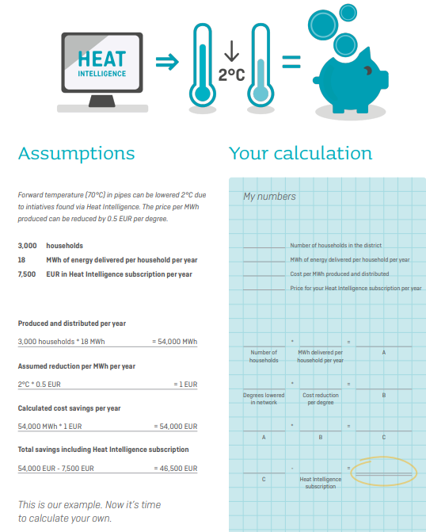
Let us help you take the next step in optimizing your distribution network
Calculation tools based on assumptions:
Calculate annual cost-savings based on reduction of temperatures
Calculate annual cost-savings based on optimization of pressure in the network
Calculate annual cost-savings based on reducing heat loss
Notes:
We have various calculation tools to calculate the expected cost-savings that initiatives based on our Heat Intelligence solution can help you achieve. Based on assumptions on average heat loss in the network, produced and distributed heat per year, and expected reduction of heat loss per year, we can calculate the expected annual cost-savings

Slide 16


Thank you
Branko Crnčević
Director
Phone +381 63639456
Mail: bnc@termonet.rs
Termonet
Thomas Tryk
Key Account Manager
Phone +29 13 56 31
Mail: ttr@kamstrup.com
Kamstrup A/S
Notes:
If you have any questions or want to discuss future opportunities with us regarding meters, softwares and solution we encourage you to reach out to Bane or me

