Slide 1
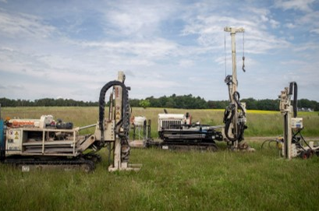
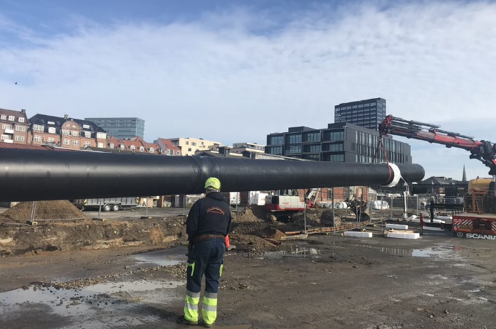
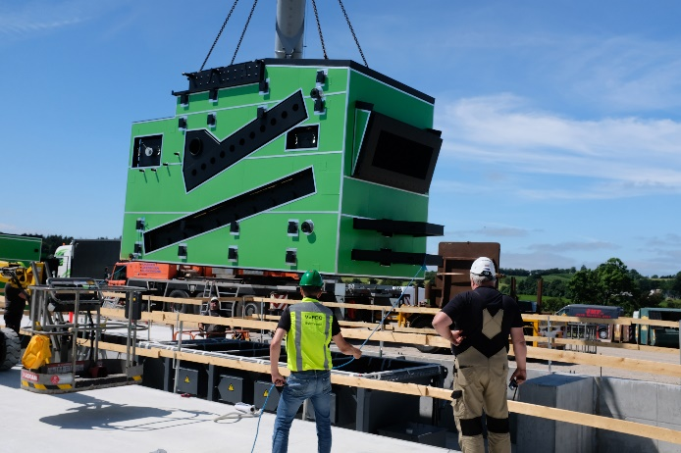
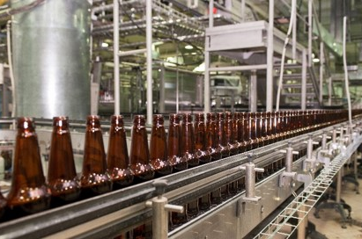
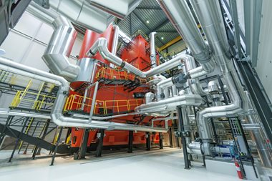
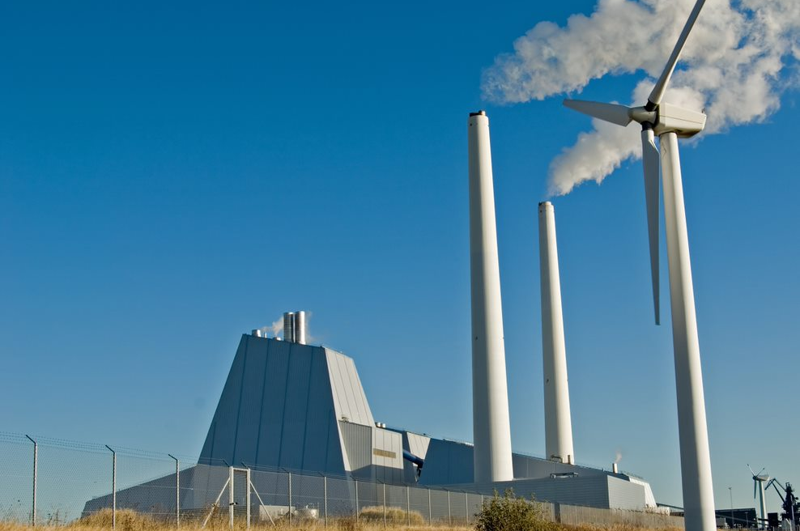
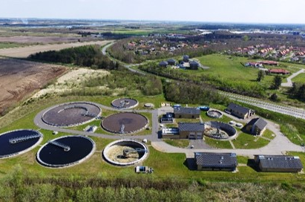

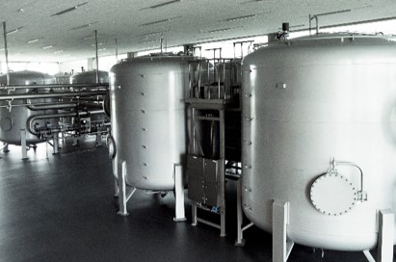
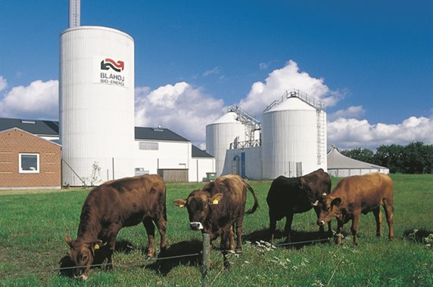
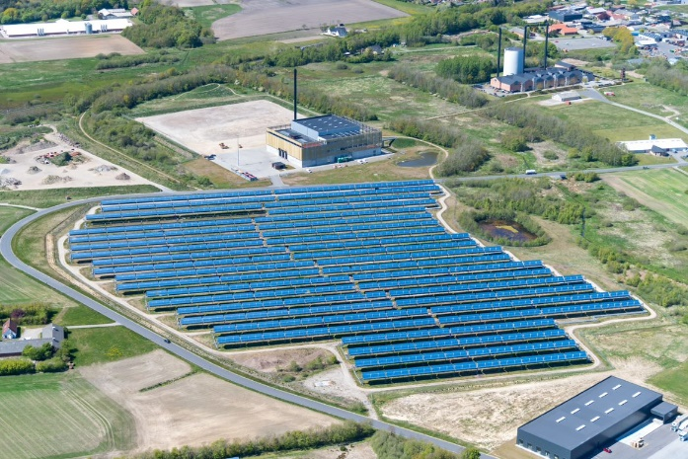
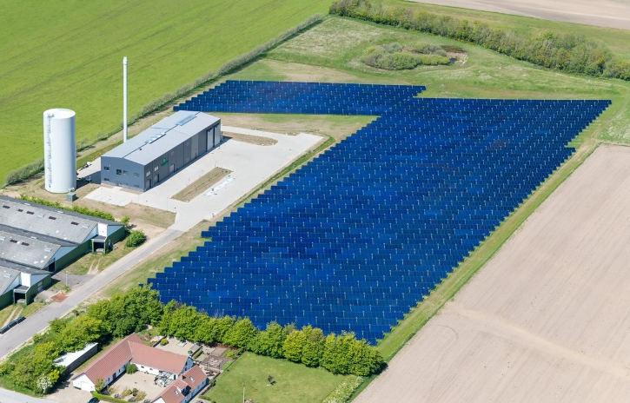

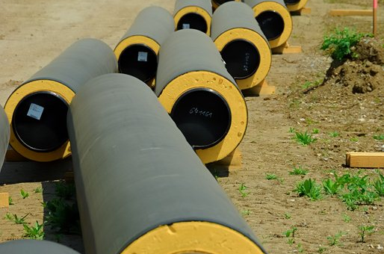
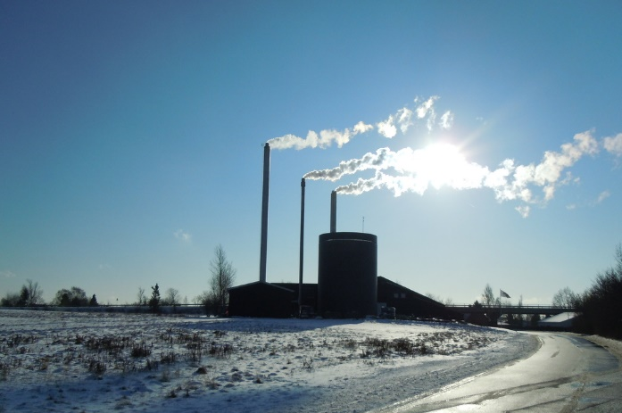
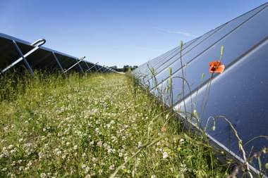
 | D | Integration of the heat pump technologies in the district heating sector in Serbia Opportunities and challenges
 |  | Vrnjacka Banja, Serbia, April 2023

Slide 2

AGENDA
Heat pump Technologies
Integration of heat pumps - Opportunities
Identified opportunities in Serbia
Challenges
Solutions – as conclusion

Slide 3
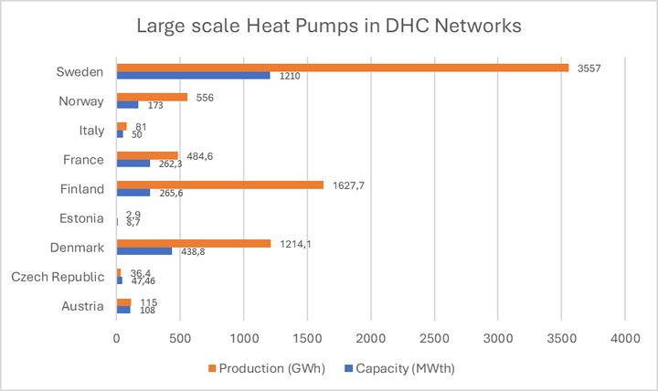
Heat pump Technologies
Why heat pumps?
State-of-art in the district heating sector in EU countries
Unlock potential for the new LOW TEMPERATURE heat sources
Contributes to the phase-out of fossil fuels in the energy system
Reduce the heat production and CO2-emission
To create a greener energy sector by using more different fuels and enable sector integration
Relevant for both small, medio-sized and bigger energy DH companies
An economically viable option
2.5 GWth (2021) of
installed capacity of large heat pumps in DHC systems*
(Heat Roadmap Europe project estimates a potential 50% market share for District Heating by 2050 in Europe, with approximately 25-30% of installed capacity based on large electric heat pumps.)
*Euroheat&Power survey

Slide 4
Integration of heat pumps - Opportunities
Drivers opening the market
Benefits for the DH Companies
EBRD Renewable District Energy Program in Serbia
KfW program for rehabilitation of district heating systems in RS
Energy crisis caused by the war in Ukraine
National legal framework - LEERUE also envisages the development of a potential analysis for highly efficient cogeneration and the possibility of using efficient district heating/cooling in accordance with Article 14 of the EED
NREAP underlines the introduction of district heating systems based on the use of RES and combined heat and power production;.
Energy security of Republic of Serbia underlines intensification of use of RES in district heating systems in Serbia
DH companies need to reduce the GHG emissions in the process of the decarbonization of the DH sector in Serbia
The combination of district heating and heat pumps are foreseen to have a key role in the future district heating systems
Could cover the base heat load reducing the current dependence on the natural gas.
Various technical solutions are available and commercially proved
Heat pumps are modular so district heating schemes can be designed to heat any number of properties of all sizes, from flats to detached houses.
Highly beneficial from an environmental perspective
Maintenance of the heat pumps is also very straightforward
Increased employment

Slide 5

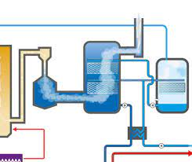



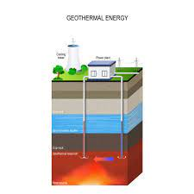
Integration of heat pumps - Opportunities
Identified projects
KRAGUJEVAC
Utilization of waste heat from data center for the heat pump
KRALJEVO
Heat pumps for flue gas condensation Central boiler house and Nova Kolonija boiler house
KRUŠEVAC
Heat pump utilizing treated water from Wastewater treatment plant
NIŠ
Large capacity heat pump using water from Nisava river
NOVI PAZAR
Heat pump utilizing the drinking water at boiler house Lug
PARAĆIN
Heat pump using geothermal water from well at the zone of textile factory including construction of new DH network and heating substations

Slide 6
Integration of heat pumps - Opportunities
Heat sources harvested

Slide 7
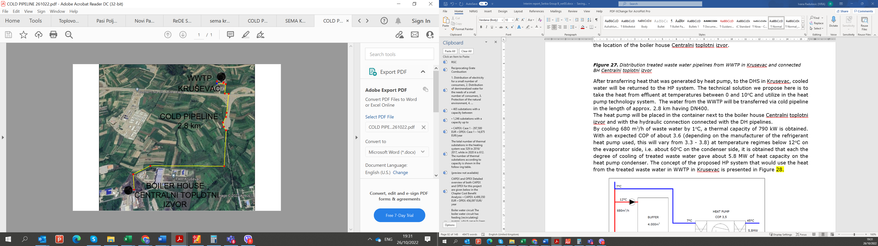
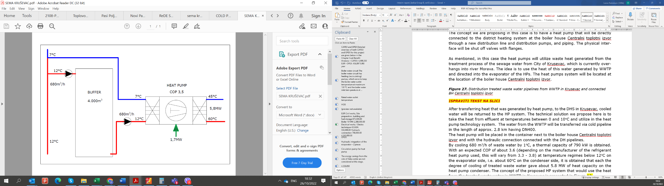
Identified opportunities in Serbia
KRUSEVAC - Heat pump utilizing treated water from Wastewater treatment plant

Slide 8
Identified opportunities in Serbia
Key parameters
Parameters | Unit | Value
Baseline scenario
Heat production "Centralni toplotni izvor" | [MWh/year] | 98,000
Specific heat production costs | [EUR/MWh] | 56.0
Annual energy cost | [EUR] | 5,487,781
Project scenario
Heat pump installed capacity | [MW] | 5.8
COP |  | 3.60
Heat production from heat pump | [MWh/year] | 25,891
Electricity consumption for HP and pumping | [MWh/year] | 7,987
The percentage of energy that will be provided by the heat pump | [%] | 26.42%
Total annual cost savings | [EUR] | 691,123
Annual CO2 emissions reduction | [tCO2] | 300
Cumulative cost savings for 20 years | [EUR] | 13,822,460
Estimated value of investment | [EUR] | 6,113,445
LCOH – Baseline scenario | [EUR/MWh] | 56
LCOH – Project scenario | [EUR/MWh] | 41
Simple payback period | [years] | 8.8
Simple payback period with 20% of grant | [years] | 7.1

Slide 9
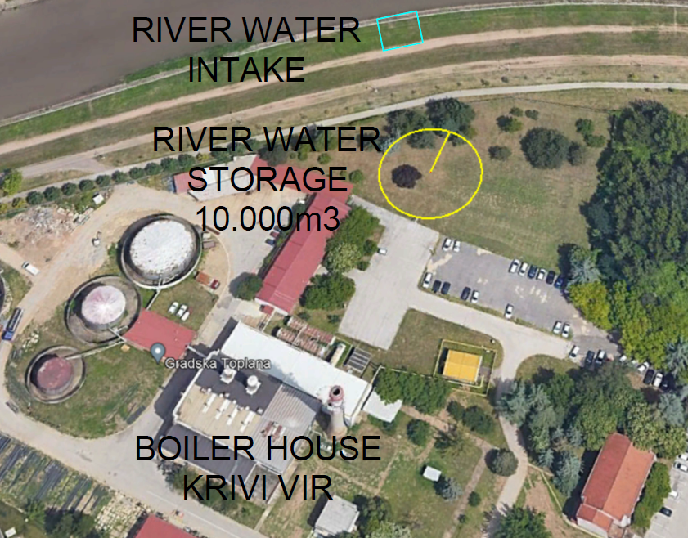
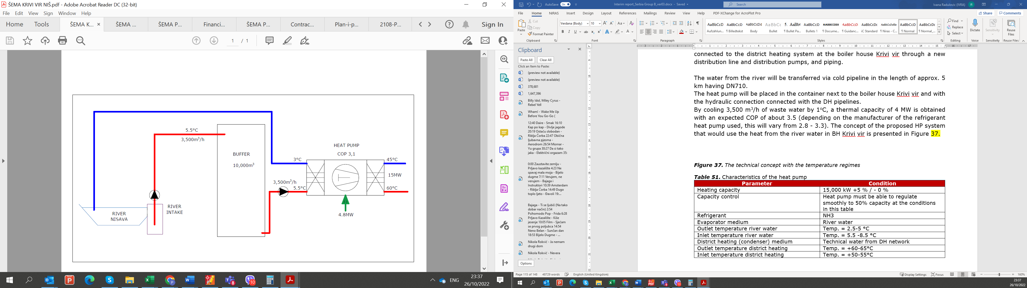
Identified opportunities in Serbia
NIS - Large capacity heat pump using water from Nisava river

Slide 10
Identified opportunities in Serbia
Key parameters
Parameters | Unit | Value
Baseline scenario
Heat production at BH Krivi Vir | [MWh/year] | 134,000
Specific heat production costs | [EUR/MWh] | 56.0
Annual energy cost | [EUR] | 7,503,701
Project scenario
Heat pump installed capacity | [MW] | 15
COP |  | 3.50
Heat production from heat pump | [MWh/year] | 66,960
Electricity consumption for HP and pumping | [MWh/year] | 20,727
The percentage of energy that will be provided by the heat pump | [%] | 49.97%
Total annual cost savings | [EUR] | 1,780,516
Annual CO2 emissions reduction | [tCO2] | 727
Cumulative cost savings for 20 years | [EUR] | 35,610,320
Estimated value of investment | [EUR] | 13,888,600
LCOH – Baseline scenario | [EUR/MWh] | 56
LCOH – Project scenario | [EUR/MWh] | 40
Simple payback period | [years] | 7.8
Simple payback period – 20% grant | [years] | 6.2

Slide 11
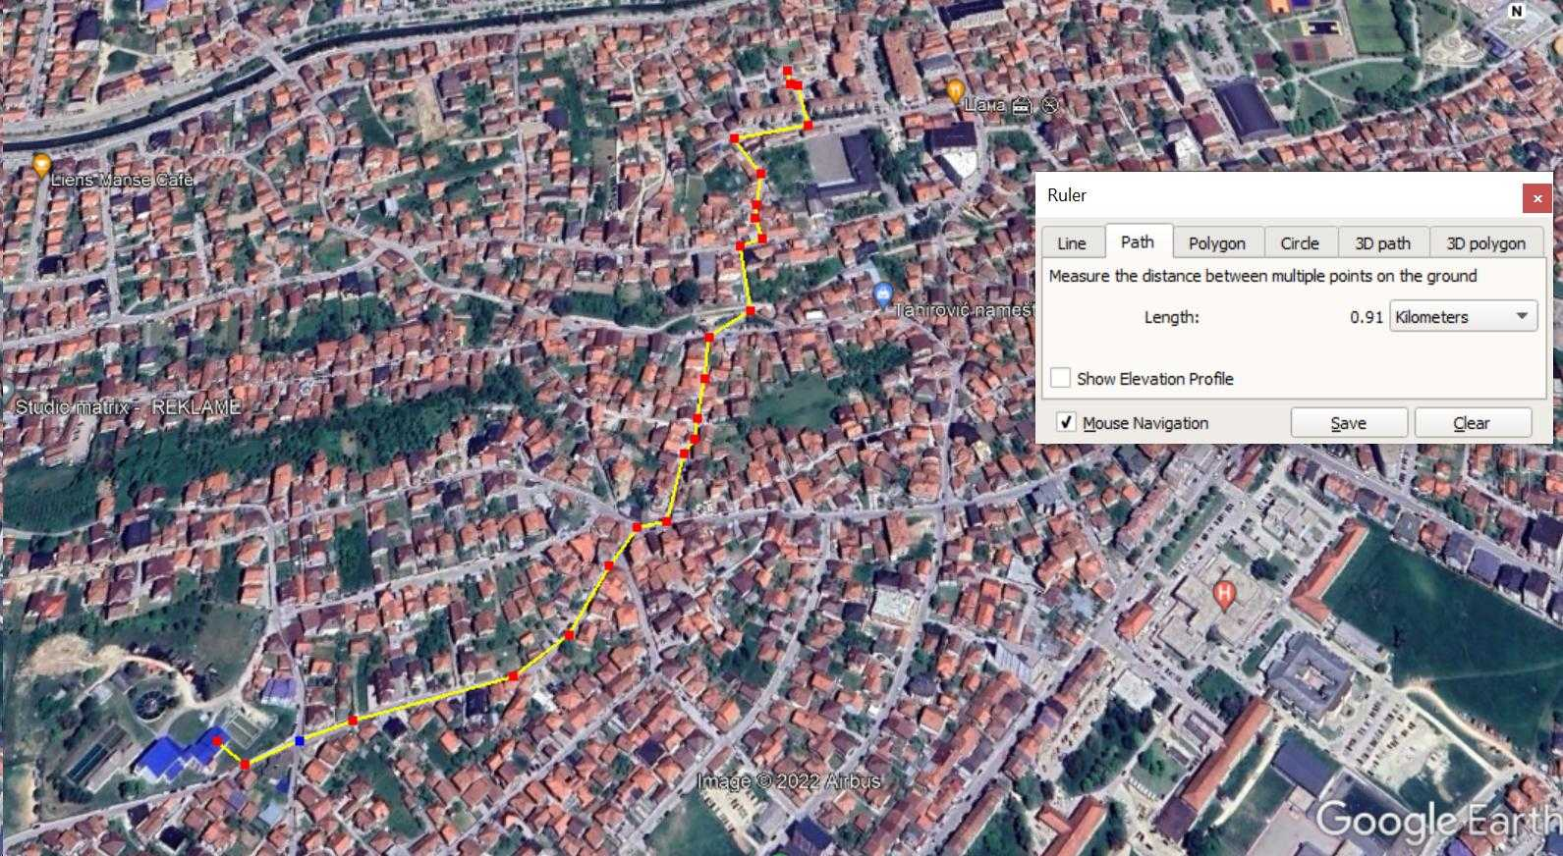
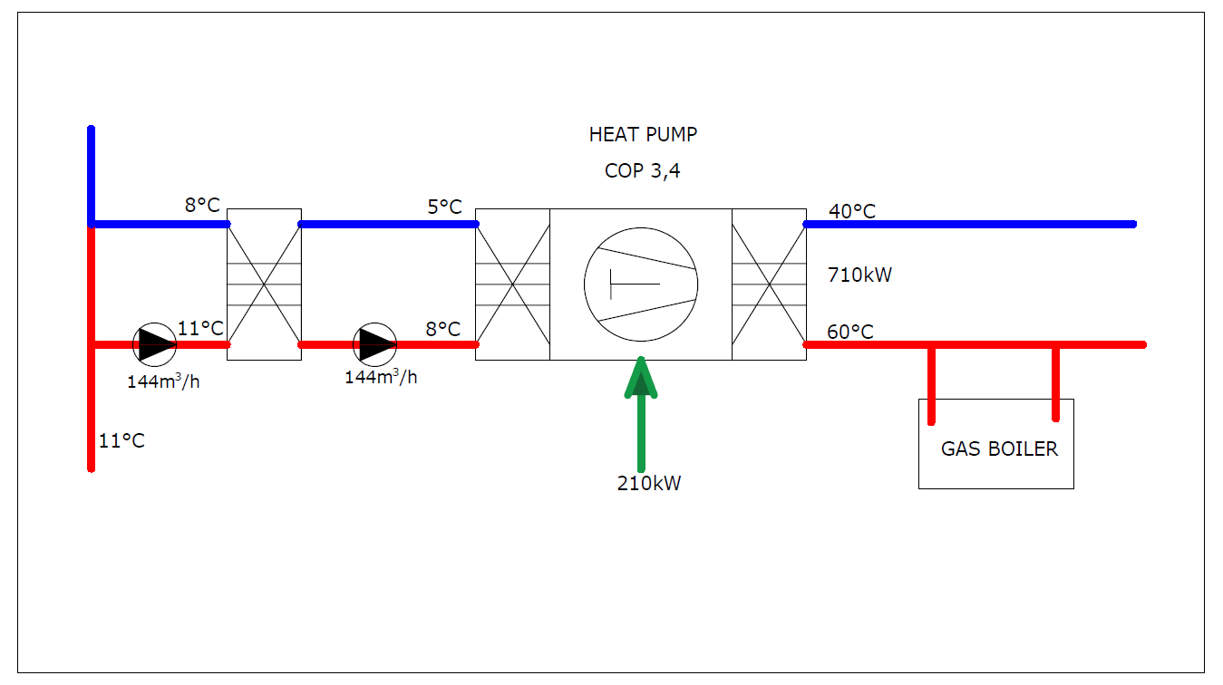
Identified opportunities in Serbia
NOVI PAZAR - Heat pump utilizing the drinking water at boiler house Lug

Slide 12
Identified opportunities in Serbia
Key parameters
Parameters | Unit | Value
Baseline scenario
Heat production at BH Lug | [MWh/year] | 1,687
Specific heat production costs Coal/Fuel oil | [EUR/MWh] | 96.6
Annual energy cost | [EUR] | 162,922
Project scenario
Heat pump installed capacity | [MW] | 0.71
COP |  | 3.4
Heat production from heat pump | [MWh/year] | 1,243
Electricity consumption for HP and pumping [MWh/year] | [MWh/year] | 438
The percentage of energy that will be provided by the heat pump | [%] | 73.67%
Total annual cost savings | [EUR] | 78,404
Annual CO2 emissions reduction | [tCO2] | 452
Cumulative cost savings for 15 years | [EUR] | 1,176,066
Estimated value of investment | [EUR] | 769,651
LCOH – Baseline scenario | [EUR/MWh] | 96.6
LCOH – Project scenario | [EUR/MWh] | 64
Simple payback period | [years] | 9.8
Simple payback period– 20% grant | [years] | 8.6

Slide 13
Challenges
Gas boilers are currently one of the most common heating technologies
Old fashion non-condensing gas boilers do not recover heat from the flue gases
Current possibilities of DH companies (in knowledge and finance)
Insufficient hydraulic regulation of DHS (excessive flows and insufficient cooling of thermal substations)
No single solution
Increase the electricity price
Lack of the heat pumps in the market
Availability of sufficient numbers of trained installers

Slide 14
Solutions– as conclusion
Cost barriers solutions
Upfront costs: Grants, Low‐interest loans, Tax rebates, Risk mitigation schemes for medium‐ to large‐scale projects
Operating costs: Rebalancing electricity and fossil fuel taxes, Electricity and heat tariff reforms, Support for building insulation and heat distribution system upgrades, Quality and settings control after installation, DH staff training
Non-cost barriers solutions
One‐stop‐shop platforms
Regulation changes for optics, noise and building permissions
Revision of decision‐making rules
Minimum energy efficiency requirements for buildings connected to DH
Information campaigns towards consumers
Supply side solutions
Long‐term certainty in policy support and regulations, as well as visibility into forthcoming regulation changes
National heat pump deployment targets and roadmaps
Securing of heat pump component supply chains
Grants
Risk mitigation
Regulations for noise, optics
HP deployment target
DH staff training
Campains
Revision of decision making rulesconsumption
Electricity tariff reform

Slide 15


 |  | NIRAS Energy
 |  | Thank you for your attention!
Notes:
https://balkangreenenergynews.com/renewables-get-increasing-role-in-district-heating-in-serbia/
Nøgleord: energy efficiency, reducing irrational consuption, start using more renewables.
introducing renewable energy sources for district heating systems, improving energy efficiency in district heating systems and improving regulatory framework at state and local level

