Slide 1
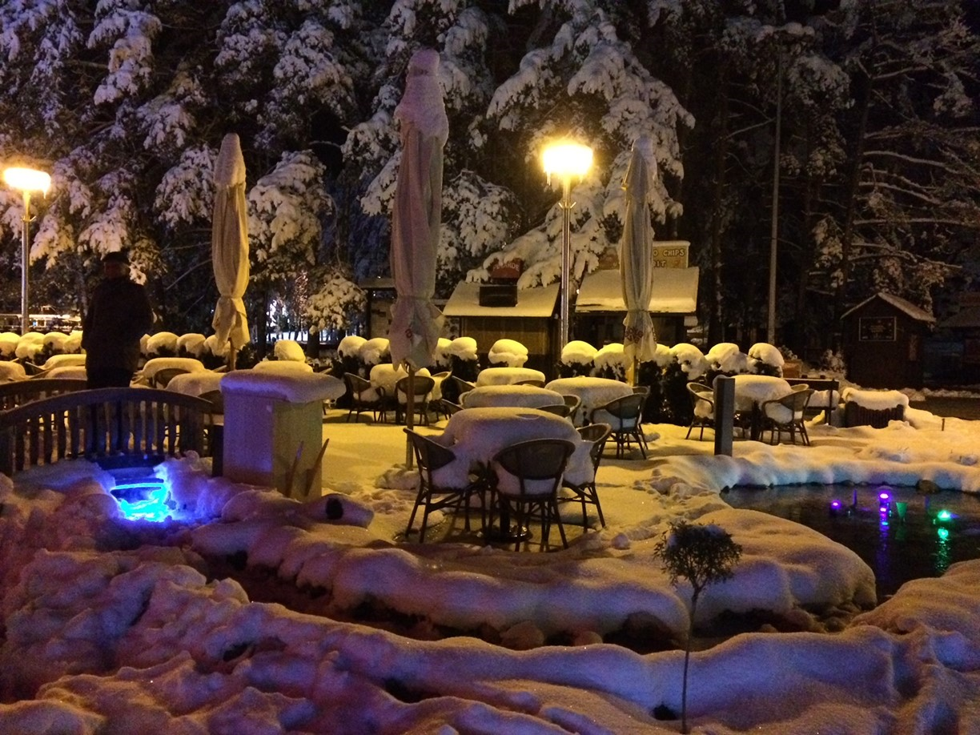
Serbian Danish District Heating Days Vrnjačka Banja, Serbia – 18 to 20 April 2023 Green transition of the district heating sector – including surplus heat from data centers
Lars Gullev
Senior consultant
Vice-chair, IEA DHC
Zlatiborski – 19 April 2017

Slide 2

Agenda
Paris Agreement
CO₂-emission in Serbia and Denmark
VEKS Strategy and CO₂-emission
Impact points
Storage
Data center
Carbon Capture (CC)
Summary

Slide 3
Agenda
Paris Agreement
CO₂-emission in Serbia and Denmark
VEKS Strategy and CO₂-emission
Impact points
Storage
Data center
Carbon Capture (CC)
Summary

Slide 4

Paris Agreement A global challenge and a global agreement
In 2015, 196 countries signed the UN's major climate agreement in Paris.
Together they set a goal:
Prevent the global temperature from rising by more than 2 degrees C.
The countries committed to share their national climate action plans and say how much they want to reduce their greenhouse gas emissions - but it is voluntary whether they actually do it!

Slide 5

Paris Agreement A global challenge and a global agreement
The EU has announced, on behalf of Denmark and the other EU countries, that we will collectively reduce our emission of greenhouse gases by 55% in 2030 compared to the level in 1990.
The EU's climate policy is about achieving that goal.
The EU was founded as a community for coal and steel. Today, it is a main priority to reduce CO₂ pollution.

Slide 6
Agenda
Paris Agreement
CO₂-emission in Serbia and Denmark
VEKS Strategy and CO₂-emission
Impact points
Storage
Data center
Carbon Capture (CC)
Summary

Slide 7
Development in CO₂ emissions Serbia and Denmark
Political decision in Denmark:
CO₂-emission in 2030 must be reduced by 70% compared to the 1990-level.
Development 2000-2019
Serbia Plus 13%
Denmark Minus 48%
Source: CO2-udslip per indb. (globalis.dk)
Source: CO2 emissions (metric tons per capita) | Data (worldbank.org)

Slide 8
Agenda
Paris Agreement
CO₂-emission in Serbia and Denmark
VEKS Strategy and CO₂-emission
Impact points
Storage
Data center
Carbon Capture (CC)
Summary

Slide 9
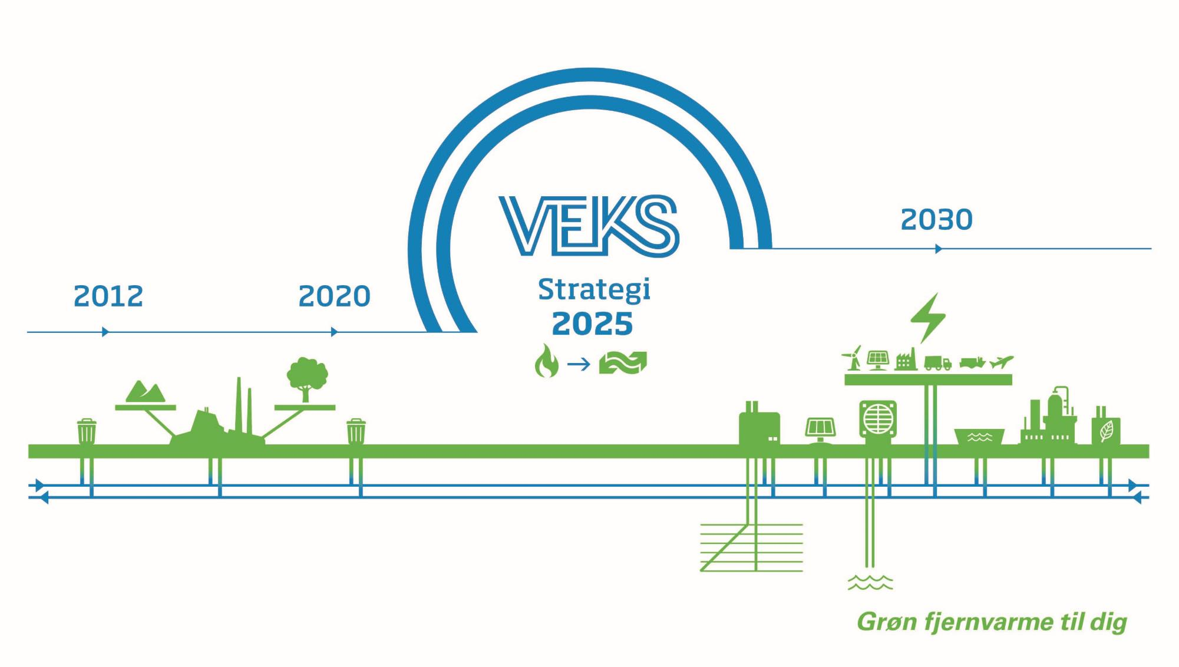

Slide 10
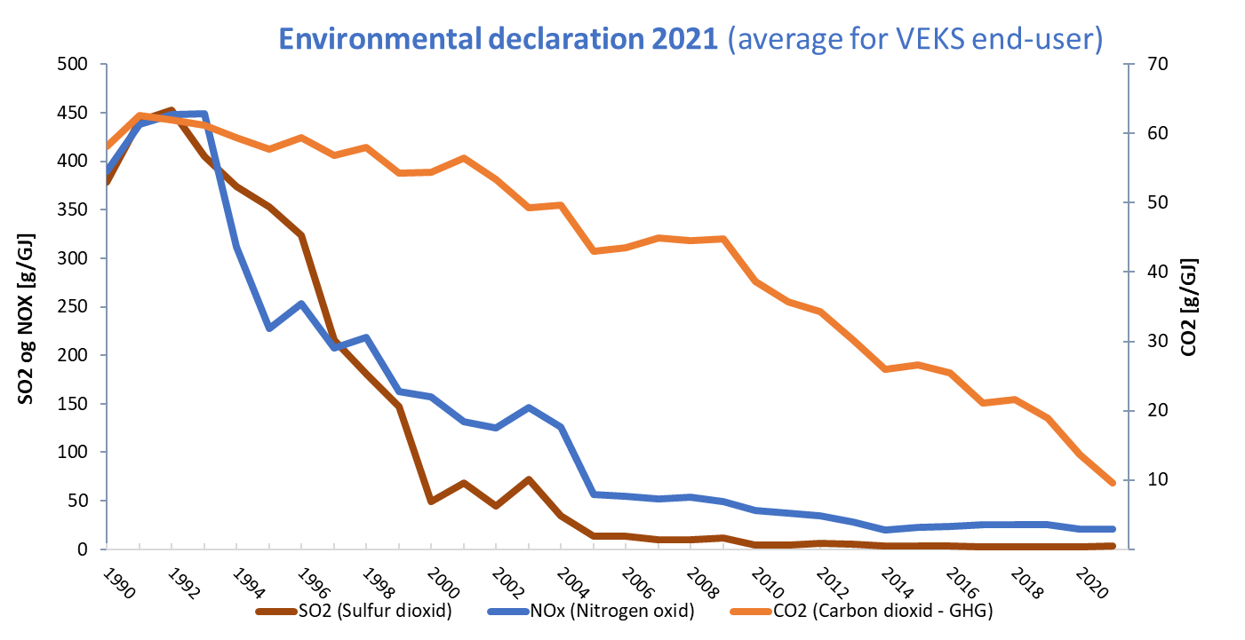
Carbon footprint
Reduction from 1990-level
83.5%

Slide 11
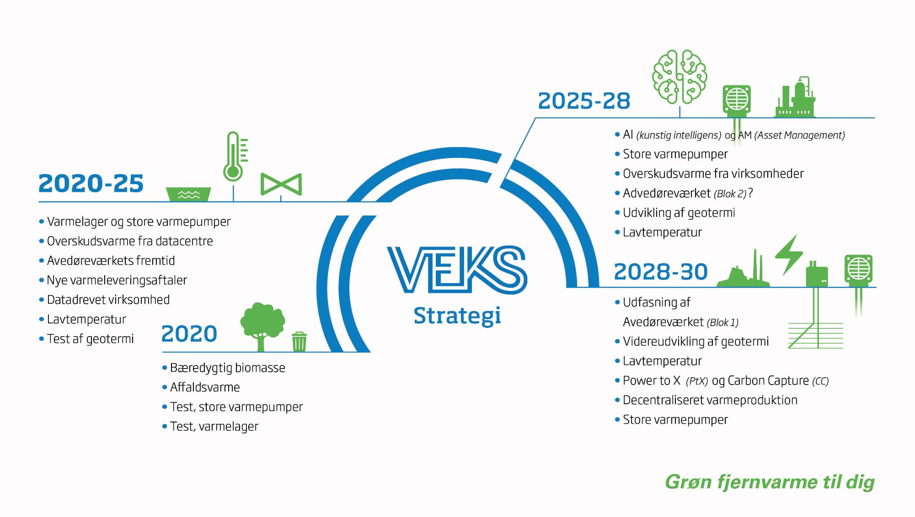
AI and AM
Large heat pumps
Surplus heat from datacentres and industry
CHP (AVV2)
Geothermal
Low temperature
Large heat pumps
Thermal heat storage
Surplus heat from datacentres
Low temperature
Test, geothermal energy
Large heat pumps
Surplus heat from datacentres and industry
Decommissioning CHP (AVV)
Geothermal
Low temperature
Power to X and Carbon capture
Decentralised heat production
Sustainable biomass
Waste-to-heat
Test, large scale heat pumps
Test, thermal heat storage

Slide 12
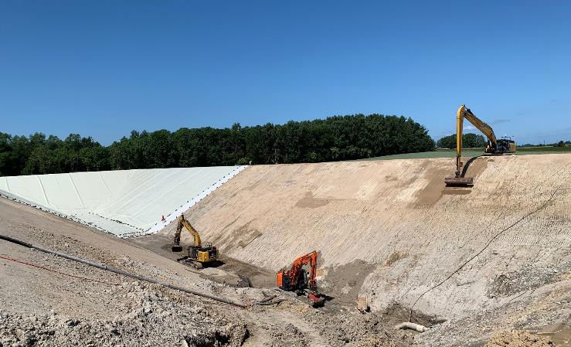
Impact point
Storage

Slide 13

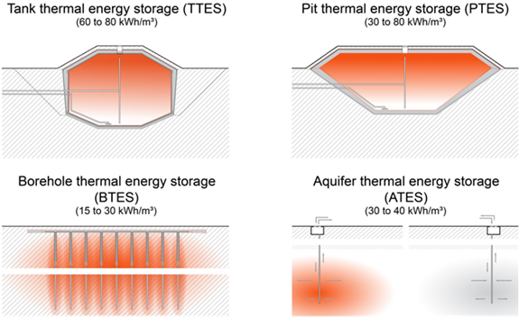
Thermal storages - Four concepts

Slide 14
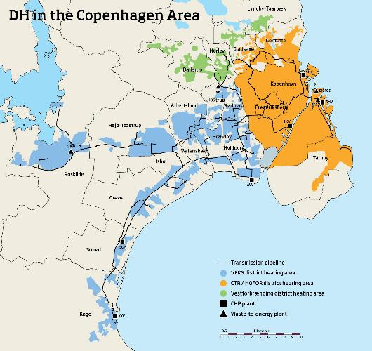
Design concept of the PTES Modelling of the PTES as part of the total heating system
Heat storage plant
The PTES receives heat from the transmission network (T_{F}~ 95-110⁰C) and delivers heat to the distribution network (T_{F} ~ 75⁰C).
The local production is operated such that it does not prevent discharge of the storage.

Slide 15
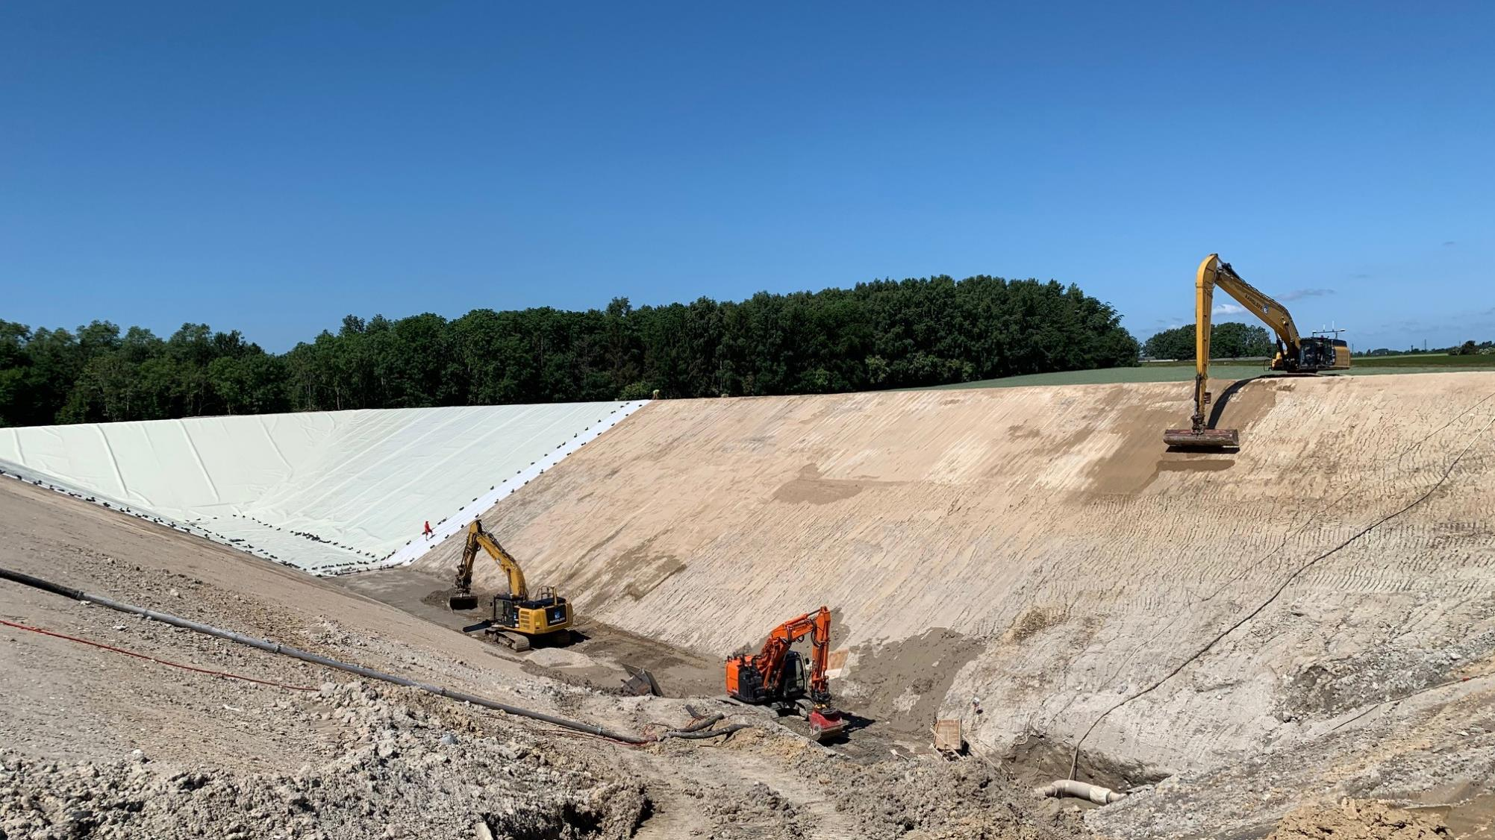
PTES in Taastrup Construction works started 2020 Went into operation February 2023
Data for PTES
Volume: 70,000 m³
Energy content: 3,300 MWh
L/W/H: 179 m/55-69 m/ 14.5 m
Annual CO₂-reduction: 10-15,000 tons

Slide 16
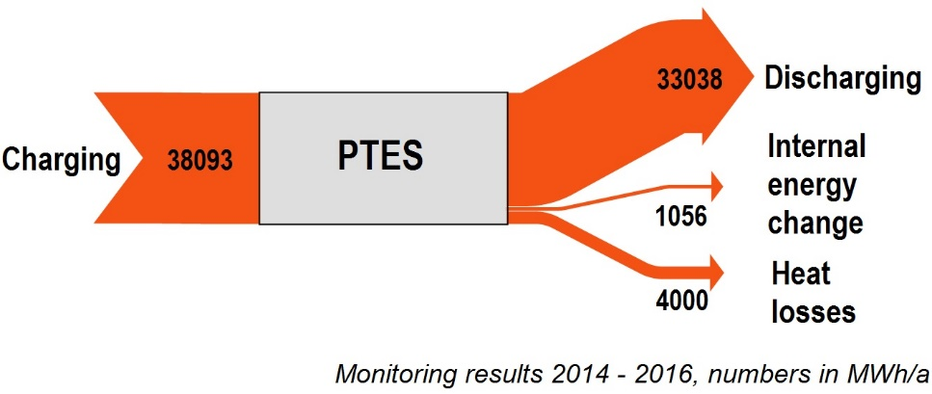
Heatlosses from PTES (60,000 m³) Dronninglund, DK - 2014-2016
10,5 %

Slide 17
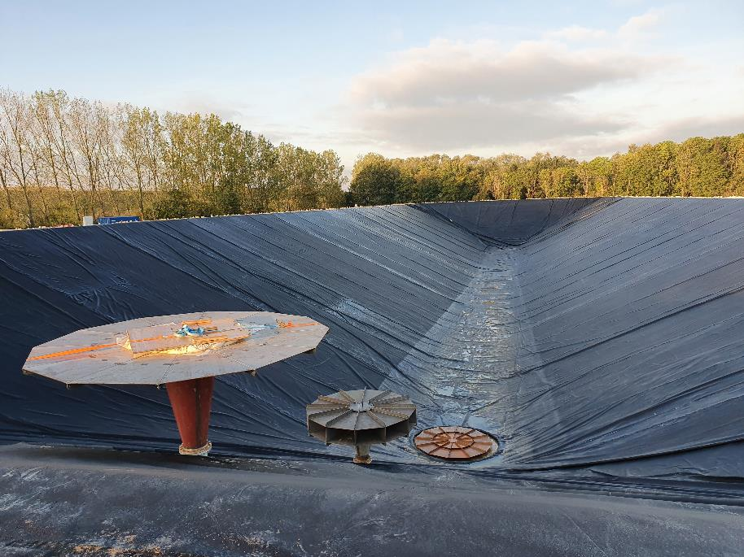
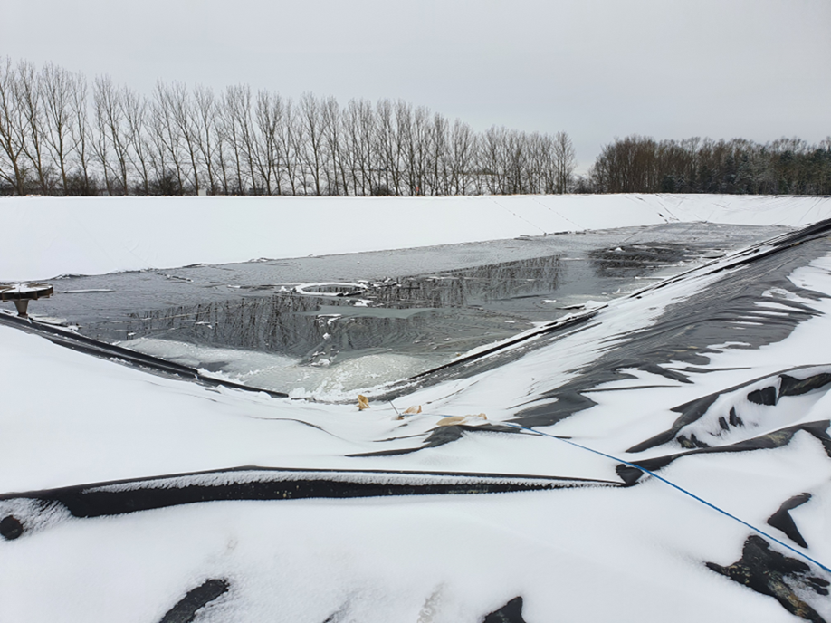
PTES under construction

Slide 18
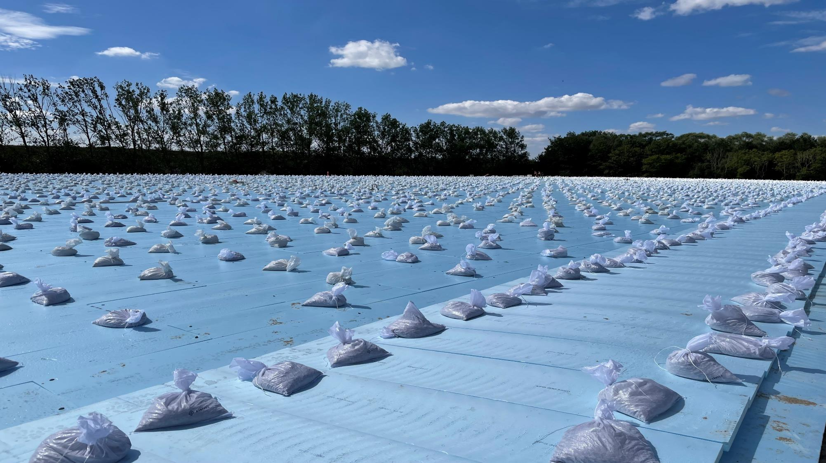
PTES in Taastrup – August 2022
6,000 bags – each 12.5 kg

Slide 19
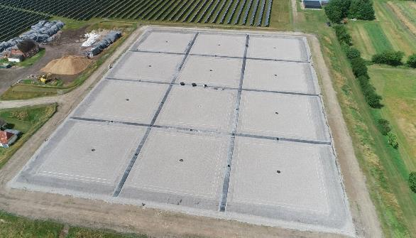
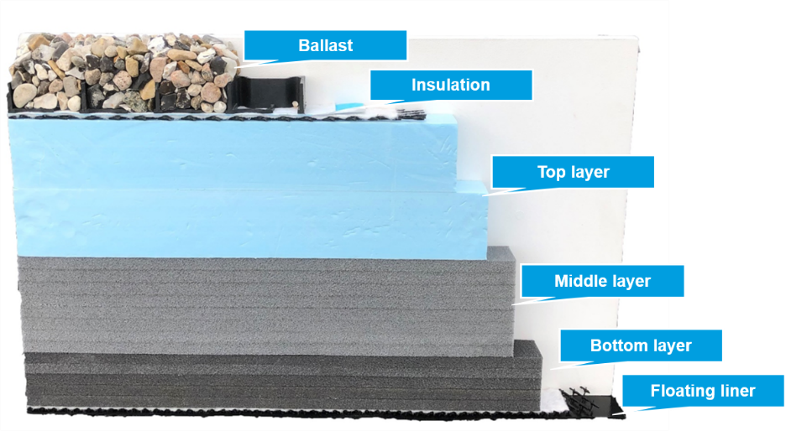
Cover
New cover solution from Aalborg CSP (used in Marstal, DK – photo).
Built on floating plastic liner.
Modular solution to minimise maintenance.
The cover is to divert rainwater and diffuse steam through a float liner – and is going to insulate against heat loss.

Slide 20

Impact point
Data center

Slide 21
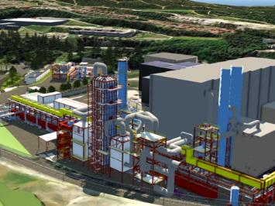
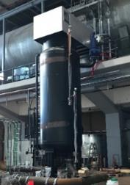

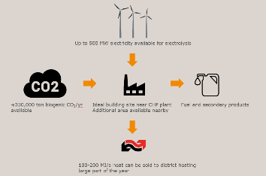
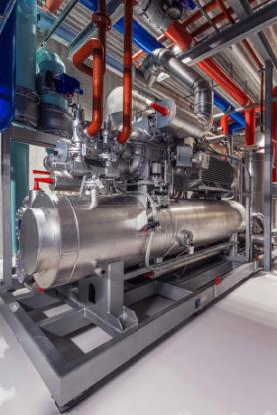
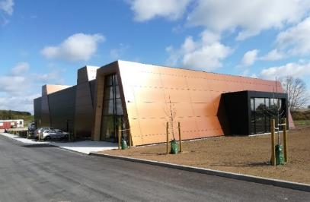
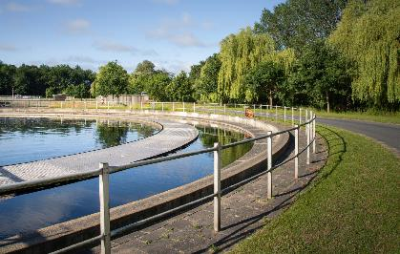
In the future DH in Odense, DK, will be green and flexible
Central
Decentral
Carbon Capture (CCS)
Power-to-X (PtX)
TBV: Tietgenbyens Varme Central (heat pumps near facebook)
EMV: Ejby Mølle Varme Central (heat pumps utilizing sewage sluge

Slide 22
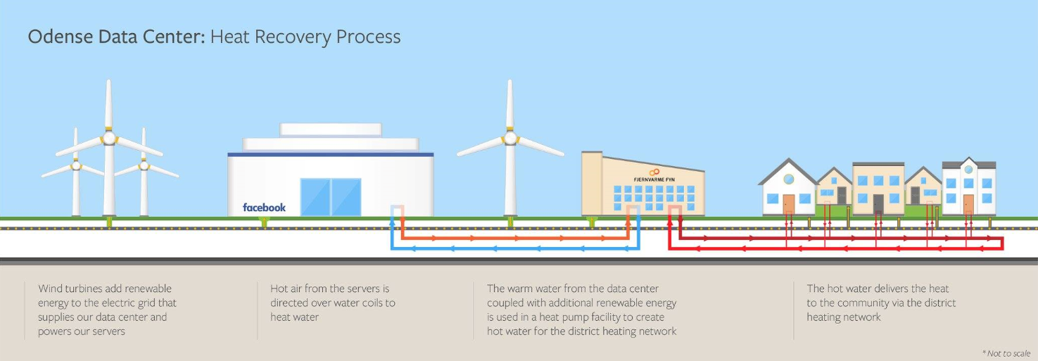
Facts about the Meta/Facebook heat recovery project
Facts:
Data center owned and operated by Facebook
Heat pump plant owned and operated by Fjernvarme Fyn
Both facilities supplied by renewable energy
Facts:
160,000 MWh surplus heat ~ 11,000 households
2017: Investment decision
2020-2021: Commissioning of TBV1 and TBV2
22

Slide 23
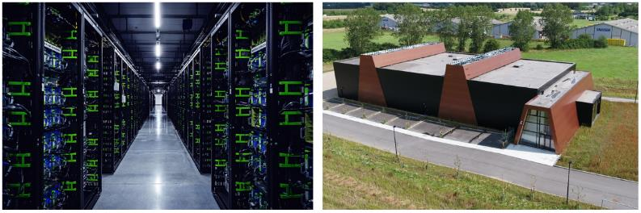
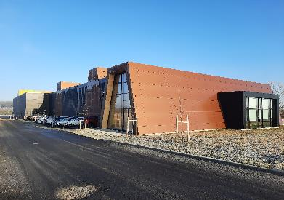
Expansion of Meta and Tietgenbyen heat central (TBV)
Phase one (2020)
Facebook: 2 data buildings (ODN 1+2)
Fjernvarme Fyn: 25 MW heat pumps (TBV 1)
Agreement: 100.000 MWh surplus heat ~ 6,900 households
Phase two (2021)
Facebook: + 1 data building (ODN 3)
Fjernvarme Fyn: + 20 MW heat pumps (TBV 2)
Agreement: + 60.000 MWh surplus heat ~ 4000 households
2023
Continuous optimization of surplus heat utilization
Source: Facebook and Fjernvarme Fyn
23

Slide 24
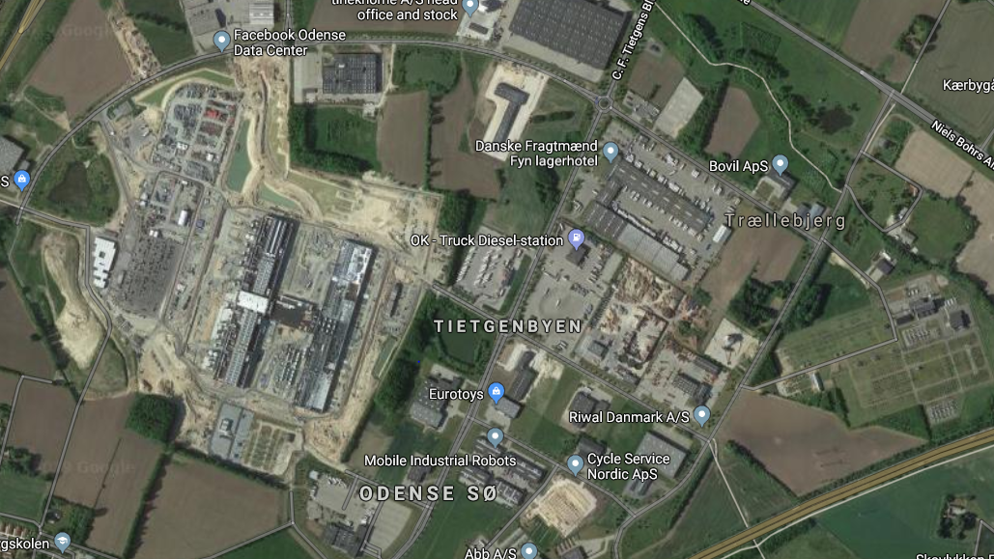
Situation map of heat pumps and data center Tietgenbyen, Odense SØ, DK
Heat Pumps
Tietgenbyens Varme Central (TBV)
Low temperature district heating grid
Odense Data Center
Facebook
Characteristics of DK system:
High security of supply
High RES
Stable data
Fraugde transformer station

Slide 25

Impact point
Carbon Capture

Slide 26

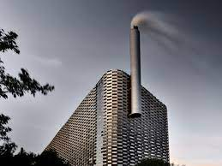


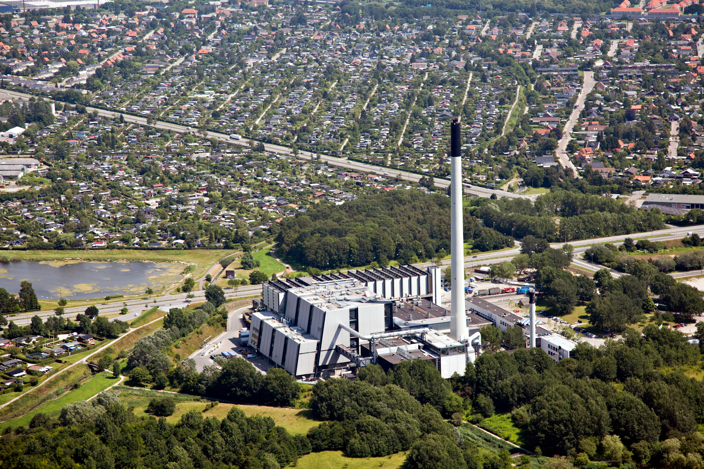



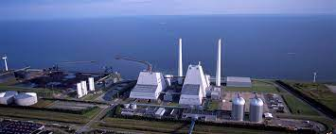
What is C4 (Carbon Capture Cluster Copenhagen)? A consortium of nine companies established December 2020
Waste-to energy plants
ARC, ARGO and Vestforbrænding
Watertreatment plant
BIOFOS
Biomassbased CHP plants
HOFOR (BIO4-plant) and Ørsted (AVV)
DH transmission companies
CTR and VEKS
Port
CMP (Copenhagen and Malmö Port)

Slide 27

What is the goal for C4?
To make carbon capture (CC) a crucial element in the green transition in Denmark.
CO₂ reductions of around 3 million tons/year are possible among the partners of C4.
3 million tons are approx. 15% of the total Danish target for reduction of 70% by the year 2030 and could be one of the largest single contributions to the green transition in Denmark.
3 million tons/year

Slide 28
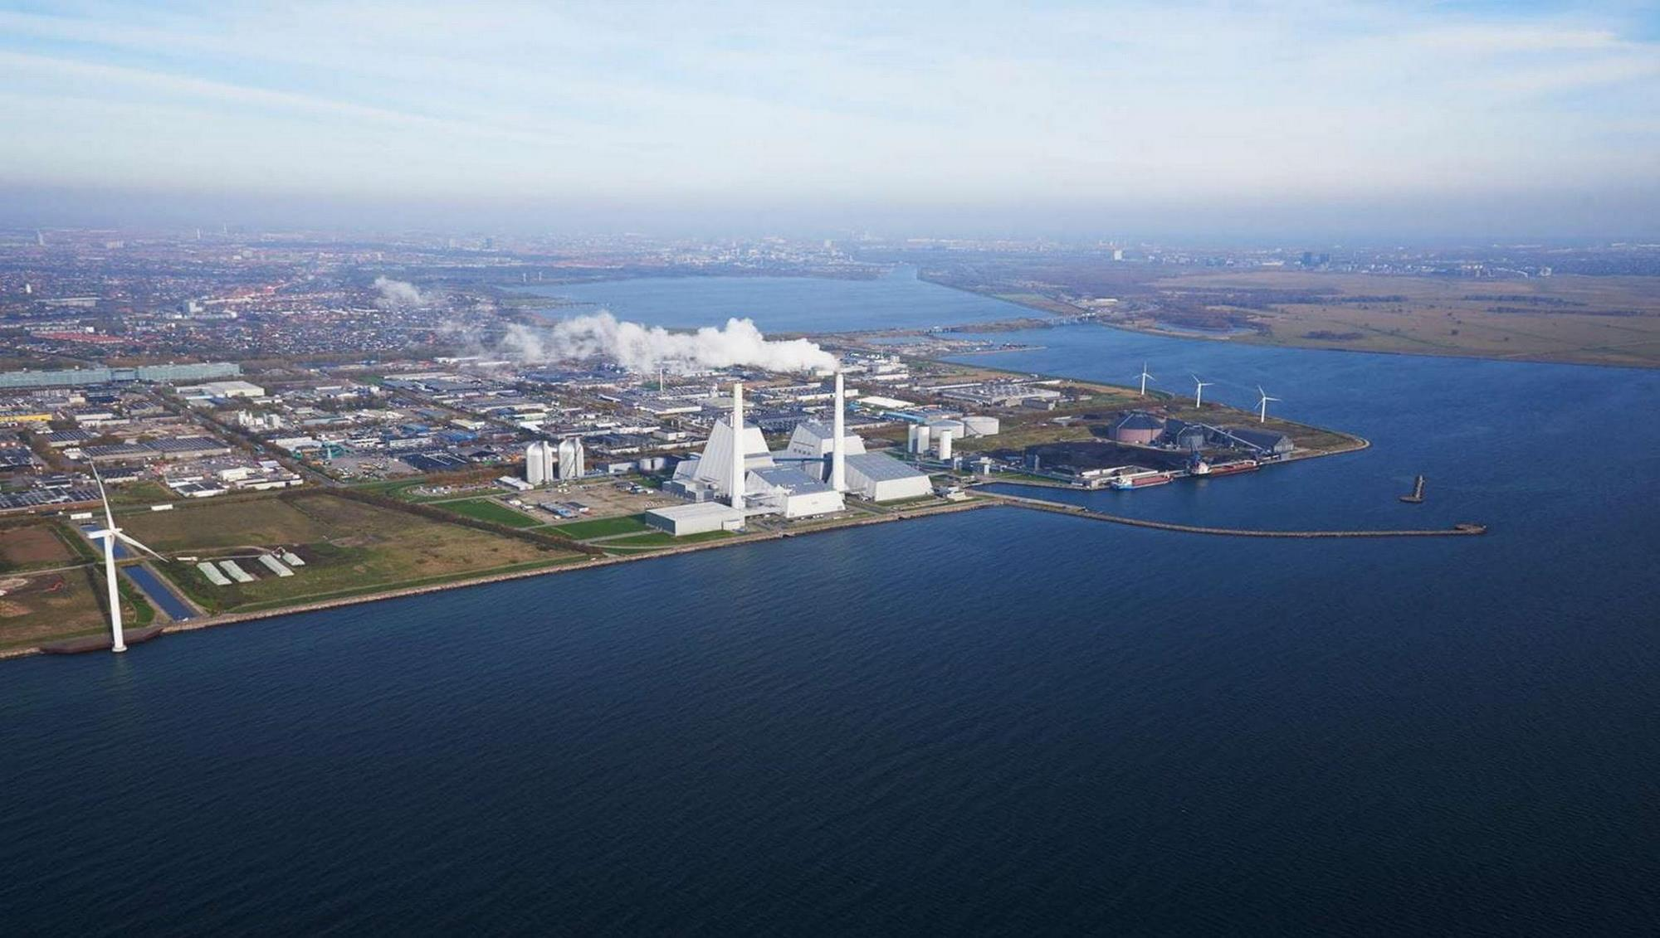

Avedøre CHP Plant, Copenhagen DK Unit 1 (1990/2016) and unit 2 (2001/2014)
Heat storage
Storage for wood pellets
Unit 2
Unit 1
Straw-unit
100 % sustainable biomass - 856 MJ/s heat

Slide 29
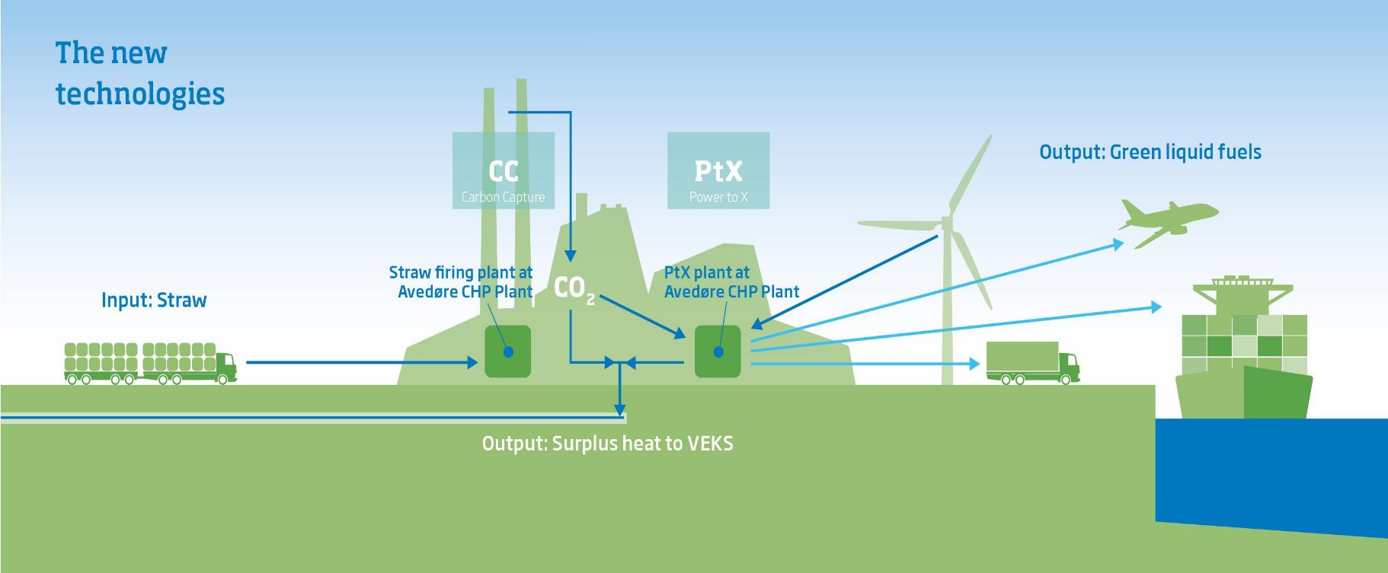
Avedøre CHP Plant – Surplus heat from CC and PtX

Slide 30
Agenda
Paris Agreement
CO₂-emission in Serbia and Denmark
VEKS Strategy and CO₂-emission
Impact points
Storage
Data center
Carbon Capture (CC)
Summary

Slide 31
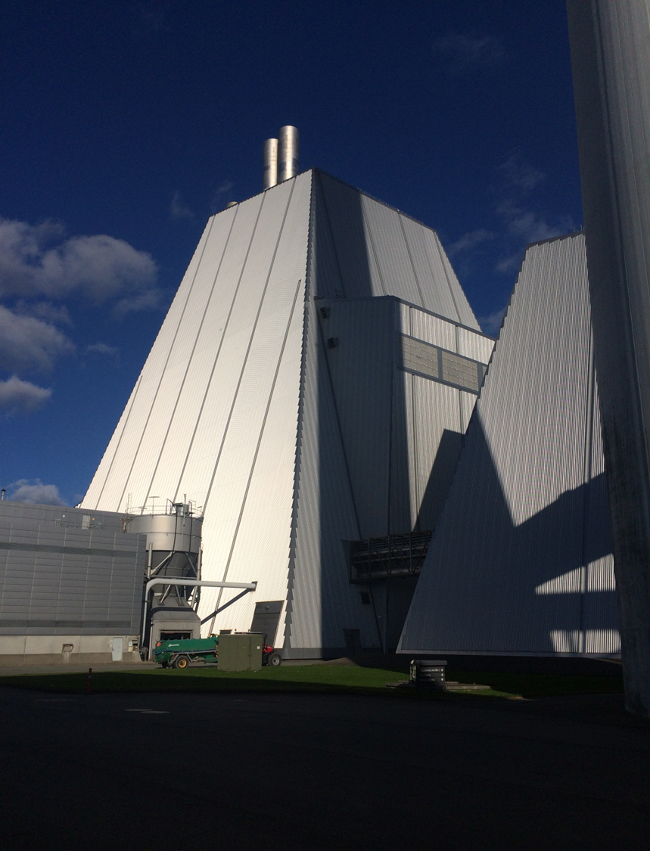
Summary
Both Data Centers, Carbon Capture process and the Power-to-X process generate large amounts of excess heat….
Notes:
18-04-2023
31

Slide 32
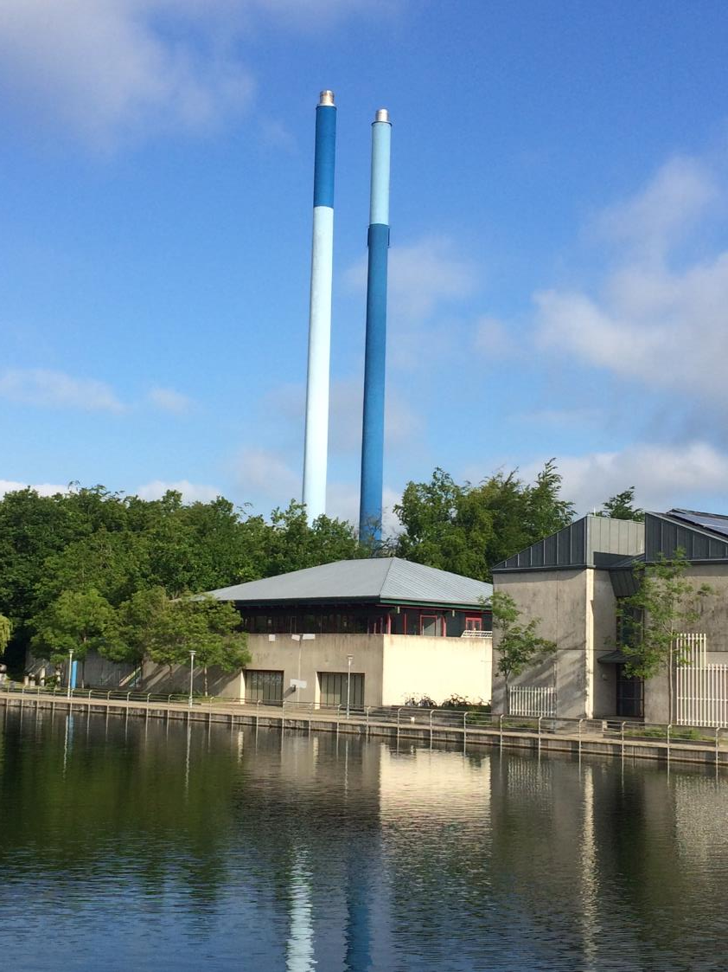
Summary
Only a society with a well-functioning district heating system can make optimal use of the energy resources of the future.
Without DH the resources would be lost for the society.
Notes:
18-04-2023
32

Slide 33
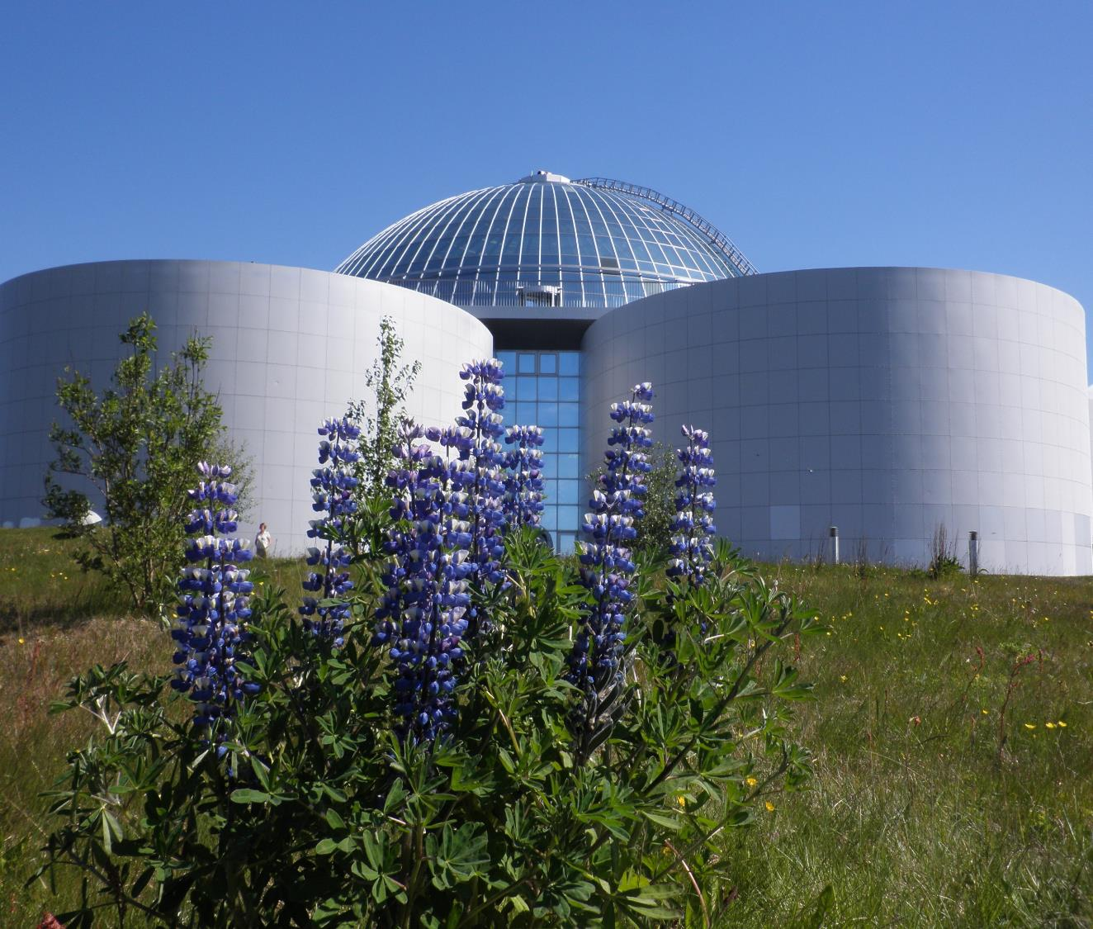


Thermal storage, Iceland
Thank you
Further information:
www.veks.dk
lg@veks.dk

